Slide 1

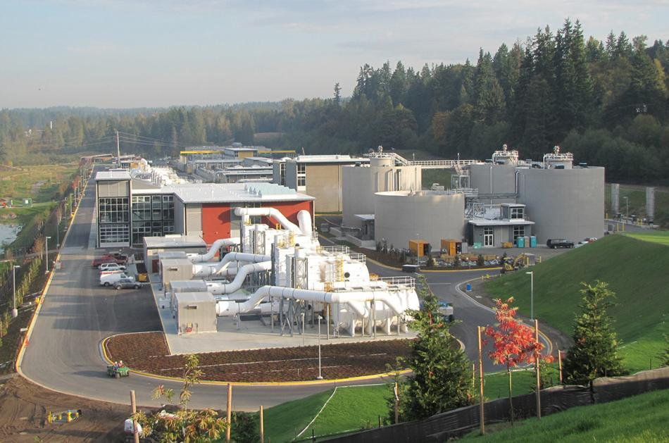
Brightwater Project Progress
Regional Water Quality Committee
March 7, 2012
Gunars Sreibers, Brightwater Project Manager

Slide 2
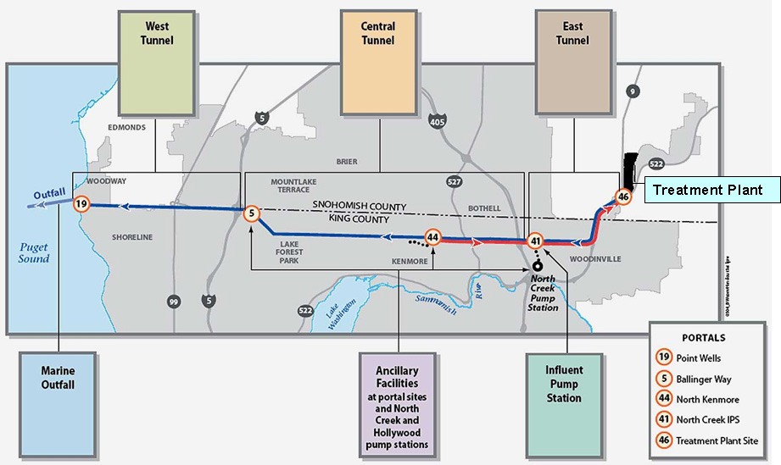
Brightwater Treatment Plant & Conveyance System

Slide 3
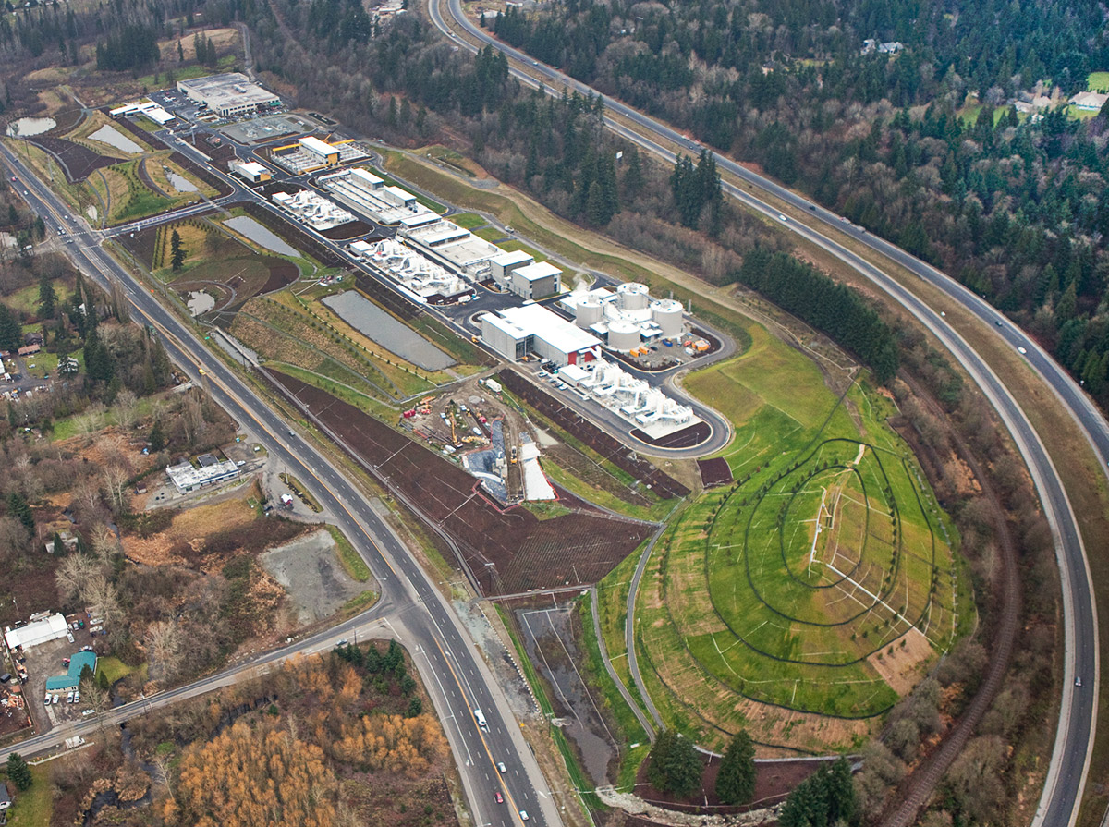
Brightwater Treatment Plant – Dec. 2011

Slide 4
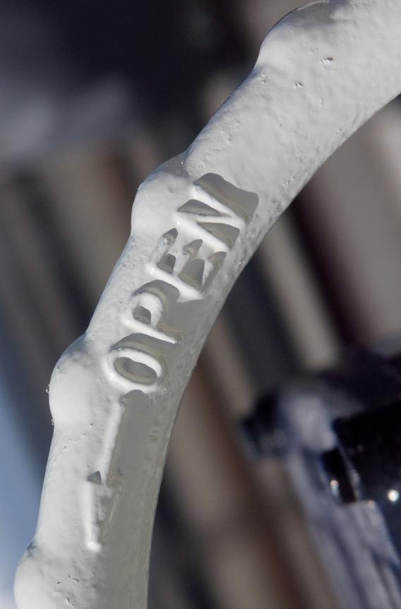
Brightwater Accomplishments in 2011
Treatment Plant
  Spring – Start Up Planning and Staff Training
  May – Continuous 10-Day Clean Water Test
  September 6 – Wastewater Treatment Begins
  September 24 – Plant Grand Opening
  November 8 – First Biosolids Truck Loaded

Slide 5
Brightwater Accomplishments Through 2011 - Conveyance System
  May 2009 – Marine Outfall completed
  April 2010 – West Tunnel (BT-4) mining completed
  July 2010 – East Tunnel (BT-1) completed
  August 2011 – Central Tunnel (BT-2) completed
  August 16, 2011 – Central Tunnel (BT-3C)
  mining completed
  September 6, 2011 – Influent Pump Station (IPS)
  begins pumping wastewater

Slide 6
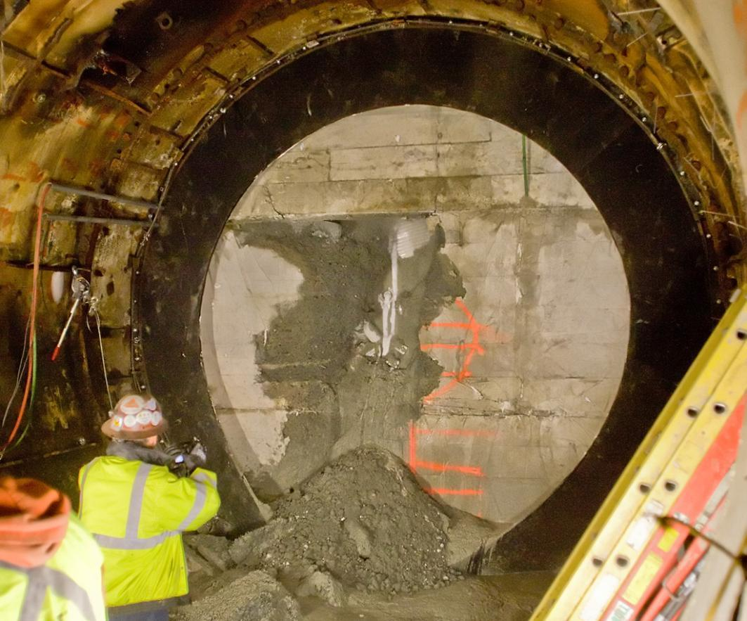
Tunnel Mining Completion – August 16, 2011

Slide 7
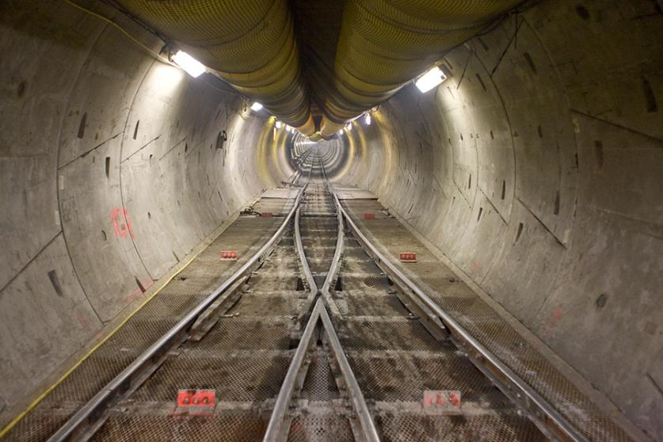
Brightwater Tunnel from Treatment Plant to Point Wells

Slide 8
Brightwater – Remaining Work
  Spring 2012 – Finish lining BT-3 and BT-4 tunnels
  Spring 2012 – Complete work on Influent Pump Station
  Summer 2012 – Complete tunnel/outfall connection,
  diffuser port opening and sampling facility at Point Wells
  September 2012 – Began conveying treated
  wastewater through conveyance tunnel and outfall
  2013 – Complete permanent odor control facilities
  at Ballinger and North Kenmore
  2013 – Restore Kenmore, Ballinger and Pt. Wells
  portal construction sites

Slide 9
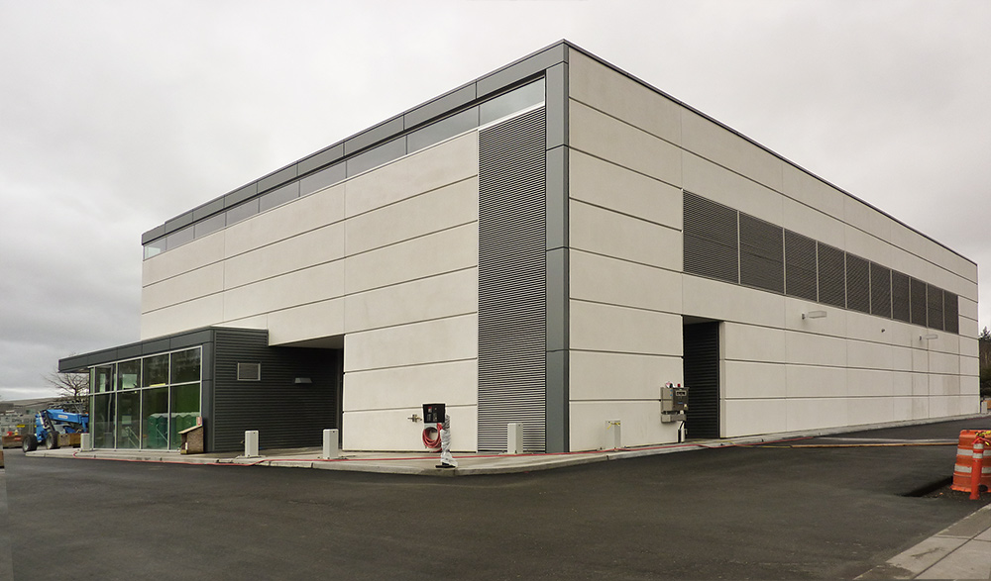
Brightwater Influent Pumping Station

Slide 10
Questions?

