Slide 1

BRIEFING FOR KING COUNTY COUNCIL
Large scale production of
algae-based substitutes for fuel
and other petroleum products
Stan Barnes
Bioalgene, Seattle
March 21, 2012

Slide 2
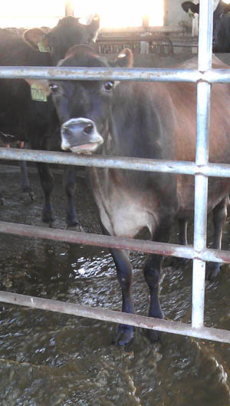
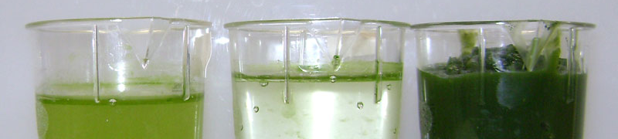

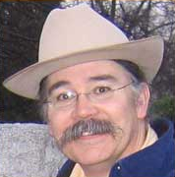
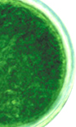
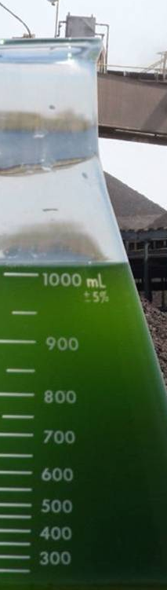
DEVELOPMENTS AND OPPORTUNITIES MATRIX
It’s all about scale | IP integrator Academic & commercial innovations | Multiple product streams | Offtake agreements | Supply
Scalable first site | Team | Demand from product customers |  | Military
Institute for Systems Biology | Grants pending NSF, DOD, DOE | Strategic partners Validation | 10 in 10 Farming to fly | What’s needed to deliver success?

Slide 3
 | SUPPLY | DEMAND
COMMITTED | Portland General Electric ThreeMile Canyon Farms Washington State University University of Texas | Glycols: Tryline Distributors Feeds: Wolfkill Energy ThreeMile Canyon Farms
TARGETED | Parallel Canadian project discussions: NRC Canada BC/Alberta Agricultural Ministries | Glycols: Polyester, polyethylene producers Fuels: Airlines, defense, trucking, transit (including King County Metro)

Slide 4














Integrating best-of-breed innovators
Portland General Electric
Washington State University
University of Washington
Institute for Systems Biology
General Atomics
The Sun Grant Consortium
ThreeMile Canyon Farms/R.D. Offutt
Energy & Environmental Research Center
National Renewable Energy Laboratory
Parametrix
Electric Power Research Institute

Slide 5
IP innovation
University of Texas at Dallas
Lipid yield
University of Michigan
Single-step refining
Washington State University
Dual process for continuous production in northern latitudes
Institute for Systems Biology
Managing the health of algal “communities”

Slide 6

Multiple product streams
INPUTS
H₂O
CO₂
N-P-K
Sunlight
Temperature
Containment
COMPONENTS
OUTPUTS
Fuels
Nutraceuticals
Chemicals
Plastics
Animal feed
Crop fertilizer
LIPIDS
CARBOHYDRATES
PROTEINS
PROCESSING

Slide 7
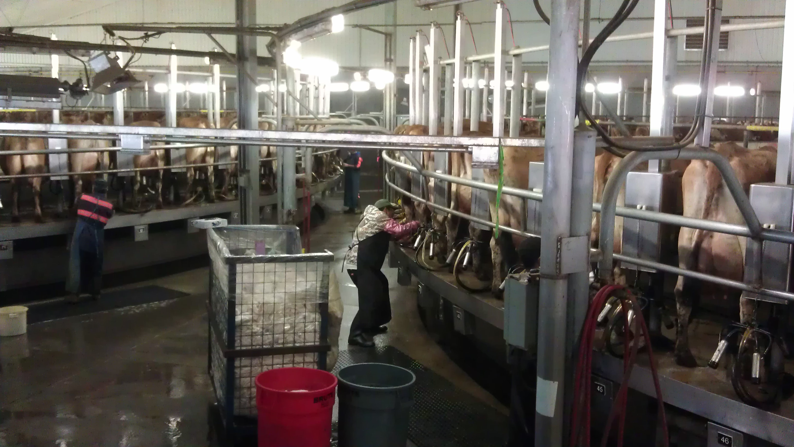
Team Nitrogen, 42,000 strong

Slide 8
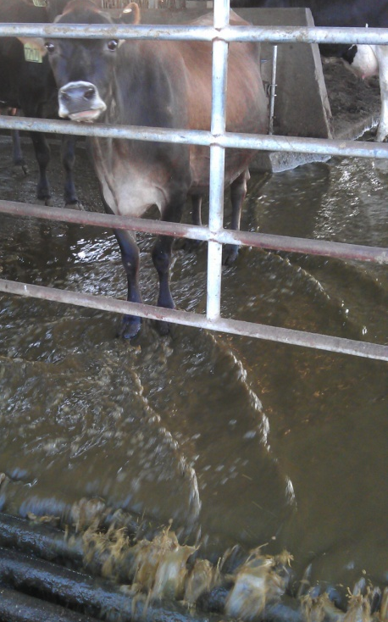
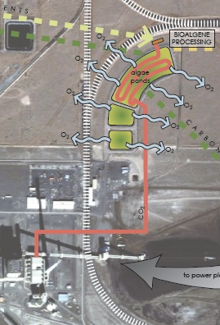
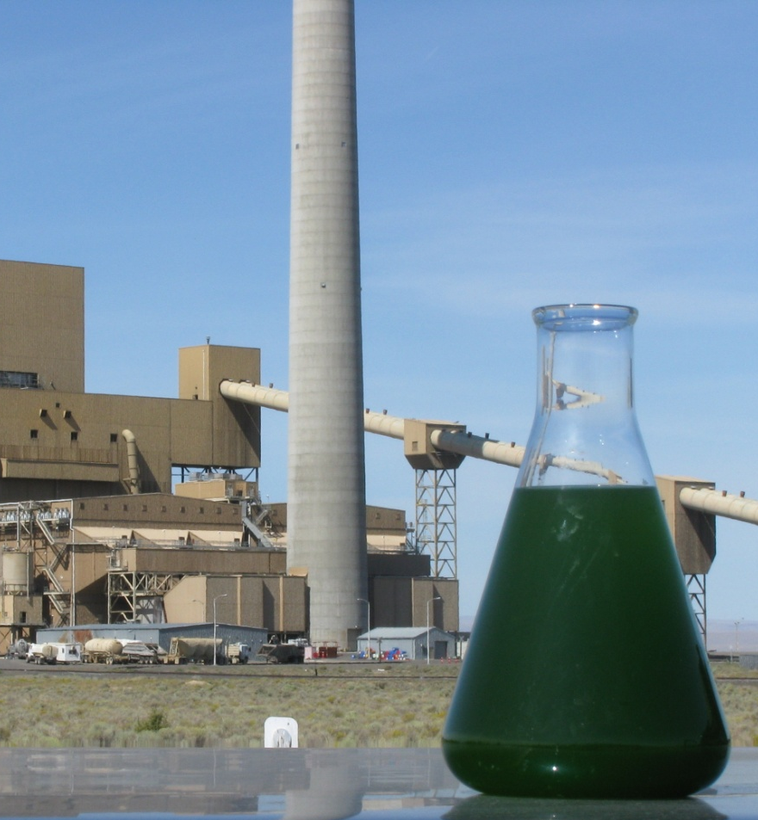
Production flows
Notes:
8

Slide 9
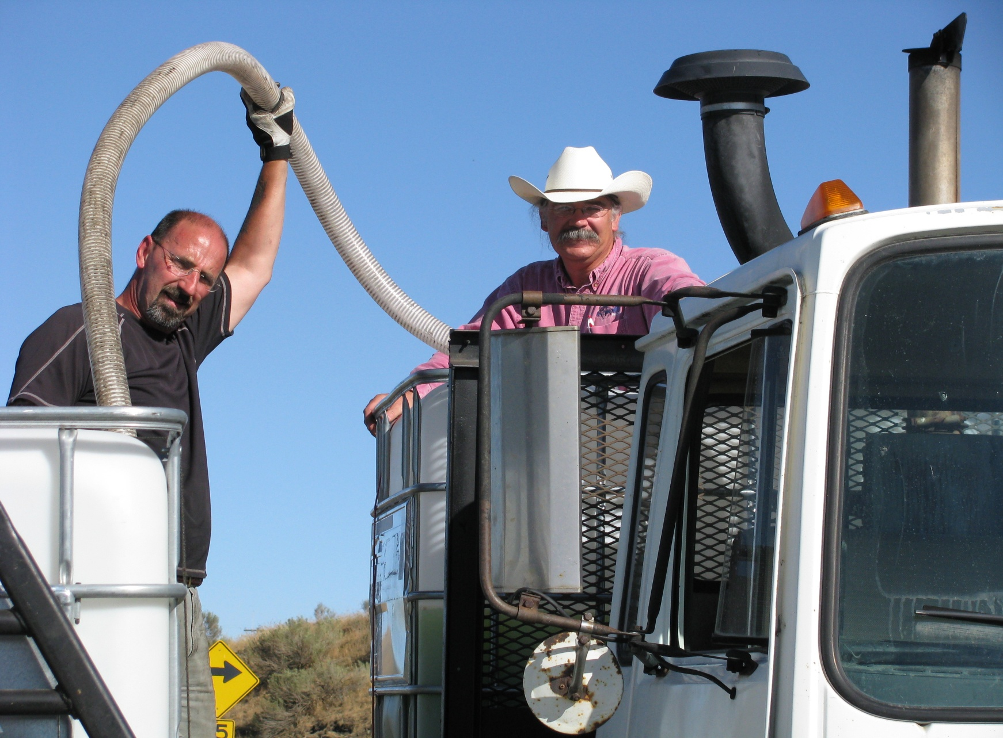
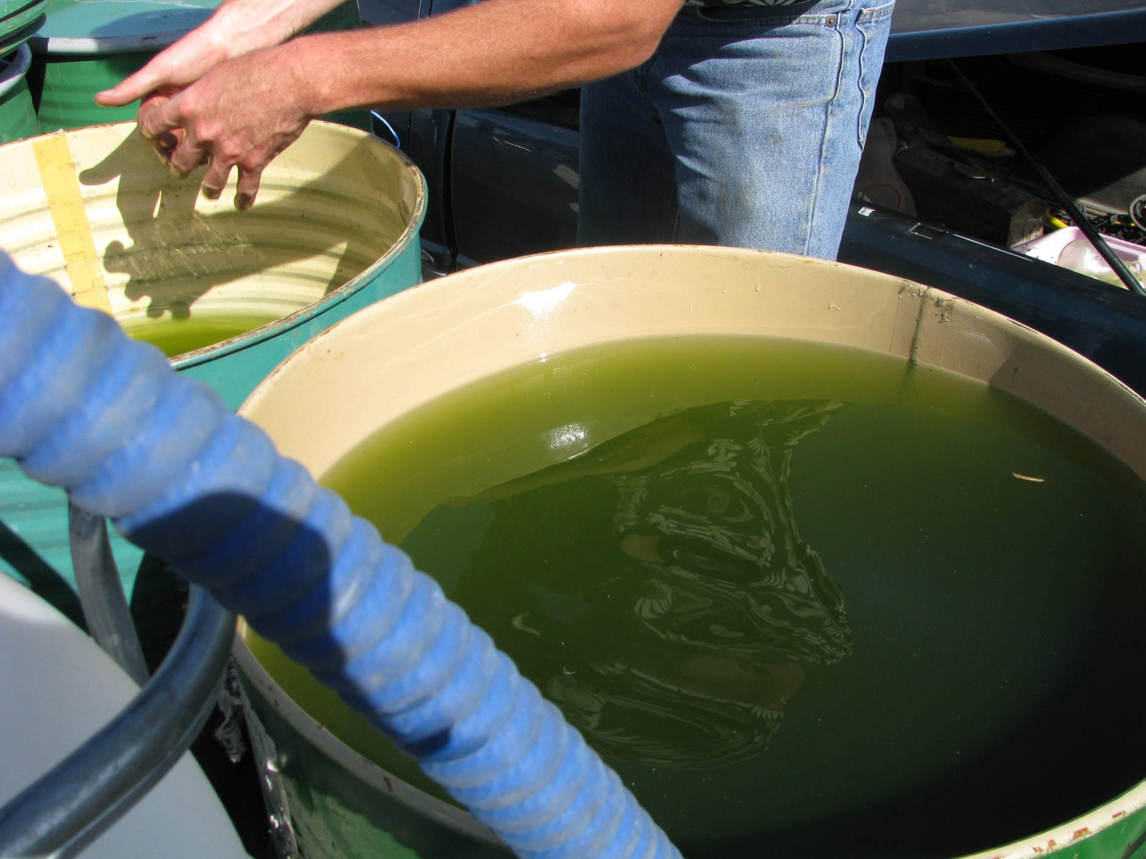
Applied biology … at scale

Slide 10
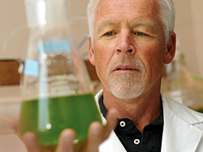
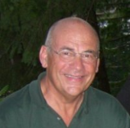
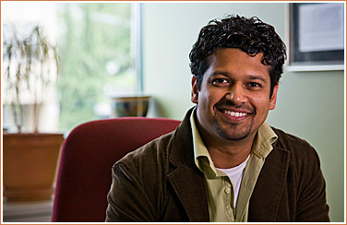
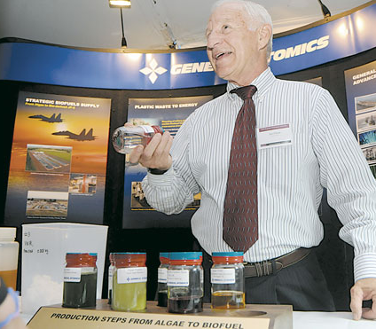
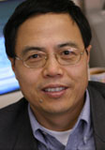
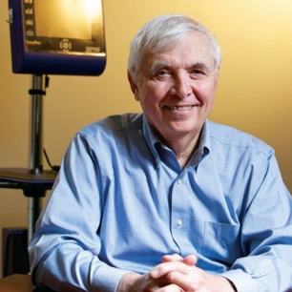
Advisory board
Pete Lammers, Ph.D., New Mexico State, NAABB co-lead
Nitin Baliga, Ph.D., Institute for Systems Biology
Chris Porter, Ph.D., Seattle Biomedical Institute, 22 patents
Shulin Chen, Ph.D., Washington State University
Jim Elliott, former General Atomics renewables manager
John Celms, Seattle Silicon, former Kleiner, Perkins Co.

Slide 11
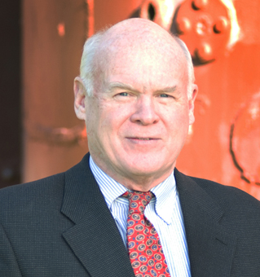

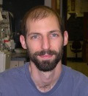
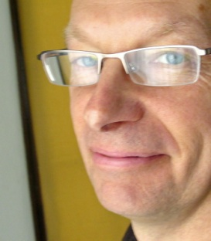
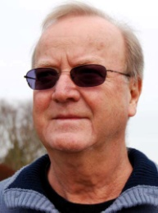
Team: Experienced scientists, engineers, managers
CEO | Stan Barnes, Harvard BA/MBA, serial entrepreneur, founder
COO | Dan Hand, ME/PE, USMA, ex-Chevron, geothermal startup
CSO | Steve Verhey, Ph.D. Plant Physiology, OSU; Boardman project manager, Central Washington Biodiesel, Evergreen State U.
Strategy | Dale Gluck, ABC, ex-Hill & Knowlton, Security Pacific Bank
Polymers | Ben Frankamp, Ph.D., Chem, University of Massachusetts; ex-Sandia, Bend Polymer, Portland State University
Water | Chris Haussmann, ChemE/PE; Water Systems Specialists, ex-GE, Electric Power Research Institute
Systems/Fab | George Richmond, ME/PE, WSU, Richmond Systems

Slide 12
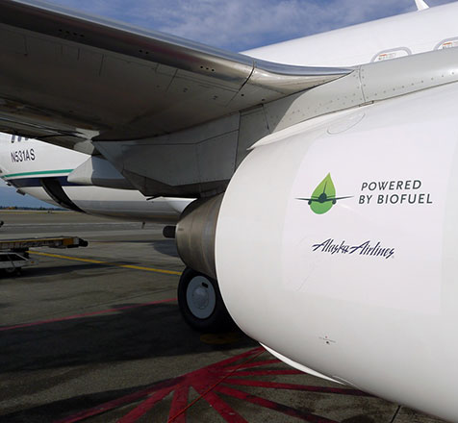
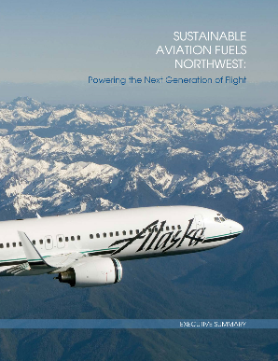
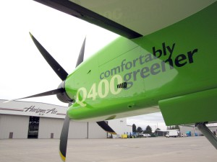
Air carrier & military demand
The algae-farming member of
Sustainable Aviation Fuels Northwest
COMMERCIAL CARRIERS
Green-fueled route in regular service requires
ASTM-spec fuel
Standalone supply chain
MILITARY
We responded to the military’s RFI and have been told to expect the RFP, when it is funded.
Grants will fund capacity building, create long-term fuel offtake contracts (jet, diesel, marine).

Slide 13
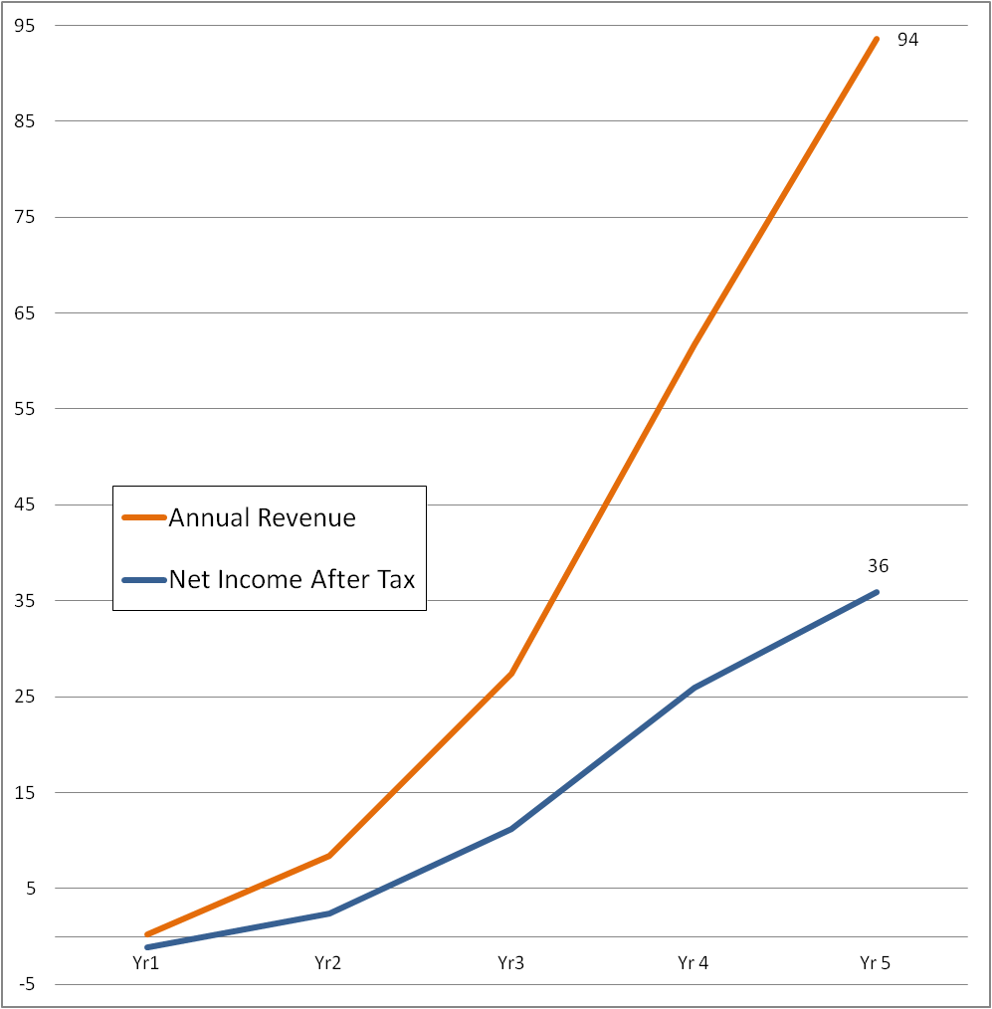
Five-year projection,
one site in full production
The 7 million gallon lipids mark from the Parametrix/USDA feasibility study.
FIVE-YEAR PROJECTION FOR THE FIRST COMMERCIAL SITE,
$ MILLIONS

Slide 14
PRODUCTION AND COSTS SCHEDULE | YEAR 1 | YEAR 2 | YEAR 3 | YEAR 4 | YEAR 5
Lipid (fuel) output target (gal/yr) | 100 | 150,000 | 750,000 | 1,000,000 | 7,000,000
Acreage cultivated | 6 | 45 | 225 | 285 | 2,000
Pond costs (Project finance) | $210,000 | $1,575,000 | $7,875,000 | $9,975,000 | $70,000,000
Non-pond costs | 450,000 | 3,425,000 | 2,125,000 | 10,025,000 | 20,000,000
Total cost | $650,000 | $5,000,000 | $10,000,000 | $20,000,000 | $90,000,000

Slide 15
Advanced, low CO₂ fuels for King County
Order fuels for Metro, Sound Transit, aviation
Pay market price + declining premium
Require county suppliers to place similar orders
Small initial quantities, annual increases
Take or pay
Order now for delivery beginning in two years

Slide 16
DEVELOPMENTS AND OPPORTUNITIES MATRIX
It’s all about scale | IP integrator Academic & commercial innovations | Multiple product streams | Offtake agreements | Supply
Scalable first site | Team | Demand from product customers |  | Military
Institute for Systems Biology | Grants pending NSF, ARPA-E, DOD | Strategic partners Validation | 10 in 10 Farming to fly | King County delivers successes!

Slide 17
 |  |  |  | All practical. Today.

Slide 18
Join us.
stanb@bioalgene.com
(206) 734-7323
Online at Bioalgene.com
COPYRIGHT © 2012, BIOALGENE, INC.
Notes:
If you would like to continue a conversation just let us know your interests, your questions, and your schedule.

