Slide 1

Law and Justice Committee
FIFA World Cup 26™
Law and Justice Committee
April 1st, 2026
SEATTLEFWC26
HEDDA McLENDON
Sr. VP of LEGACY

Slide 2
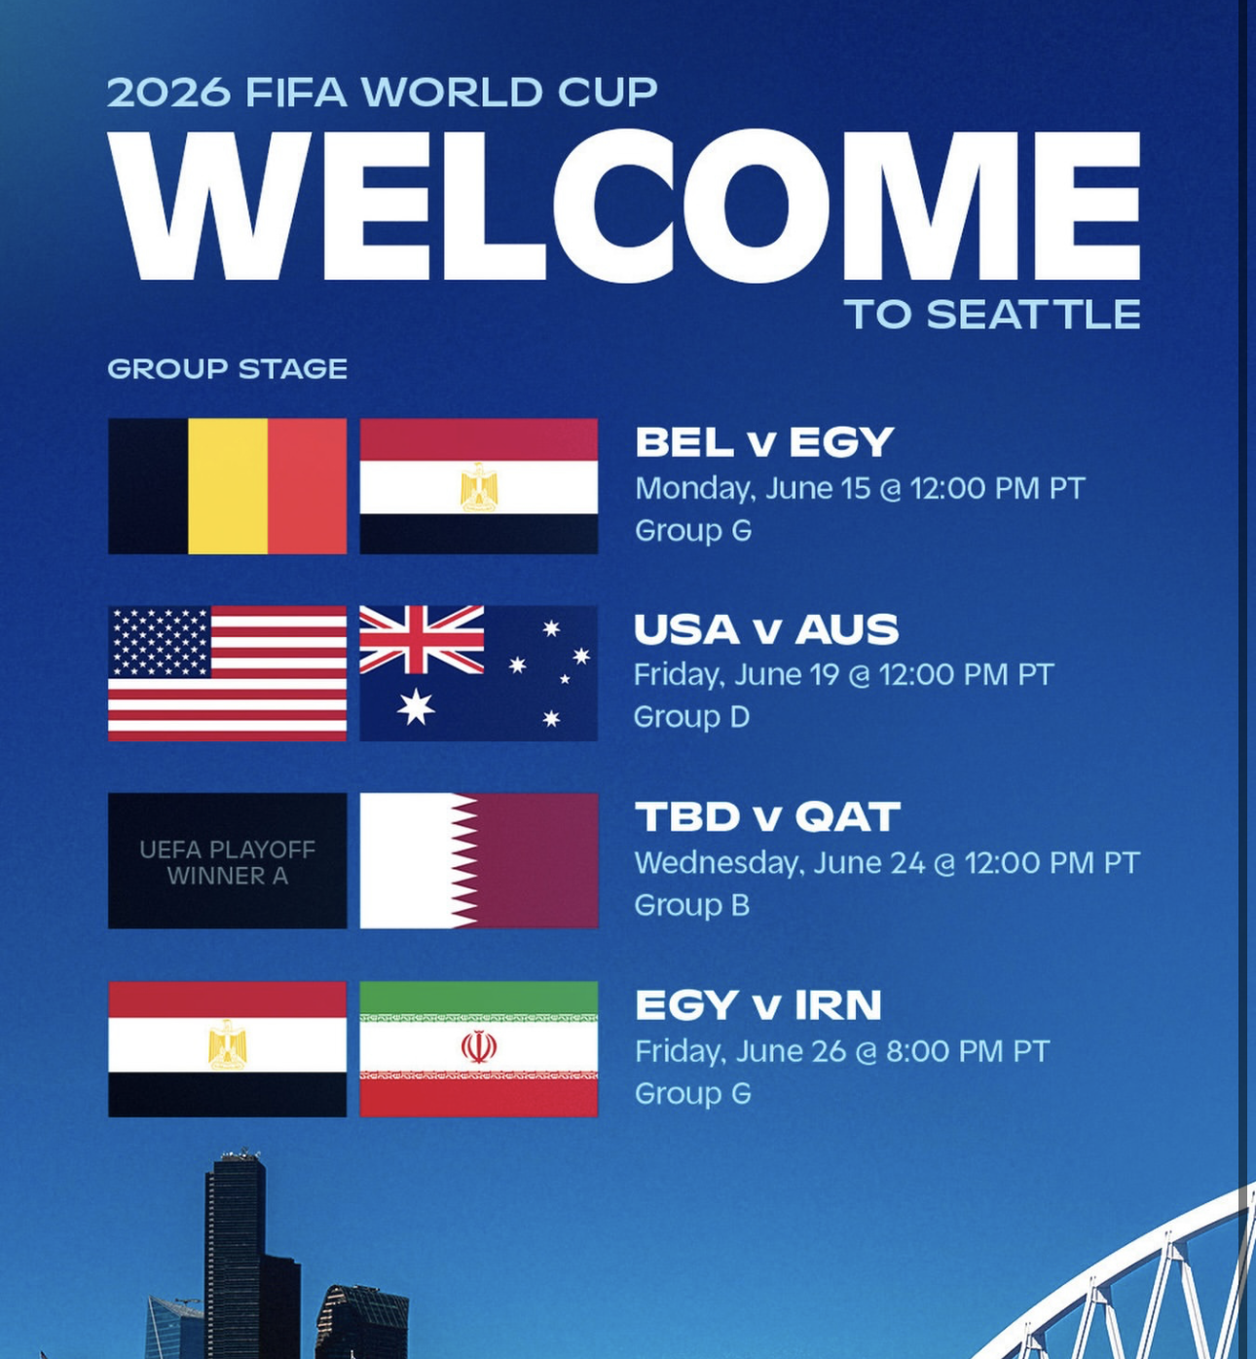
Seattle FWC26 is a non-profit
Not fifa
not government
not in stadium
role/responsibility
to coordinate amongst all parties and plan a safe, responsible, and fun tournament
Round of 32 Jul 1 @ 1:00
Round of 16 Jul 6 @ 5:00

Slide 3
Why It Matters
Major events like FWC26 increase vulnerability due to crowds and transient populations.
Trafficking poses serious risks to staff, customers, the community, and brand reputation.
Informed individuals can take proactive steps to prevent trafficking, especially in high-risk industries like hospitality, transportation, and events.
A well-trained public is a powerful deterrent—communities become safer when more people are educated and vigilant.

Slide 4
Human Trafficking
Prevention vs Mitigation
Prevention
Mitigation
Training.
  Recognize the signs of human trafficking and know how to respond safely and effectively.
Antitrafficking Campaigns.
  Public awareness campaign that aims to educate people about human trafficking and how to respond to it.
Victim Services.
  Support services or campaign to help victims access services.
Respond.
  Provide an immediate response to violence as it occurs.
Notes:
Human trafficking prevention aims to stop human trafficking from happening, while human trafficking mitigation aims to help victims and bring justice to them.
There is an established network of legal systems and community-based organizations that exist to prevent, mitigate, and respond to sex trafficking.
The Seattle Host Committee’s approach to preventing sex trafficking during FWC26 will primarily work with existing organizations to respond to increased risks related to the tournament and its related activities. The Seattle Host Committee’s actions also reflect an emphasis on training and awareness.
Behavioral signs:
Appears fearful, anxious, depressed, submissive, or nervous—especially around a specific person
Avoids eye contact or interaction with others
Seems coached on what to say or unable to speak for themselves
Sudden changes in behavior or personality
Not allowed to speak alone or is constantly monitored
Physical signs:
Signs of abuse (bruises, burns, cuts) or untreated medical issues
Appears malnourished, exhausted, or poorly cared for
Wears inappropriate clothing for the situation (e.g., sexualized clothing in certain contexts)
Control and restriction indicators:
Not in control of their own ID, money, or personal documents
Limited freedom of movement; someone else speaks for them
Lives and works in the same place under poor conditions
Owes a large debt they can’t repay (debt bondage)
Work or living situation clues:
Works excessively long or unusual hours
Paid little or nothing for work
Multiple people living in cramped or unsafe conditions
Not sure where they are or give inconsistent stories about their situation
For minors specifically:
Involvement in commercial sex is always considered trafficking
Running away frequently or being with much older individuals
Sudden access to expensive items (phones, clothes) without explanation

Slide 5
Human Trafficking Prevention Strategy
Our current focus based on community engagement to date is on:
Support Survivor Advisor Pilot
Amplify Missing and Murdered Indigenous Women Awareness
Train Businesses and Workers

Slide 6
Support Survivor Advisor Pilot
SeattleFWC26 is working with partners in public safety and survivor advocacy to embed a Survivor Advisor within the World Cup Emergency Operations Center (EOC).
This pilot will test the long-term feasibility of including someone with lived experience and trauma-informed expertise in large-scale event operations—ensuring that when individuals affected by trafficking are identified, they receive supportive, survivor-centered care.
The goal of this action is both to improve the ability of security planners to prevent and respond to sex trafficking during FWC26 and to test a model of integrated security planning and operations that can influence future events.
Notes:
While the legal and community-based organizations and systems that respond to human trafficking are outside of the host committee’s control, community engagement has identified a FWC26-related opportunity to ensure that tournament security planning and the emergency operations center that will exist during the tournament both have access to survivor-centered expertise and resources.
This in-process action is seeking to embed advice and access to response capacity for survivor-centered services in World Cup Security Planning and/or Emergency Operations Center.

Slide 7
Amplify MMIW Awareness
Amplify MMIWP Awareness
MMIWP Awareness
In partnership with the Puyallup Tribe of Indians (PTOI), SeattleFWC26 will support a Native-led awareness campaign during May 2026, coinciding with Missing and Murdered Indigenous Women and People (MMIWP) Awareness Month.
This collaboration will amplify Indigenous leadership and storytelling, raise awareness through public art and digital channels, and align with the LOC’s broader effort to center Indigenous voices and visibility leading up to the World Cup.
Notes:
The Seattle Host Committee will support Indigenous-led efforts to elevate awareness of the crisis of Missing and Murdered Indigenous Women in May 2026.
May is Missing and Murdered Indigenous Women and Persons Awareness Month each year and comes the month before FWC26 kicks off across North America.
Support for this campaign will entail using resources and advertising access enabled by FWC26 to promote an Indigenous-created information campaign that calls attention to this crisis

Slide 8
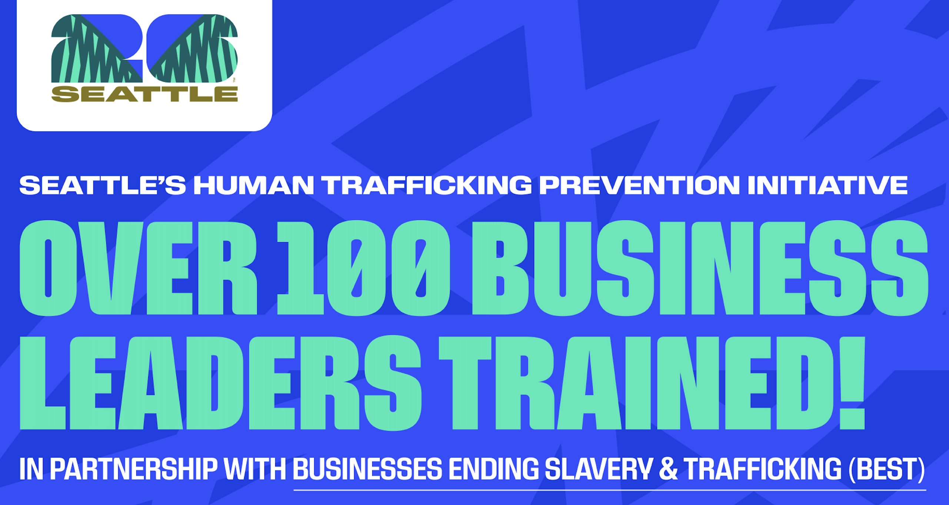
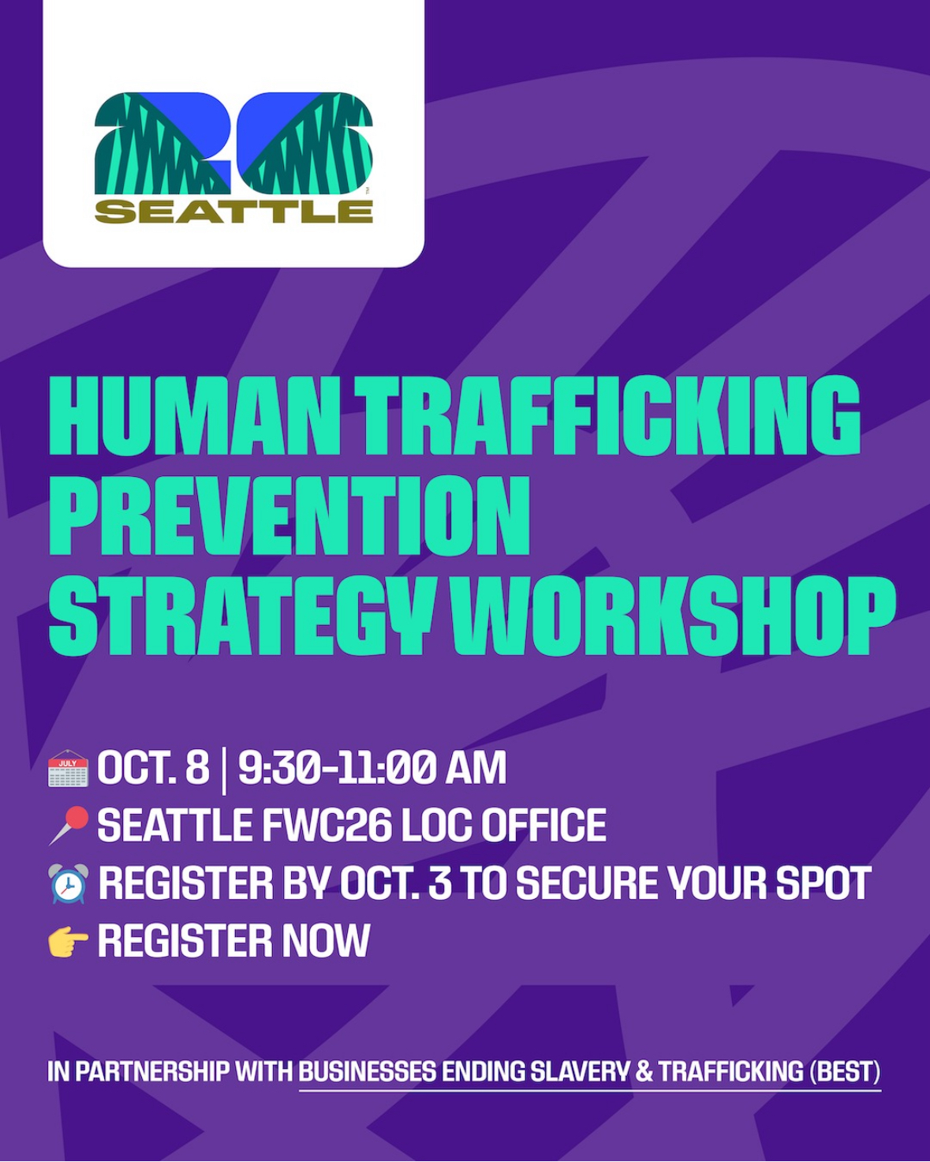
Train Businesses
SeattleFWC26 has partnered with Businesses Ending Slavery & Trafficking (BEST) to provide free prevention training and awareness materials to hospitality, tourism, transportation, and event-zone workers along the Unity loop and in Fan Zones.
Leadership Kick Off Session
Training for 2,500 Staff: Free access to BEST Basics online training in English and Spanish.
Strategy Development Support: Guidance for employers to create prevention and mitigation strategies
Ongoing Learning: A virtual Q&A in January 2026 to reinforce knowledge and preparedness.
in their workplaces.

Slide 9
Train Workers
The short-term surge in activities that will come with FWC26 will see thousands of temporary and part-time workers coming to the region in 2026.
The Seattle Host Committee is partnering with MLK Labor to identify training opportunities for temporary workers and integrate Human Trafficking training tailored to workers in industries like hospitality and private security.
This partnership is still in development, and it is intended to remain part of temporary worker training well beyond FWC26.
Notes:
To extend reach and sustainability, SeattleFWC26 is also collaborating with MLK Labor to integrate Human Trafficking Awareness Training into worker education offered through the Union Hiring

Slide 10
Lessons Learned to Date
Work with existing organizations and systems in place
Role and resource clarity
Offer businesses access to free training and consultation early

Slide 11
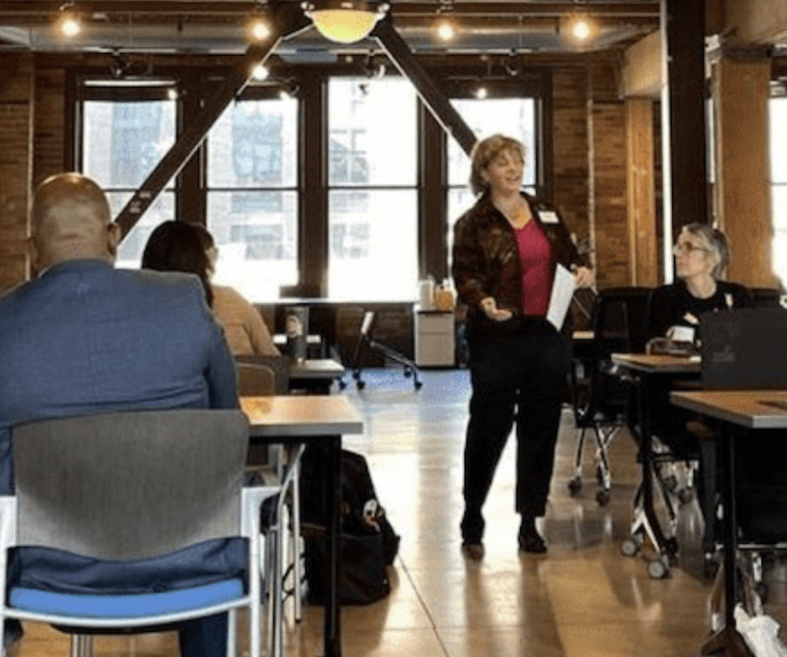
Outcomes & Benefits on Benefits
Staff and Volunteers trained to recognize signs of sex and labor trafficking
Safer workplaces and communities
Improved staff retention and morale
Reinforces corporate social responsibility and values
Risk mitigation and improved compliance posture

Slide 12

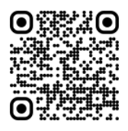









Sharing the Economic Benefits
Community playbooks
Getting WA Ready for 2026
WATCH
PARTY
PLAYBOOK
COMMUNITY BRANDING
PLAYBOOK
HOW EMPLOYERS CAN PREVENT HUMAN TRAFFICKING
Helps community organizations navigate
FIFA rules and best practices for hosting unofficial FWC26 viewing parties
Provides all organizations customizable digital marketing assets and usage guidance to promote cohesive unofficial FWC26 branding across city, region and state
Shares guidance, case studies, and strategies to help small businesses benefit from FWC26 economic dev activity and sustain operations for future mega-events
PROVIDED BY
PROVIDED BY
PROVIDED BY
FOR MORE INFO, CONTACT INFO@SEA2026.ORG

Slide 13
If you ever suspect human trafficking:
Don’t confront the situation directly Contact local law enforcement or a trafficking hotline
  National Human Trafficking Hotline
  (1-888-373-7888 or text 233733)
If someone is in immediate danger, call emergency services

Slide 14





Stay engaged!
www.seattlefwc26.org
info@sea2026.org
@fwc26seattle
#WeAreSeattle
#Seattle26
www.fifa.com/tickets

