Slide 1
Preliminary Economic and Revenue Forecasts for the King county Budget:
2011 and Beyond
Briefing to the King County Forecast Council
March 10, 2010
Tom Goodwin PhD, Chief Economist
Office of Economic and Financial Analysis

Slide 2
Briefing outline
Economic outlook
Forecast methodology
Assessed valuation and new construction
Inflation and COLAs
Sales tax revenues
Hotel/motel and rental car tax revenues
Real estate excise tax revenues
Investment pool returns

Slide 3
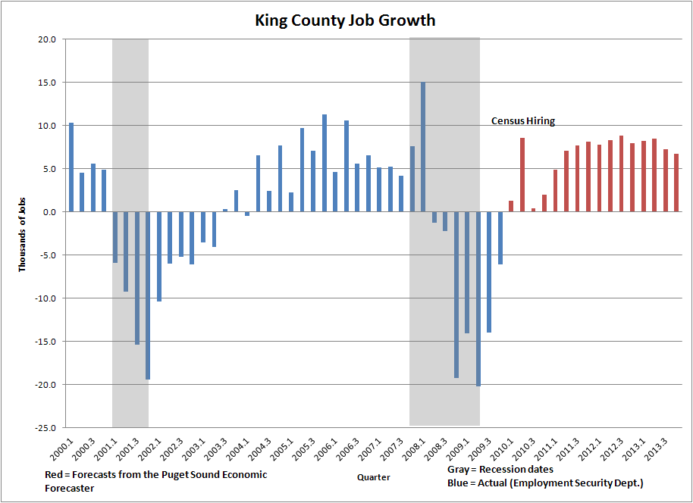
Positive job growth expected this quarter

Slide 4
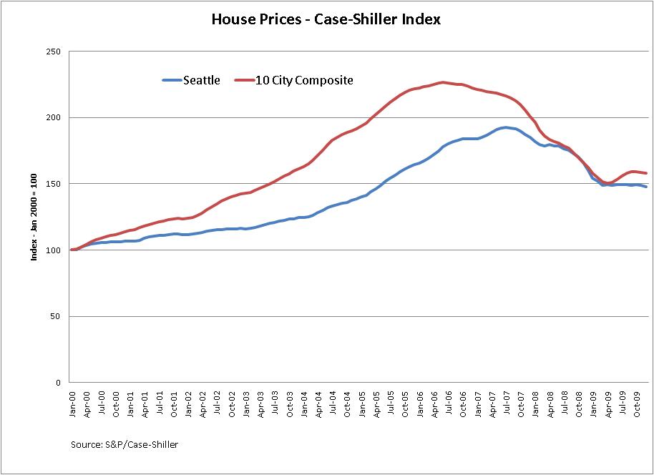
House prices have bottomed out

Slide 5
But challenges remain
The 75,000 jobs lost in King County will require 2-3 years of good job growth just to get even
Long-term unemployment will rise in the near term
Consumers are still very cautious

Slide 6
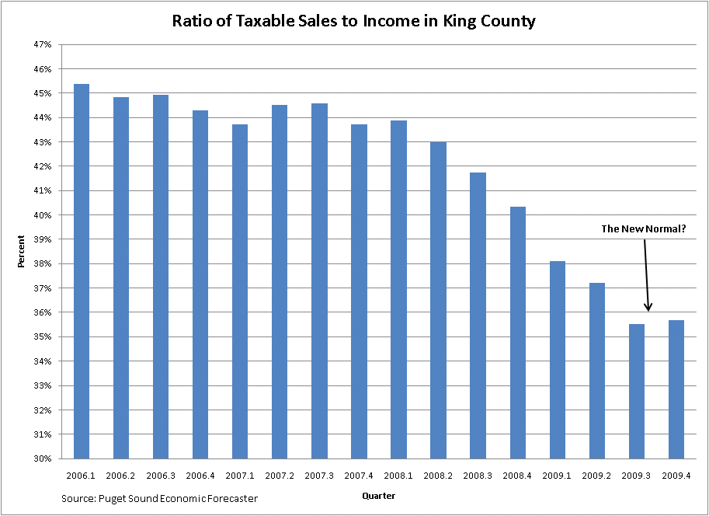
Households are repairing their balance sheets

Slide 7
Forecasting methodology
King County revenues and inflators are linked to a blend of projections from these forecasting services.
Professional Forecast Services
IHS Global Insight US Macro Model
Blue Chip Consensus Forecasts
Washington Economic & Revenue Forecast Council
Puget Sound Economic Forecaster

Slide 8
Median/high/low forecasts to facilitate budget scenario analysis
Forecast | Definition
Median Forecast (Baseline) | “Most Likely”: Actual value has 50% chance of being higher or lower
Low Forecast (Pessimistic) | 10% chance actual will be less
High Forecast (Optimistic) | 10% chance actual will be higher
High – Low Forecasts | 80% confidence interval

Slide 9
Preliminary Forecasts for 2011

Slide 10
Assessed valuation and new construction
Single-family housing is poised to rebound
Condominium sales are still struggling
There is a glut in the office market
Small businesses are still finding it difficult to get financing for any new construction

Slide 11
Further reductions in new construction and valuations are likely
 | New Construction (bil. $) |  |  | Assessed Valuation (bil. $)
Tax Year | Actual | Median Forecast | % ∆ | Actual | Median Forecast | % ∆
2010 | 5.21 |  |  | 342.0
2011 |  | 3.32 | -36% |  | 322.2 | -6%
2012 |  | 3.10 | -7% |  | 309.8 | -4%
2013 |  | 3.58 | +15% |  | 322.7 | +4%

Slide 12
Inflation and cost-of-living-allowances (COLAs)
The CPI fell in 2009, in spite of “loose” monetary policy
A modest snap back of inflation is expected in 2010

Slide 13
COLA for 2011 will likely be above the 2% floor
The COLA is 90% of September-to-September
CPI-W applied to the following calendar year. There is a floor of 2% and a ceiling of 6%.
 | CPI-W |  | COLA
 | Actual | Median Forecast | Actual | Median Forecast
2009 | -1.68%
2010 |  | 3.15% | 2.00%
2011 |  | 2.46% |  | 2.87%
2012 |  | 2.23% |  | 2.22%
2013 |  | 2.09% |  | 2.02%

Slide 14
Median forecasts of additional inflators for 2011
CPI-U - US = 2.0%
CPI-W – Seattle = 1.8%
PPI – Pharmaceuticals = 8.7%
CPI-U – Transportation = 1.6%
Price of diesel fuel = $2.43/gallon

Slide 15
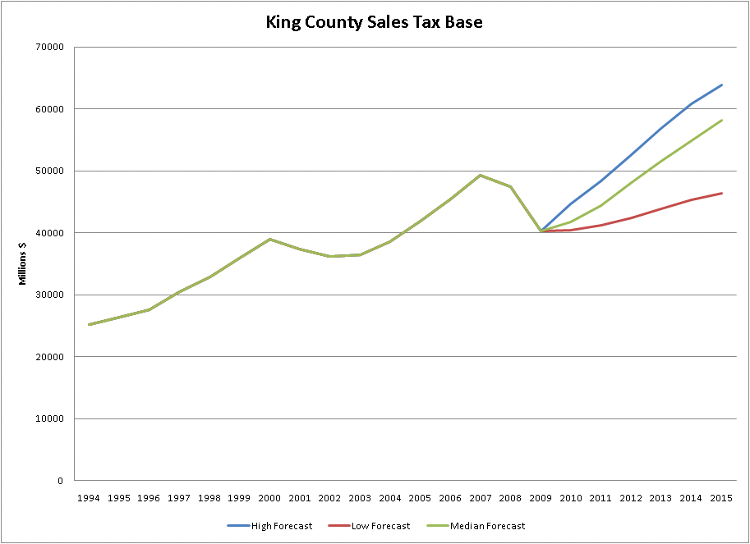
Sales tax base set to grow modestly in 2011

Slide 16
Sales tax revenues will see an increase in 2011 (except criminal justice)
Year | General Fund | Children & Family Services | Transit | Criminal Justice | Mental Illness & Drug Dep.
2009 (Actual) | -13.3% | -13.3% | -13.3% | -14.9% | +17.0%
2010 (Median) | 3.0% | 3.0% | 2.1% | -2.7% | 2.3%
2011 (Median) | 4.4% | 4.4% | 6.3% | -0.9% | 6.3%
2012 (Median) | 7.3% | 7.3% | 8.3% | 4.9% | 8.3%
Annexations: North Highline X (March 2010); Panther Lake (July 2010); Juanita/Finn Hill/Kingsgate (July 2011)
Delinquent payments of 3% assumed
Mitigation payments are NOT assumed going forward

Slide 17
Hotel/motel and rental car revenues
Year | Rental Car |  | Hotel/Motel
 | Actual | Median Forecast | Actual | Median Forecast
2009 | -8.2% |  | -17.3%
2010 |  | +4.7% |  | +7.4%
2011 |  | +3.7% |  | +5.7%
2012 |  | +5.1% |  | +7.4%

Slide 18
Real estate excise taxes
Recovery in transactions will be led by the single-family housing market
Transactions in multi-family and commercial properties will be below trend for the next two years at least

Slide 19
Real estate excise taxes
Year | Actual | Median Forecast
2009 | -22.4%
2010 |  | +6.1%
2011 |  | -0.1%
2012 |  | +9.6%
2013 |  | +12.1%
Annexations: North Highline X (March 2010); Panther Lake (July 2010); Juanita/Finn Hill/Kingsgate (July 2011)

Slide 20
Investment pool returns
Forecasts developed in consultation with the investment pool portfolio manager
Factors affecting pool returns/yields
  Fed Funds rate
  Timing of cash inflows and outflows
  Callable features of some instruments
  Average maturity/duration

Slide 21
Investment pool returns
Year | Actual | Median Forecast
2009 | 1.75%
2010 |  | 0.80%
2011 |  | 1.10%
2012 |  | 2.75%
2013 |  | 3.70%

Slide 22
Summary for 2011
New construction and assessed valuation will see further declines in 2011
Sales tax revenues will increase modestly, except for criminal justice
The COLA will likely be around 3%
REET will increase in 2010 and level off in 2011
Hotel/motel and rental car revenues will bounce back with the recovery
Investment pool returns will increase if the Fed raises rates

Slide 23
Questions?

