Slide 1
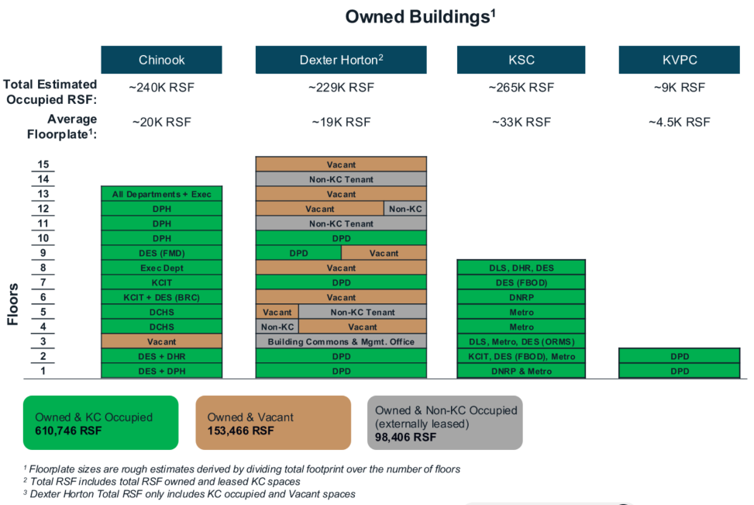
Supply: Office Portfolio Owned Buildings – Current State
May 21,2026
Chinook | Dexter Horton | King Street Center | Kent Valley PC | Polyclinic (EAST) | Blackriver* | Yesler | Administration
~20,000 RSF | ~19,400 RSF | ~33,000 RSF | ~12,450 RSF | ~14,000 RSF | ~22,000 RSF | ~10,800 RSF | ~18,000 RSF
~260,000 RSF | ~336,000 RSF | ~264,000 RSF | ~24,900 RSF | ~56,000 RSF | ~66,000 RSF | ~75,600 RSF | ~162,000 RSF
~260,000 RSF | ~142,000 RSF | ~264,000 RSF | ~9,700 RSF | 0 RSF | ~66,000 RSF | ~18,800 RSF | 0 RSF
0 | ~21,200 RSF | 0 | ~10,700 RSF | 0 (future state) | 0 | ~10,800 RSF | 0
0 | ~172,800 RSF | 0 | ~4,500 RSF | ~56,000 RSF | 0 | ~46,000 RSF | ~162,000 RSF
Average Floorplate:
Total Occupiable RSF:
Total Est. KC Occupied:
Non-KC Tenant Occupied RSF:
~260 RSF
Vacant Space RSF:
Vacant
Vacant
VACANT
VACANT
VACANT
VACANT
OMBUDS/OLEO/DPD
KCRHA
VACANT
VACANT
VACANT
Future DCHS
EAST
VACANT
VACANT
WEST
VACANT
ASSESSOR/KCSO CID
SOBERING CENTER - TEMP
VACANT
DPD
CRISIS CARE CENTER
VACANT
DPER/DLS/KCSO CID
DAJD
VACANT
DPD
CRISIS CARE CENTER
VACANT
DLS/AFIS/TRADES
DAJD
VACANT
Chinook
Dexter Horton
King Street Center
Kent Valley PC
Polyclinic
Broadway
VACANT
Blackriver
Yesler
Administration
Owned & Occupied: 760,500 RSF
*Blackriver is primarily occupied by KCSO.
Assumes a building count of 275 seats.
Owned & Vacant: 441,300 RSF
Owned & Non-KC Occupied: 42,700 RSF
(externally leased)

Slide 2
RTO Current Status
DEPARTMENT | CURRENT STATUS
DAJD | 3 days/week
DCHS | 2 days/week
DES | 3 days/week for most teams; FBOD and ORMS need additional space
DHR | 3 days/week
DLS | 3 days/week except Permitting, which is 100% remote
DNRP | 1 day/week as of March 30th; 2 days starting June 30th ** **All unions except TEA signed MOA
DPD | 3 days/week for attorneys; 2 days/week for administrative support staff
DPH | 2.5 days/week
EO | 3 days/week
KCIT | 2.5 days/week
KCSO | 3 days/week
Metro | No standard – some teams coming in 1-2 days now; 2 days starting June 1st

Slide 3
RTO Adjustments
DEPARTMENT | CURRENT STATUS
DCHS | The 3rd floor of Chinook is currently being built out for DCHS and should be ready for occupancy in June. This should enable occupancy at 3 days/week.
DES | Evaluating vacant spaces and needed tenant improvements for FBOD and ORMS
DLS | Have identified space for Permitting with occupancy in early Fall 2026
DNRP | FMD and DNRP are working to put together a department strategy that considers locations outside the Seattle CBD; strategy should be finalized by Fall 2026 with full 3 days/week TBD but no sooner than January 1, 2027
DPD | Evaluating vacant space in Dexter Horton and reconfiguration of Kent Valley Professional Center
DPH | Evaluating vacant spaces and needed tenant improvements
KCIT | Evaluating vacant spaces and needed tenant improvements
Metro | Metro is developing their occupancy strategy and evaluating the addition of workstations at King Street Center; once final numbers are understood Metro & FMD will develop location strategy for remaining seat deficit

Slide 4
Cost Estimates
Category | Omnibus 1 | Omnibus 2
Moving Expenses (1) | $765,000 | n/a
Furniture & Fixtures | $2,340,000 | $3,150,000
KCIT Activation | $832,000 | $1,890,000
Rent/Leases (Short Term) | n/a | $3,500,000
Tenant Improvements (2) | n/a | $8,220,000(3)
Other | $1,500,000 | n/a
TOTAL | $5,437,000 | $16,760,000
Omnibus 1 anticipates consolidating some departments, requiring moves; Omnibus 2 presumes most occupancies are for staff who did not previously have permanent seating.
Omnibus 1 presumes tenants take space largely “as is”; Omnibus 2 includes changes to the floor layouts as needed.
(3) Core and shell cost of $5.48 million will also need to be considered.

