Slide 1
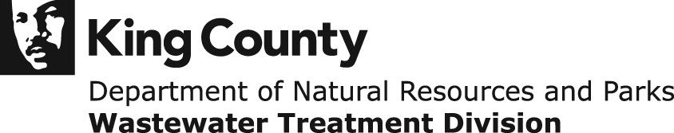
CSO Control Program
Presented to
Regional Water Quality Committee
April 4, 2012

Slide 2
Today’s Presentation
What are Combined Sewer Overflows (CSOs)
Why control CSOs
Progress made on CSO control
WTD recommended plan to control remaining CSOs
Cost control measures
Next Steps

Slide 3
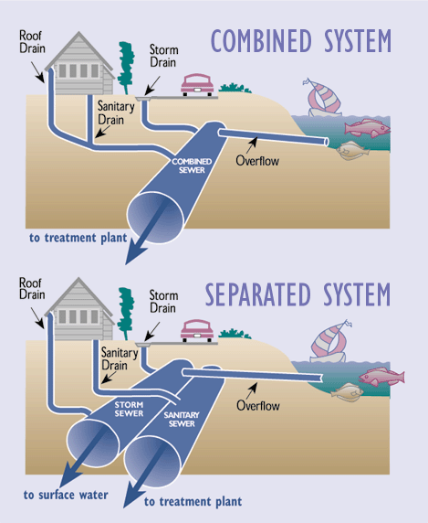
What are Combined Sewer Overflows?
In older cities, sewage and stormwater flow in the same pipe
CSOs are designed relief points that allow untreated discharges during heavy rains
Notes:
Older cities, like Seattle…other older cities in the area include Bremerton, and in the nation – Portland, Boston, Chicago, Philadelphia, etc.

Slide 4
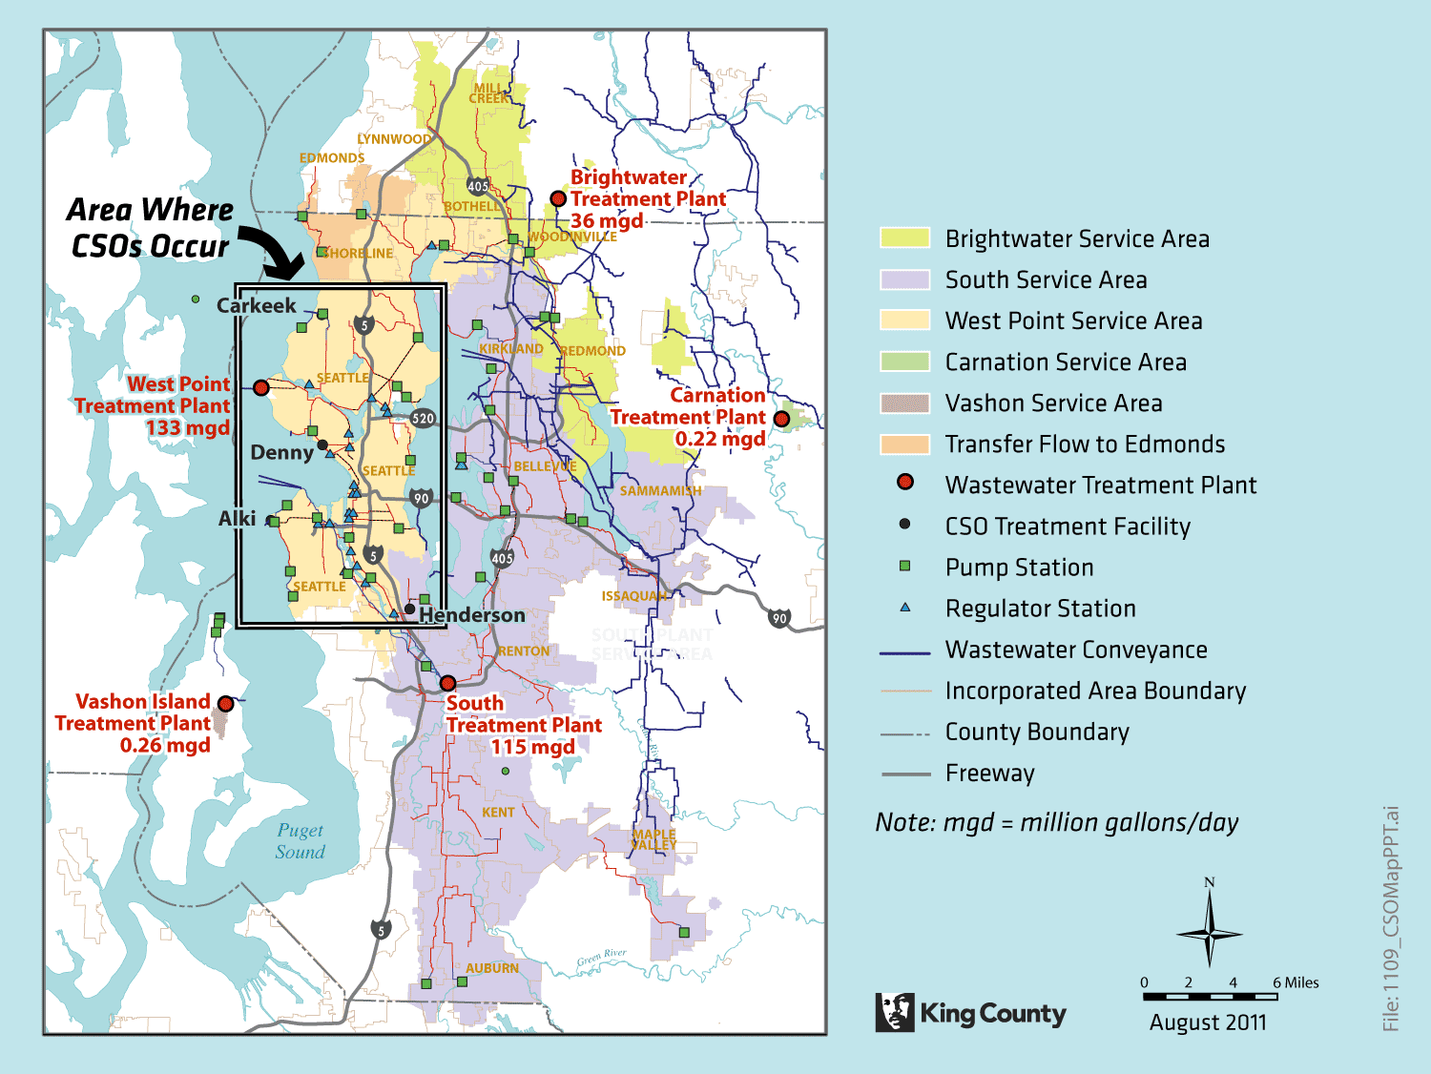
Notes:
This shows you the County’s wastewater service areas and where CSO occurs in relation to the entire service area

Slide 5
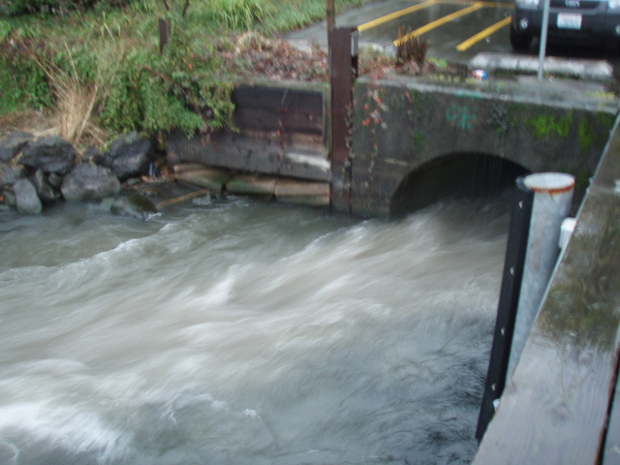
Why Control CSOs
CSOs contain raw sewage diluted with stormwater
CSOs release pollutants and pathogens into waterways
CSO control protects public health
CSO control is required by state and federal regulations
University CSO

Slide 6
CSO Control Regulations
Washington State regulations require control to one untreated overflow event per outfall per year as an average
  An event is defined as an overflow followed by 24 hrs without an overflow
Federal regulations include a mix of approaches
  85 percent of wet weather flow is captured
  4-6 events per system per year
  Demonstrate that Water Quality Standards are met
When completed, King County CSO control program appears likely to meet both state and federal regulations
Notes:
Reduced from 471 outfall events per year to 38 (need to get clarity from Karen on this figure…)

Slide 7
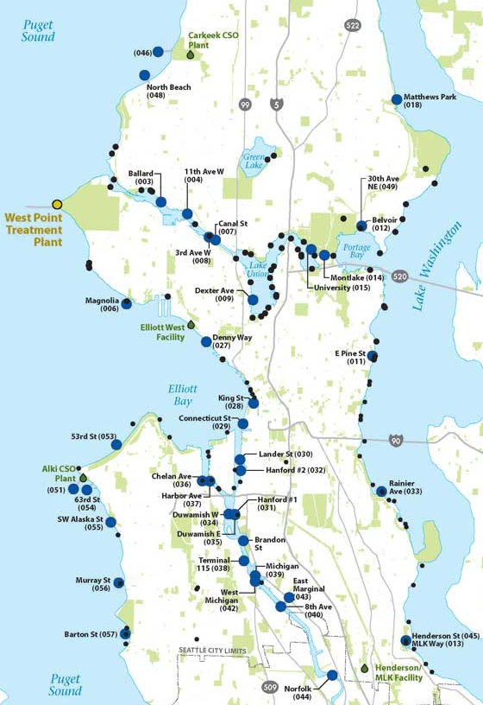
Both Seattle and King County
Manage CSOs
Seattle has about 90 CSOs
  37 remain uncontrolled
King County has 38 CSOs
  19 are controlled
  5 have projects under way
  14 remain uncontrolled
Notes:
Large dots – County CSOs
Small dots – Seattle CSOs
Orange dots – County CSO projects under way
Red dots – County uncontrolled CSOs
Remaining large blue dots – County controlled CSOs

Slide 8
Policy Guidance
Regional Wastewater Services Plan CSO Control Policies – King County Code 28.86.080
  Public input helped shape policies
  Directs County to control CSOs to state standard by 2030
  Sets priority to protect public health
  Promotes coordination with Seattle
  Requires periodic assessment and review of CSO control program
Notes:
Executive-recommended RWSP had 2045 as the end date for CSO control – public feedback felt that was too late and that’s why 2030 was approved as the date to meet CSO control.

Slide 9
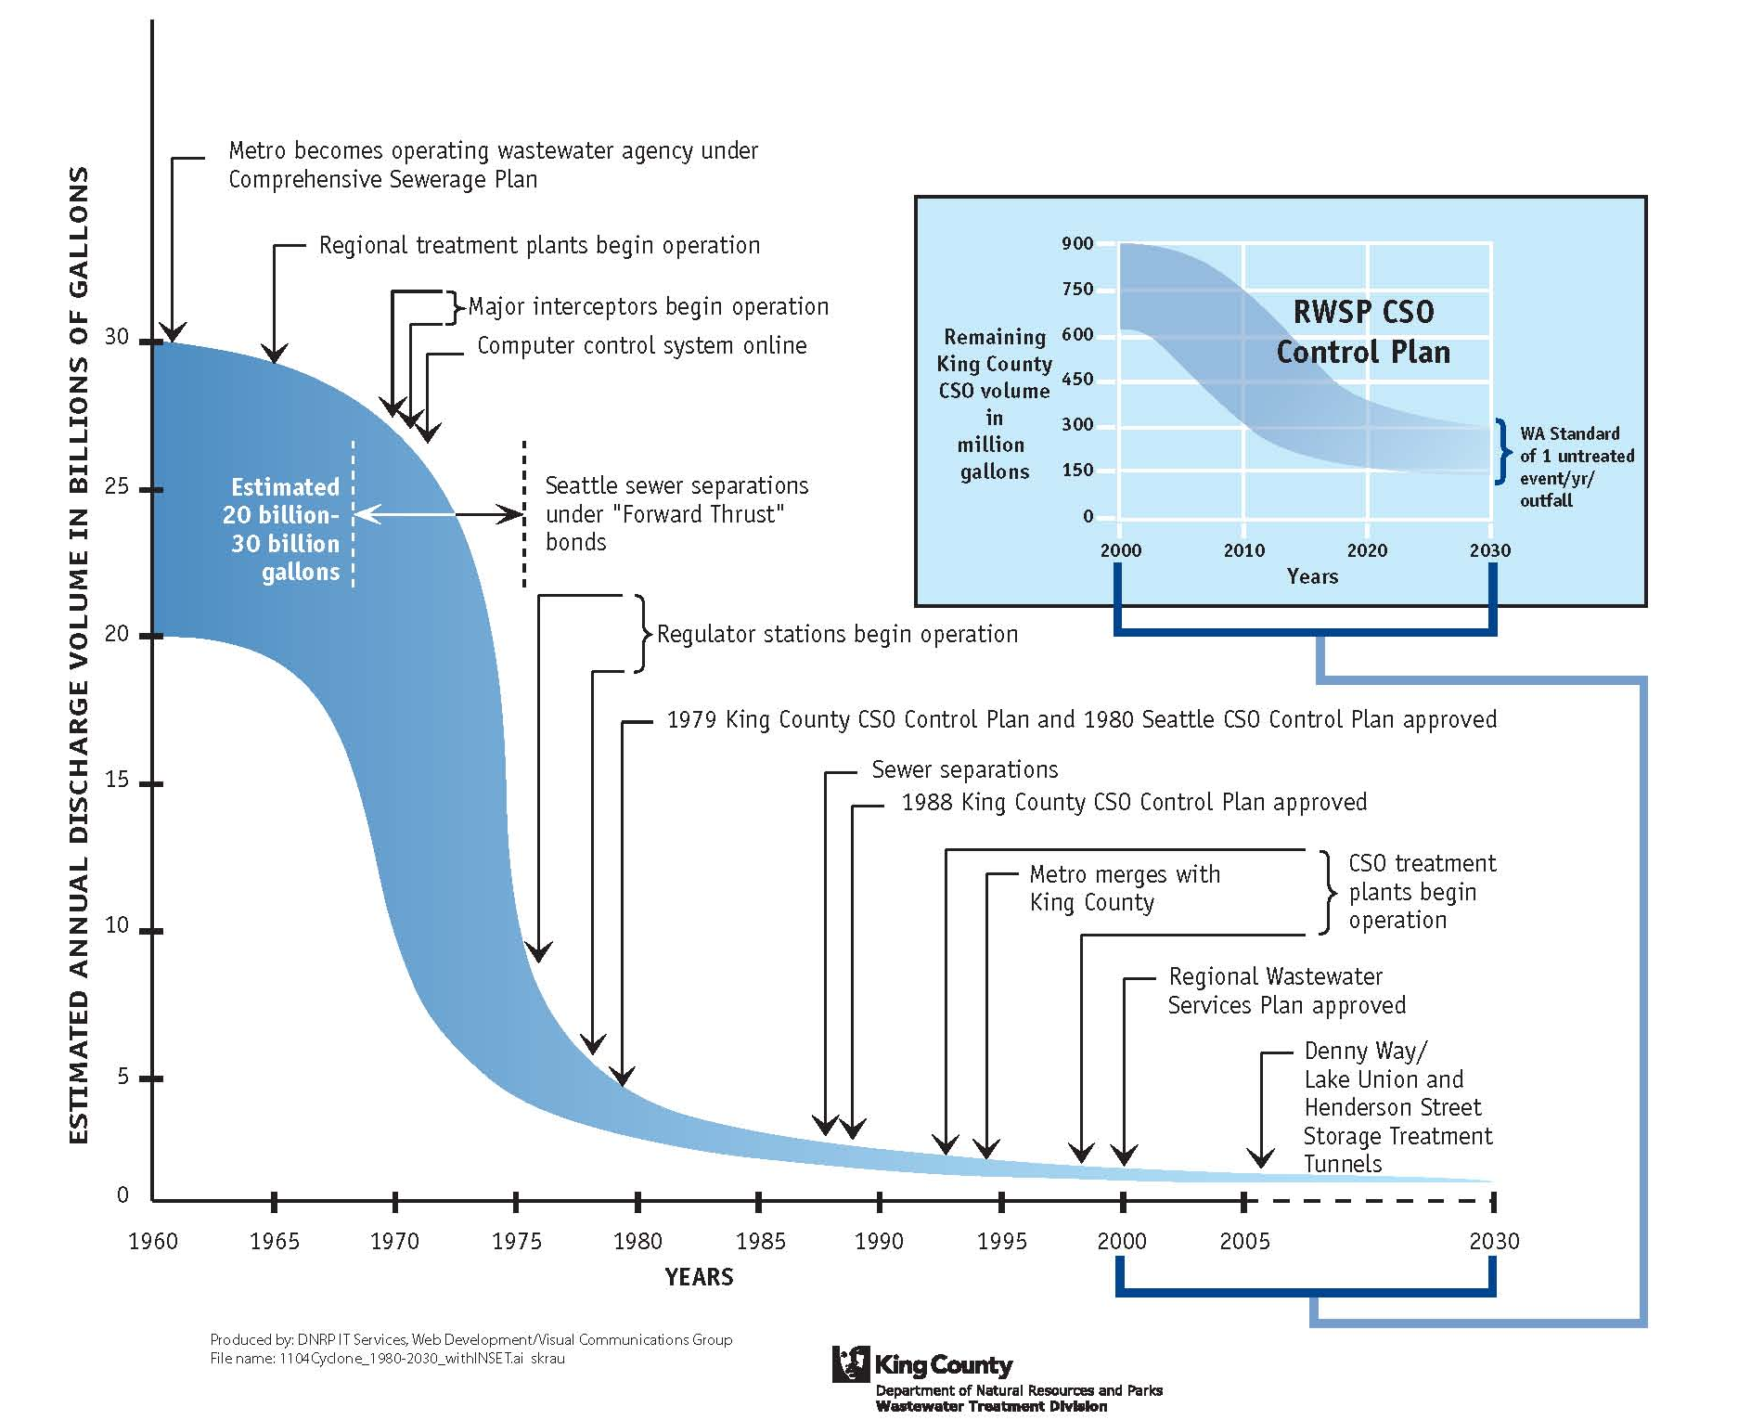
Progress Made to Date
Historically, 20-30 billion gallons of wastewater released to waterways each year
Sewage overflows have been reduced since Metro was formed in 1958.
Since the 1980s, CSOs have been reduced by ~60% from 2.4 billion gallons per year to ~800 million gallons per year
Completing the RWSP CSO control program leads to all CSOs meeting the State standard
Notes:
The state standard for CSO control is one event per year per CSO outfall on average – about 300 million gallons/year (inset)
Getting to 0 is impossible. Need a relief point to avoid back-ups into homes, businesses and streets

Slide 10
Reduction in CSO Events
19 CSO locations controlled
  Reduced CSO events from ~135 per year to 19 or less per year
5 CSO locations with control projects under way
  CSO events will be reduced from ~70 per year to 5 or less per year
14 CSO locations in WTD Recommended CSO Control Plan
  Completion of plan will reduce CSO events from ~270 per year to 14 or less per year
Notes:
Per year means per year on average
Modeled numbers

Slide 11
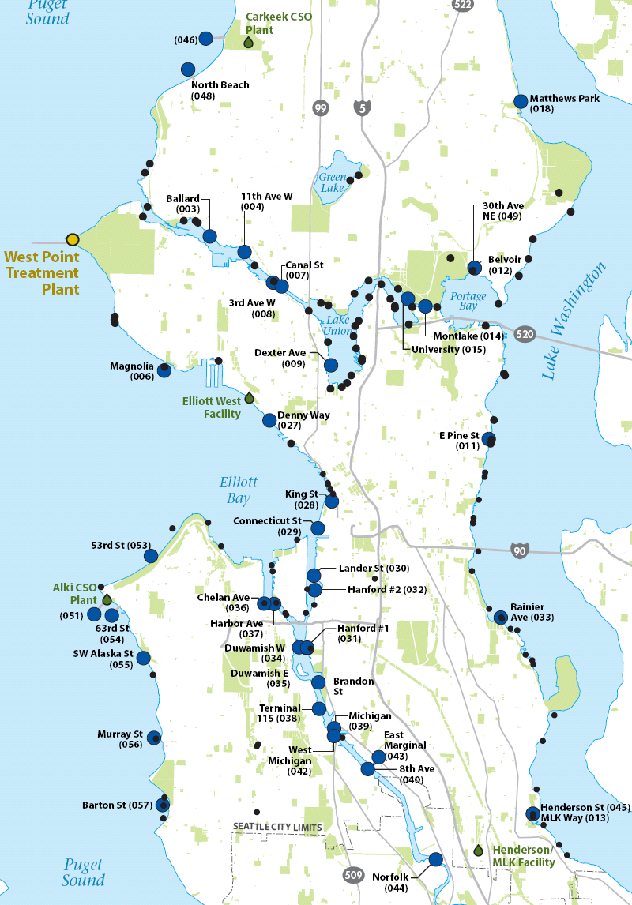
Five CSO Control projects under way
  North Beach
  Ballard
  Magnolia
  Murray
  Barton
Notes:
Yellow dots, reading from top to bottom

Slide 12
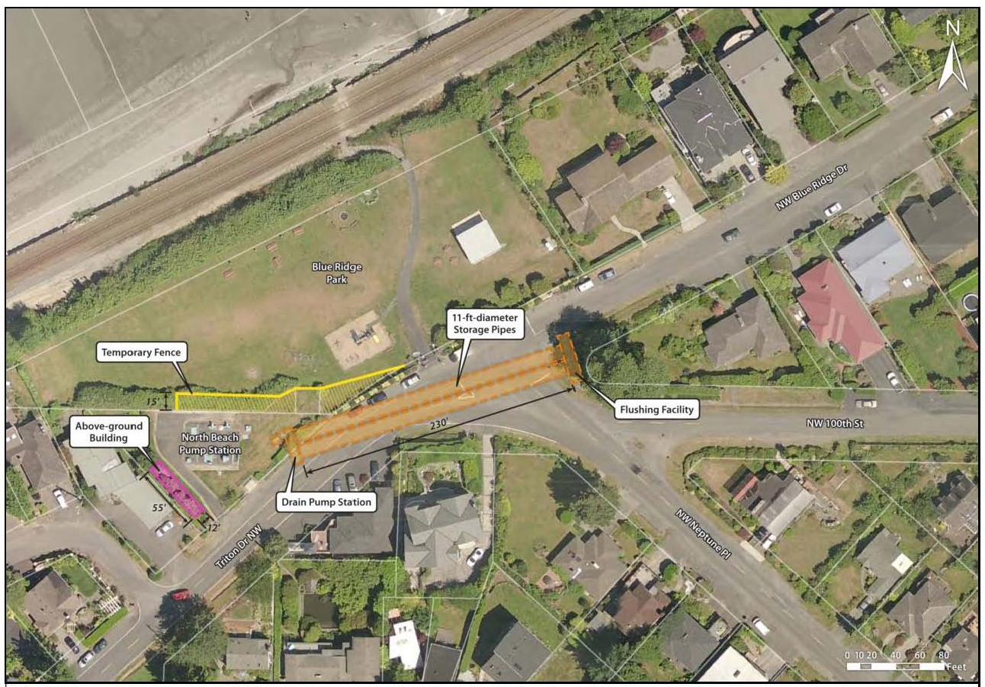
North Beach CSO Control Project
  2 parallel 11 ft x 230 ft storage pipes
  Complete in 2015
Notes:
Project Description
King County is designing and building an underground storage pipeline in the right-of-way in N.W. Blue Ridge Drive and Triton Drive N.W. This facility will store peak flows when the North Beach Pump Station reaches maximum capacity. After storms have passed, an underground pump will transfer stored flows to the pump station for conveyance to King County’s Carkeek Wet Weather Treatment Facility for transfer to West Point Treatment Plant or onsite treatment. The project includes an underground diversion structure that will convey peak flows to the facility. There will be a new odor control and electrical facility on King County property.

Slide 13
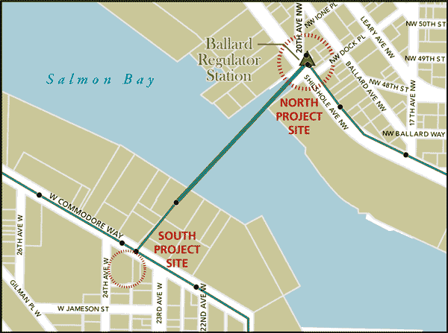
Ballard Siphon Replacement and CSO Control Project
Increased capacity in new Ballard siphon
Complete in 2013

Slide 14
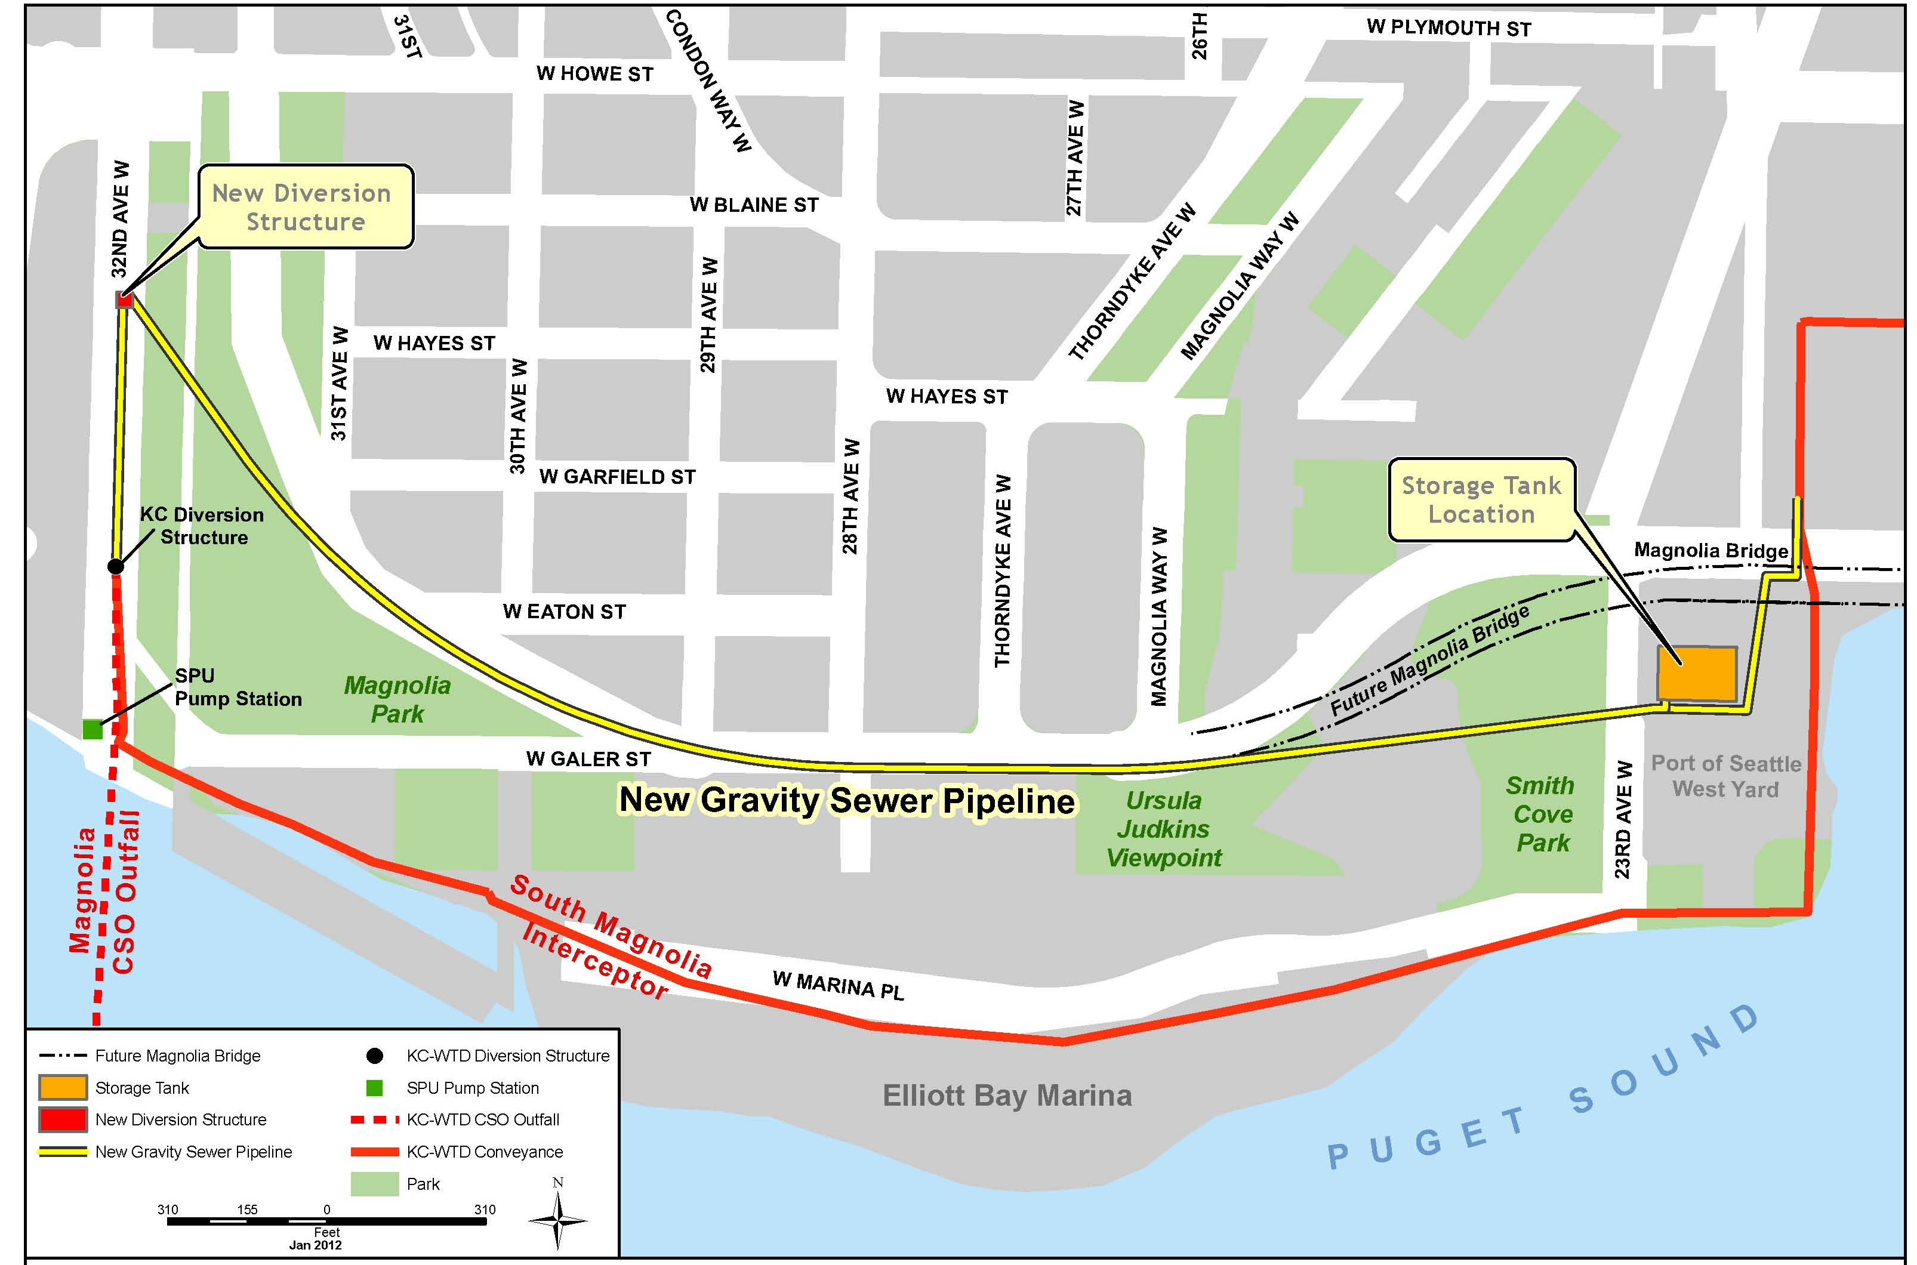
S Magnolia CSO Control Project
  1.9 MG storage tank by Port’s Terminal 91 W. yard
  Complete in 2015
Notes:
Project description
King County is designing and building an underground storage tank in the Port of Seattle’s Terminal 91 West Yard south of the Magnolia Bridge. This facility will store peak combined sewer flows conveyed from a diversion structure on 32nd Avenue West when the South Magnolia Trunk Line reaches maximum capacity. After storms have passed, stored flows will be transferred to the Interbay Pump Station for conveyance to the West Point Treatment Plant.

Slide 15
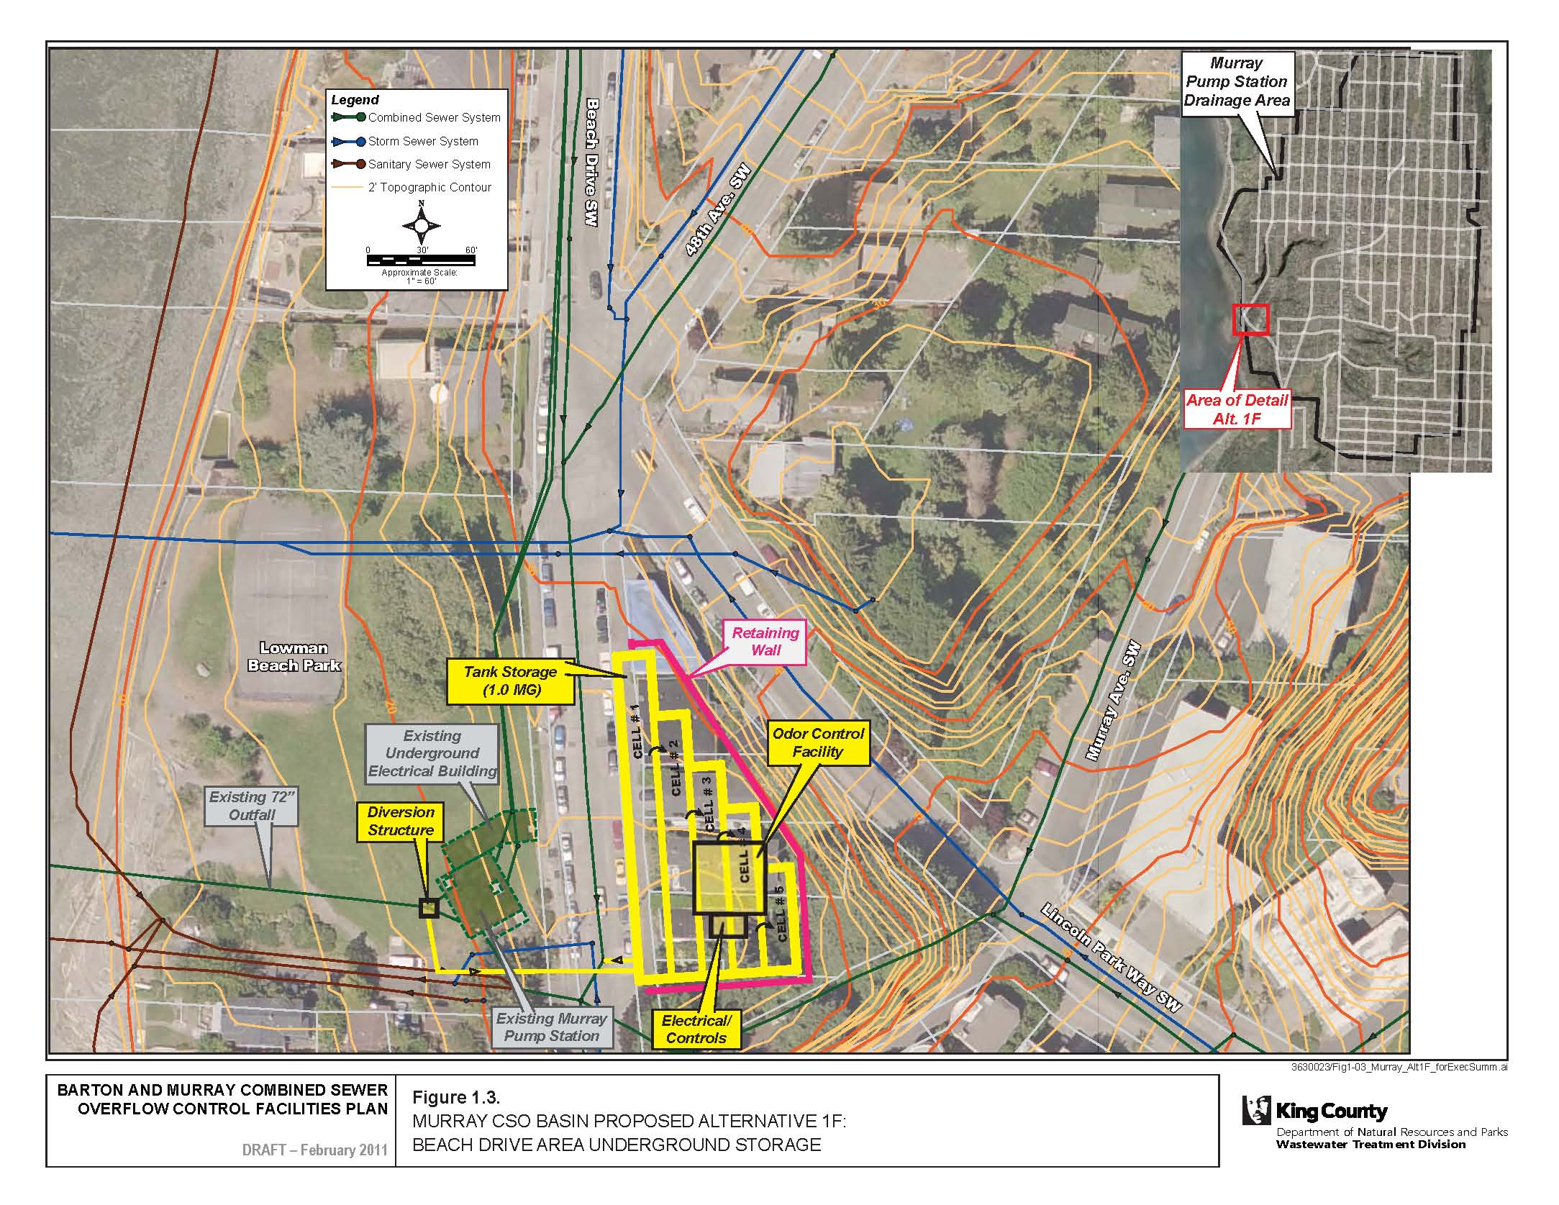
Murray CSO Control Project
  1 MG storage tank across from existing PS at Lowman Beach Park
  Complete in 2015
Notes:
King County plans to design and build a one million gallon underground storage tank on private property across from Lowman Beach Park along Beach Drive S.W. This facility will store peak flows when the Murray Pump Station exceeds capacity. The recommended proposal also involves an underground diversion structure located under the southeastern corner of Lowman Beach Park and an ancillary equipment facility (odor and electrical unit) above ground on the storage tank site.

Slide 16
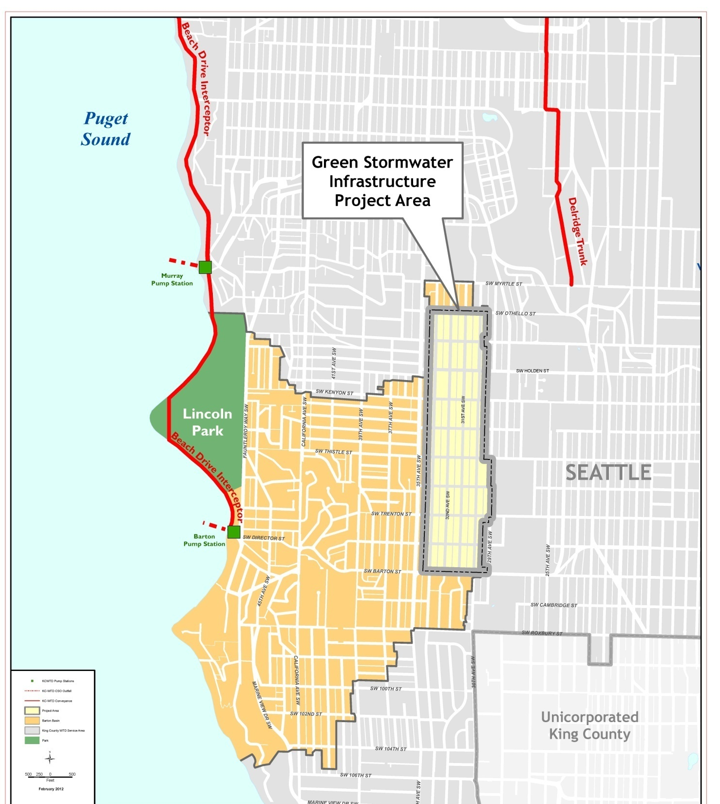
Barton CSO
Control Project
Green Stormwater Infrastructure in coordination with pump station upgrade
Complete in 2015
Notes:
Orange-y area is the Barton basin
Project Description: King County is designing bioretention swales, a type of green stormwater infrastructure, in the City of Seattle’s parking strips in the Sunrise Heights and Westwood neighborhoods. Street runoff will be diverted away from storm drains and into the vegetated swales. Once in the swales, the water will filter through soil to an underdrain, which will take the water deep underground and allow it to slowly infiltrate into the soils. This bioretention swale system is needed to reduce the amount of stormwater entering the combined sewer system which can cause combined sewer overflows (CSOs) of sewage mixed with stormwater at the Barton Pump Station near the Fauntleroy ferry dock.

Slide 17
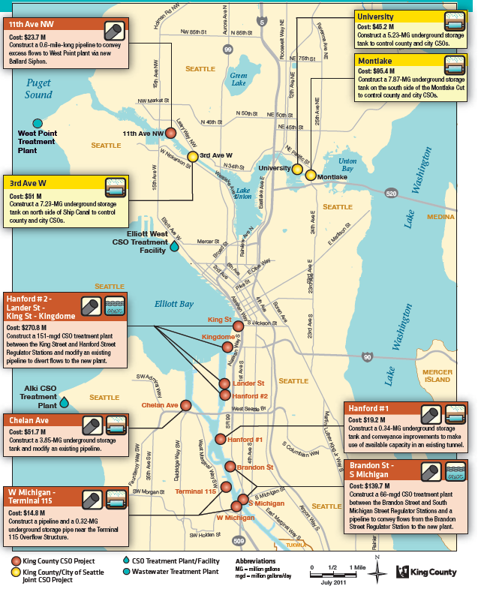
WTD Recommended CSO Control Plan
Nine projects to control remaining 14 uncontrolled CSOs by 2030
2 Duwamish CSO treatment plants
7 storage & conveyance options
  4 with significant “Green” potential
  3 joint projects with Seattle
  A joint tunnel under the Ship Canal is still being evaluated
Planning-level cost estimate is $711 million (2010$)
Notes:
Here is a snapshot of our recommended CSO Control Plan –9 projects to control 14 CSOs
2 will be large CSO treatment plants in the Duwamish – we’ve decided to use new high rate technologies that remove more pollutants along with UV disinfection that reduces risk to fish
The rest are combinations of conveyance and storage
4 have high potential for “Green – 3 along the Ship Canal and 1 in the lower Duwamish
3 are proposed as joint projects with Seattle – their mayor and Council must agree first
These 3, plus 2 more, could be replaced by a large tunnel that is still being evaluated. If recommended you will see it in the Executive’s Preferred Plan
These are very expensive - $711 million in today’s dollars
The projects should reduce untreated CSO volume by 600 million gallons per year

Slide 18
Cost Control Measures
Plan analyzed variety of technologies to reduce size of treatment facilities
Green Stormwater Infrastructure to reduce project size and cost - not yet counted
Working closely with Seattle to combine projects and identify cost-savings and cost-sharing opportunities
Effort under way to identify less costly sites

Slide 19
Stakeholder Feedback
CSO control is important and protects our region’s water quality and public health
Support to control Duwamish CSOs next
King County and Seattle should collaborate
Strong interest for incorporating Green Stormwater Infrastructure where possible
Concern about costs and rate impacts
  Is CSO control the best investment for improved water quality?
Communities in project areas want to be engaged in siting decisions

Slide 20
Next Steps
King County Executive is expected to transmit Executive-recommended plan to Council by June
RWQC review will be first step in Council review
Council approval of plan is hoped for in September
WTD submits Council-approved plan update to Ecology in fall 2012

