Slide 1
King County Auditor’s Office
Kymber Waltmunson, County Auditor
March 2026 Update on 2020 Harborview Bond Program Delivery
Ben Thompson
MARCH 24, 2026 | COMMITTEE OF THE WHOLE

Slide 2
Context
Voters approved $1.7B bond in November 2020
Ordinance Working Group (OWG) narrowed program plan
OWG plan approved by Council in October 2023

Slide 3
Teams working together to deliver program
Harborview Bond Program Team
King County and Harborview Medical Center Staff
PROGRAM DELIVERY
Owner-Advisor
Vanir Construction
TECHNICAL AND ORGANIZATION SUPPORT
Design-Builder
Mortenson and Perkins&Will
DESIGN AND CONSTRUCTION

Slide 4
Key takeaways
Full OWG scope may not be delivered without additional funding
New in-patient tower estimated to open in 2032, three years later than OWG estimate
Program faces several significant risks

Slide 5
Program status
Parking solutions identified including planned garage at 9th and Alder
Lack of agreement on target value for design
Schematic design will begin once agreement reached on target value

Slide 6
Cost estimates are rising
Inflation
Updated building codes
New geotechnical information
Significant differences in Owner-Advisor and Design-Builder estimates for target value

Slide 7
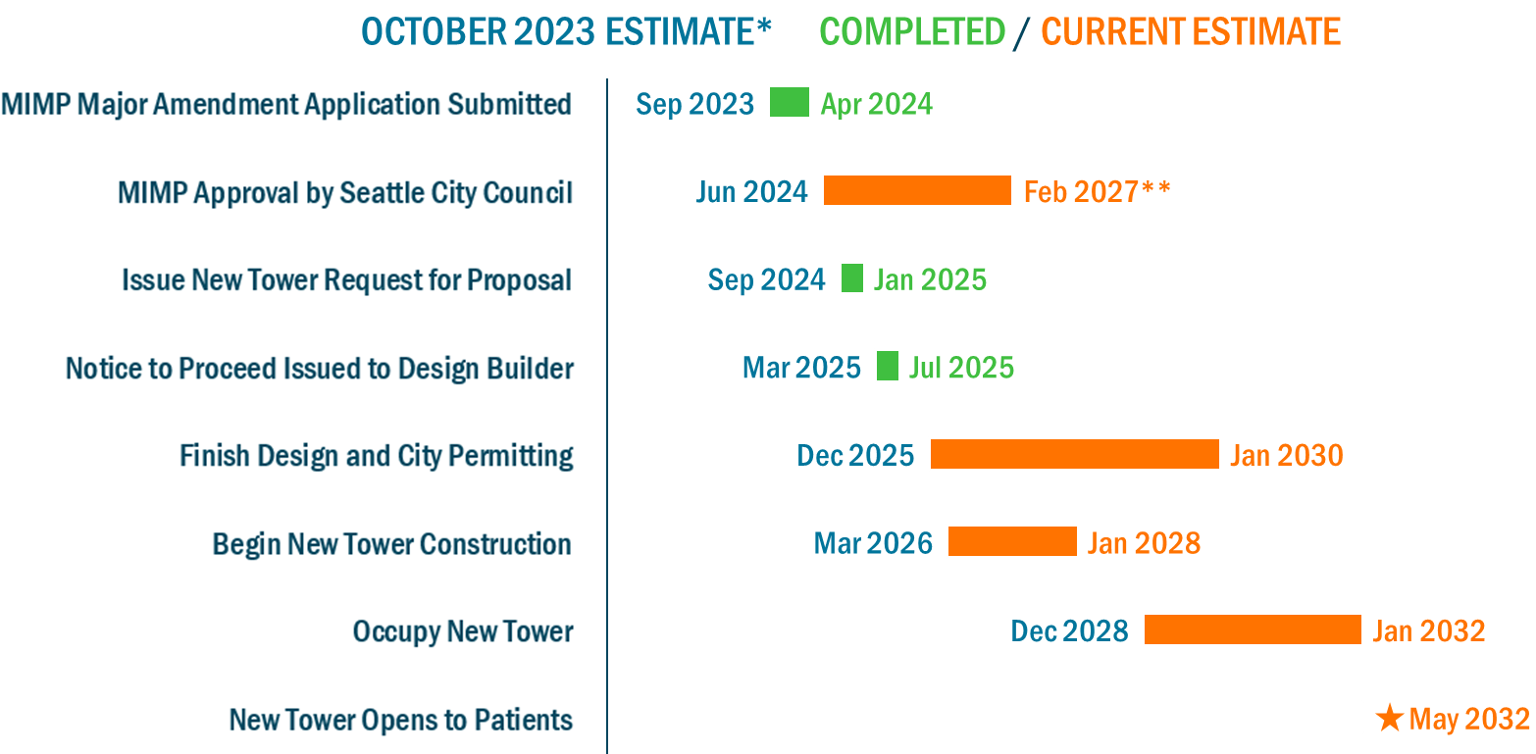
Schedule estimates have lengthened

Slide 8
Sources of delay in opening new tower
More time than originally estimated
    Permitting
    Construction
Risks exist that could delay opening even further

Slide 9
Risks: Major Institution Master Plan (MIMP)
Approval needed from Seattle City Council
Limited work can be permitted prior to MIMP approval
City Council could place additional conditions that increase costs

Slide 10
Risks: Incomplete management documents
Program charter and management plan not yet finalized
Individual project management plans not completed

Slide 11
Risks: Parking
Demolition of View Park 1 Garage
Increase in demand
  Temporary needs for construction workers
  New tower drives future needs
  Long-term unmet needs

Slide 12
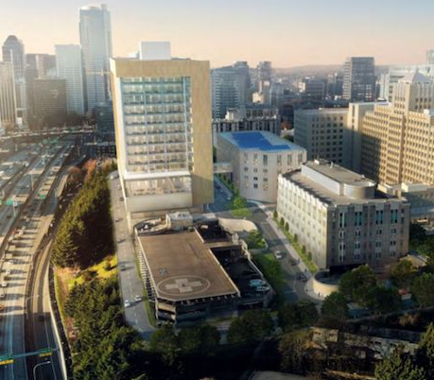
Risks: Permanent Loop Road
Provides vehicle circulation for new tower
WSDOT must grant lease or transfer ownership
Could require NEPA process, adding years to timeline or requiring tower re-design
Source: https://harborviewbondprogram.com/tower-rfp-released/

Slide 13
Risks: Temporary Haul Road
Provides access to all sides of site during construction
Temporary lease of land adjacent to new tower from WSDOT
Lack of lease would increase construction time and increase traffic impacts around campus

Slide 14
Key takeaways
Full OWG scope may not be delivered without additional funding
New in-patient tower estimated to open in 2032, three years later than OWG estimate
Program faces several significant risks

Slide 15
Thank you!
Full report available online at
KingCounty.gov/Auditor
Help us promote positive change in King County government!
Suggest an audit topic online at
bit.ly/KCAOAuditInput

