Slide 1
King County Financial Outlook
Aaron Rubardt
Chief Budget Officer
April 2026

Slide 2
What has changed since the 2026-2027 budget passed?
Federal funding
  Preliminary injunctions in place, ongoing risk of interrupted funding
  Continue to monitor federal changes
Uncertainty at the federal level – tariffs, immigration policies, war in Iran
State legislative changes
  Millionaires tax
  HB 2442
March OEFA Forecast
2025 year-end fund balances

Slide 3
Financial Outlook
Outlook for most funds is positive
Some of the largest County funds have projected shortfalls over the next five years
  General Fund
  Public Health Fund
  Environmental Health Fund
  Regional Animal Services
  Roads
  Permitting
  Behavioral Health
  Housing
Other funds have financial challenges
  Wastewater
  Solid Waste
  Metro Transit

Slide 4
addressing financial challenges
Tightening financial management
  Implementing cost-saving measures
  Closely tracking one-time expenditures
  Reprioritizing base budgets
Reductions may be necessary in the second omnibus

Slide 5
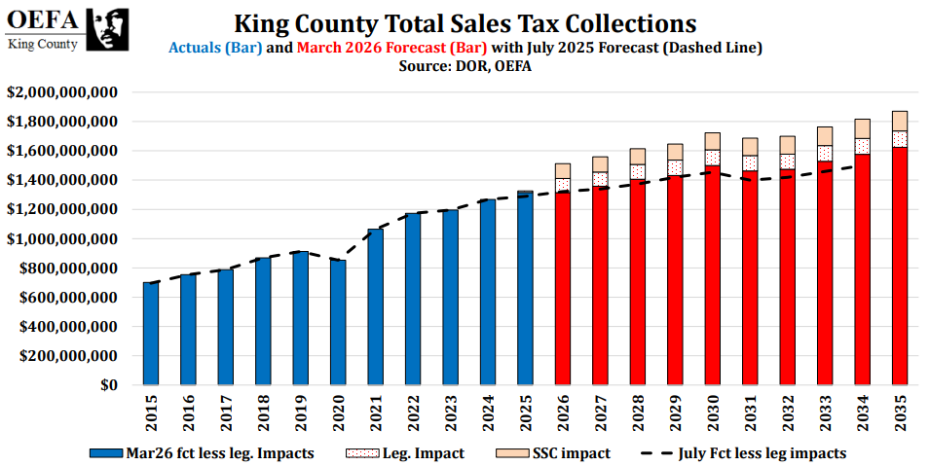
Fiscal impacts of Millionaires Tax
Sales tax revenue increased by $157M in 2026-2027 from the expansion of the sales tax base in 2026
The Millionaires Tax will lead to a drop off in sales tax revenue beginning in 2029

Slide 6
Implementing HB2242
Adds flexibility and revenue tools
  New councilmanic $0.05 property tax to fund public health clinics
  New sales .01% sales tax authority for children and families (up to $10M)
  Expanded use of REET, Health Through Housing sales tax, rental care sales tax, flood control zone district recovery assistance
Analysis of new tools is ongoing
Proposed changes will be in the second omnibus

Slide 7
General Fund
Projected $75M deficit by the end of 2029
  Does not include required funding increases for Public Defense
Work to analyze base budgets to identify funds that could be reprioritized kicked off in March
Reductions may be necessary in the second omnibus

Slide 8
Public Health Fund
About $60 million budgeted reserve deficit by the end of 2029 per the adopted financial plan
Implementing the HB2442 public health clinic property tax could raise up to $40-45 million per year
Separate from clinical operations, a deficit remains for population health services, which could see a $3-4 million reduction in state funding

Slide 9
Roads and transit
Roads has a deficit by the end of 2029 and is unable to fund its capital program beyond 2029.
Metro Transit is unable to meet reserve requirements by 2031; its fund balance will be depleted by 2033.
Long-term fiscal state of Roads and Transit is dependent on the Transportation Benefit District.

Slide 10
What’s next
First omnibus is under consideration by the Council
Second omnibus will transmit in early October
Work on the 2028-2029 budget begins in Q2 2026
Likely not doing a third omnibus
July OEFA forecast will give us a clearer financial picture

