Slide 1
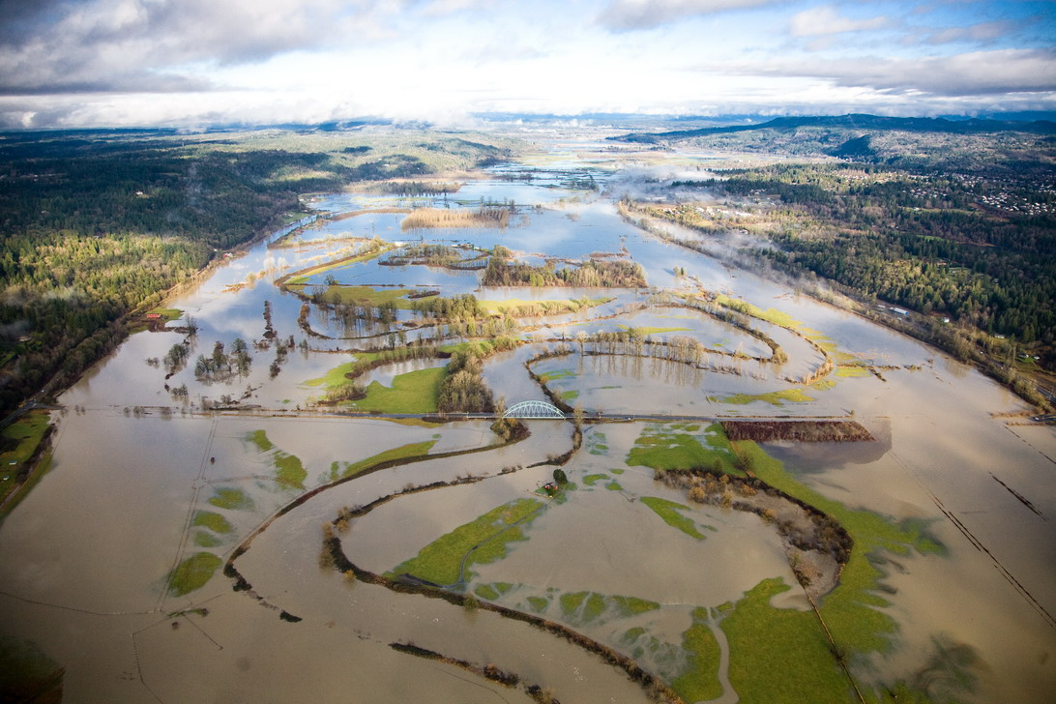




Board of Supervisors
2012 Budget Public Hearing
November 7, 2011
Protecting public safety, the regional economy and critical infrastructure.

Slide 2
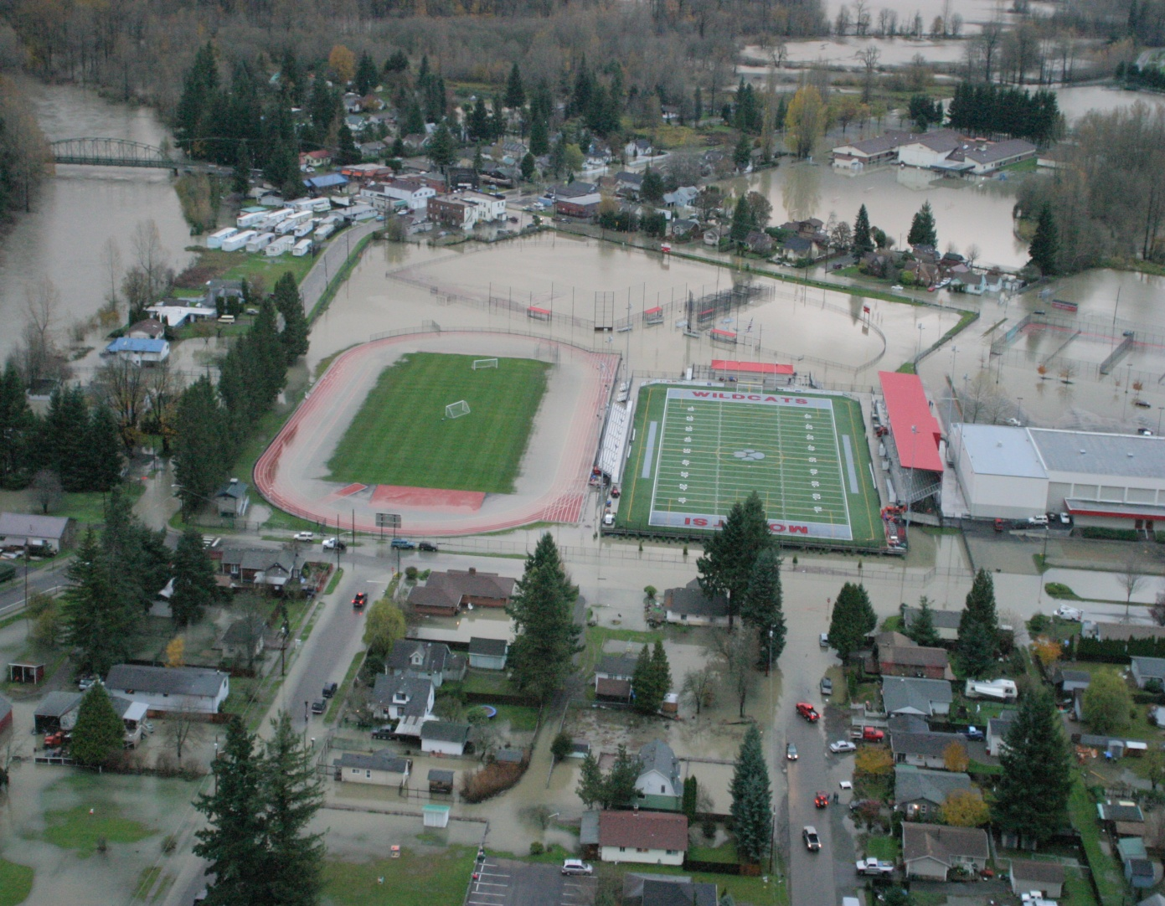
King County Flood Control District Overview
Take actions to reduce flood risk.
Understand flood risks and where we are vulnerable.
Build awareness of flood risks.
City of Snoqualmie
Notes:
12 Federal Disaster Declarations since 1990
Flood protection is critical to protect public health and safety and ensure regional prosperity.
Protect warehouse distribution centers for Puget Sound Region
Protect critical public infrastructure
Levees are the weak link:
500 aging facilities along 119 miles
Investing in infrastructure is far less expensive than rebuilding entire communities after a catastrophe

Slide 3
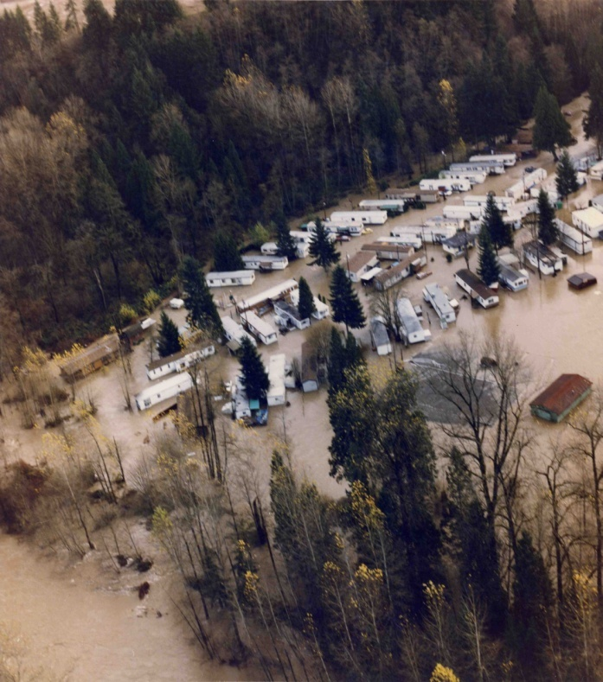
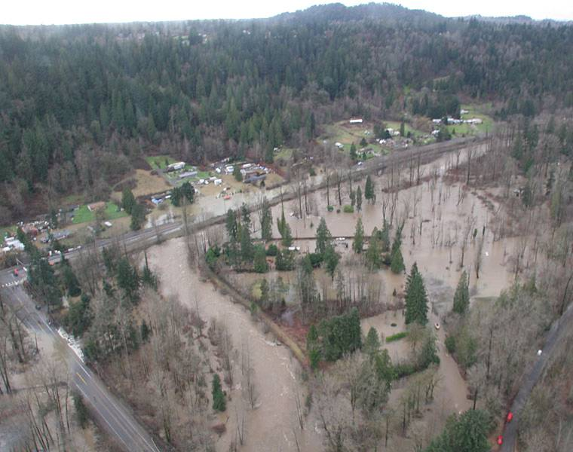
Actions to Reduce Flood Risk:
Frequently Flooded Structures
Before: Homes and Residents at Risk
After: Tenants Relocated and Structures Removed
Rainbow Bend, Cedar River
Since 2008, 86 parcels and 178 acres were acquired in the floodplain from willing landowners. Over 175 tenants relocated to safer, superior housing.

Slide 4
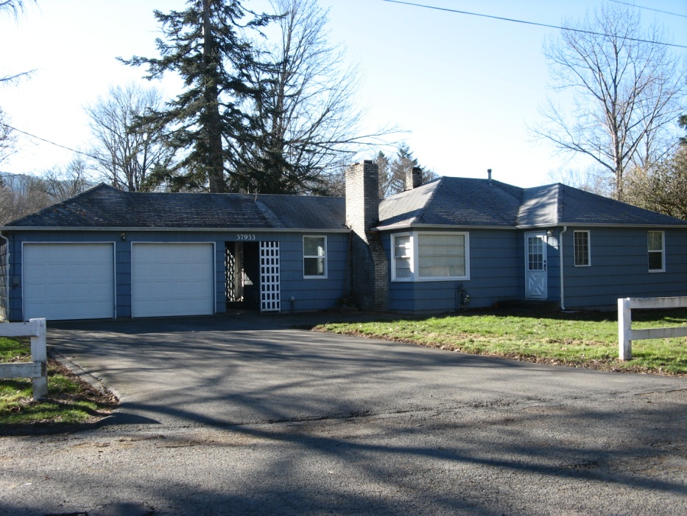
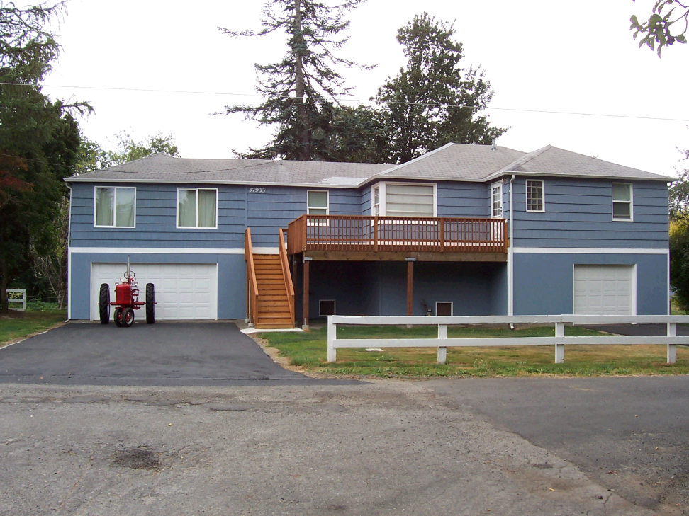
Actions to Reduce Flood Risk:
Home Elevations
48 homes elevated above flood height
17 home elevations in progress
Federal and state grants mean minimal costs to homeowner
Snoqualmie Home Elevation Before and After

Slide 5
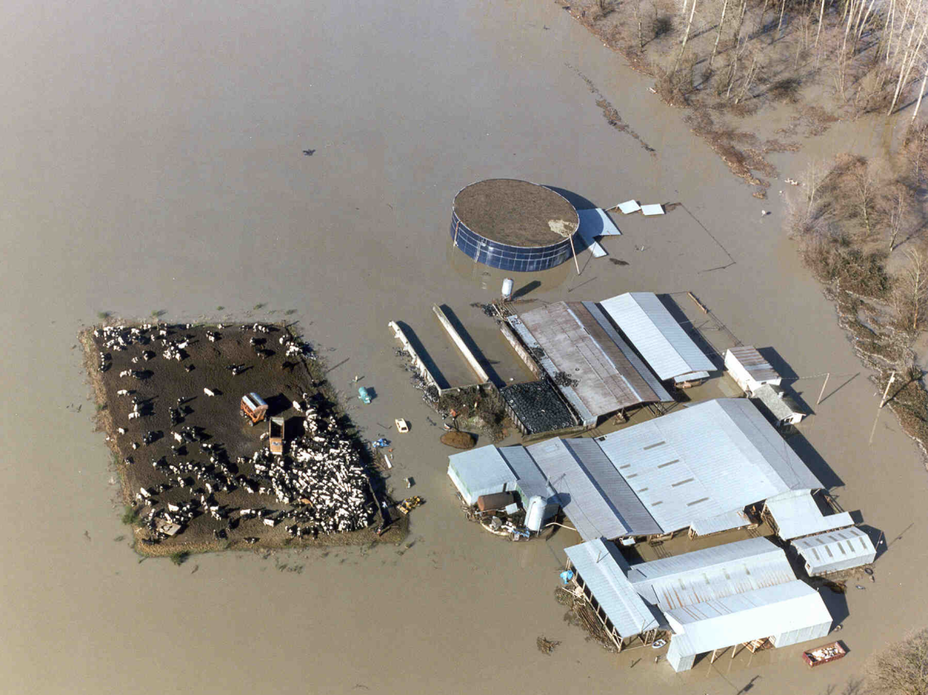
Actions to Reduce Flood Risk:
Farm Pads and Barn Elevations
20 farm pads constructed since 2008
5 farm pads in development for 2012
2 barn elevations in 2012 as pilot project
Lower Snoqualmie Valley

Slide 6
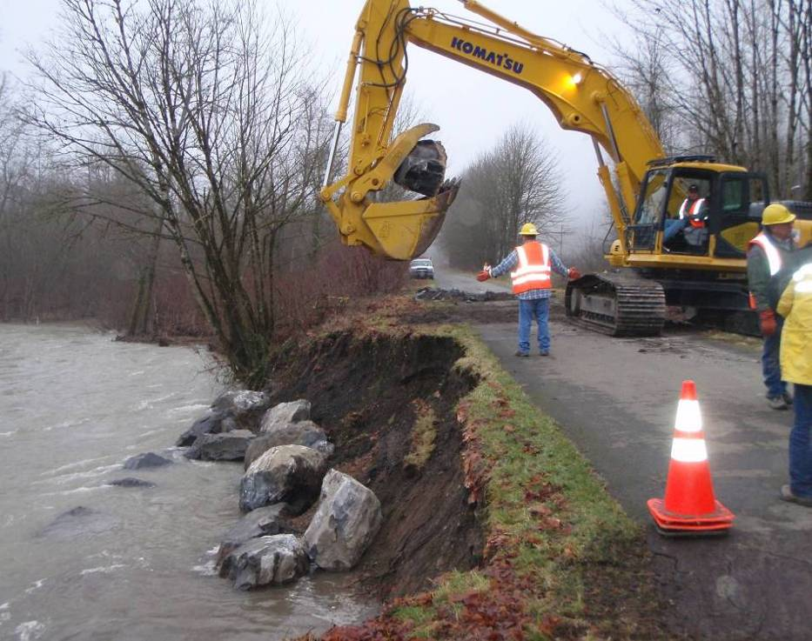
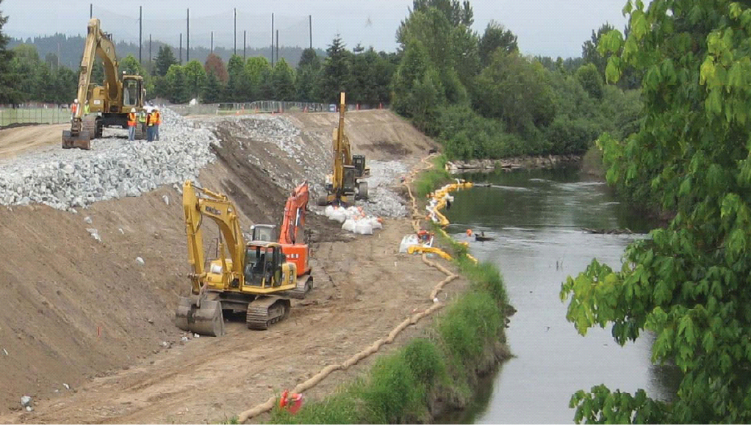
Actions to Reduce Risk:
Rebuilding Levees
60+ levee projects completed
5-7 major levee rehabilitations scheduled for construction in 2013
25-30 major projects programmed during
6-year CIP
Cedar River (top)
Lower Green River (bottom)

Slide 7
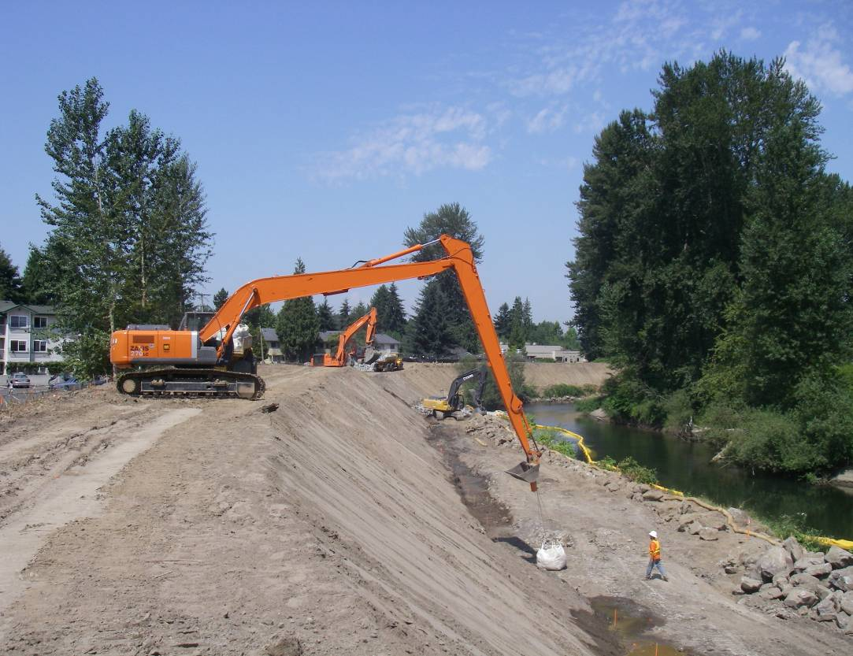
Actions to Reduce Risk:
Partnerships and Grants
Since 2008, 37 grants from FEMA, Corps, State of Washington, KCD, and Conservation Futures
$42.5M in external funds for flood risk reduction
$2.50 in local, state, and federal funds leveraged for each FCD $1 invested
Funding to 40 jurisdictions through the Opportunity Fund
Lower Green River – Horseshoe Bend

Slide 8
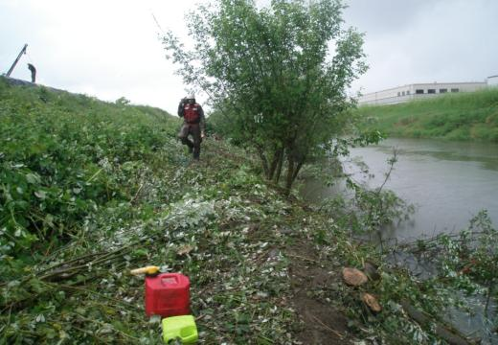
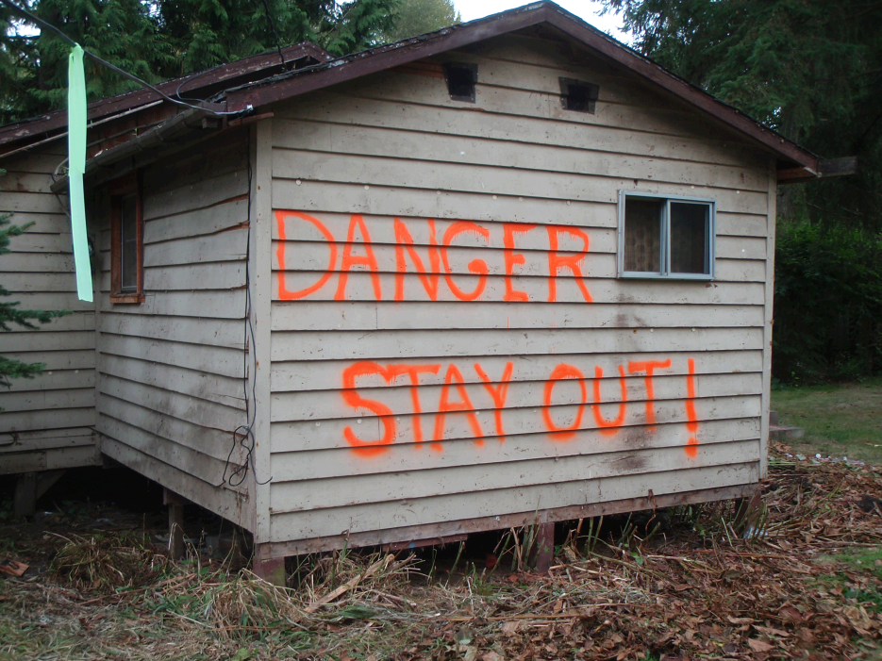
Actions to Reduce Risk:
Maintaining Levees
500 levees and revetments along 120 miles of river
Inspection and access for flood season
600 acres of property to maintain
Demolish 15-20 structures per year
Vegetation removal, Tukwila (top)
Home demolition, Cedar River (bottom)

Slide 9
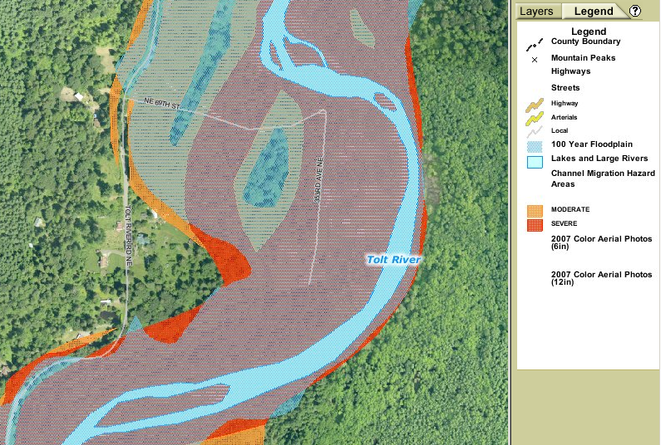
Improving Understanding of Flood Risk:
Consequence, Severity, and Urgency
Tolt River Channel Migration Map – Available on King County iMap
Notes:
For our actions to be effective they need to be based on a clear understanding of the consequence, severity, and urgency of flood problems – the value of this information was underscored during the recent Howard Hanson Dam crisis, when up-to-date models allowed us to quickly generate ‘what if’ flood scenarios and develop emergency response plans.

Slide 10
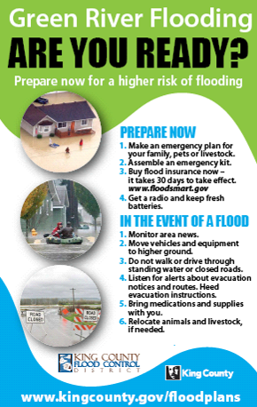
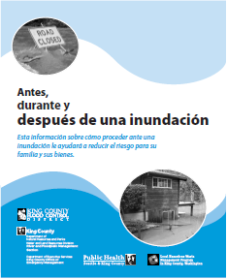
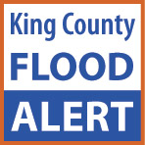

Building Awareness of Flood Risks
Flood information available in multiple languages
Flood Update mailed to 5,200 floodplain addresses
Over 4,900 flood alert subscribers and flood safety videos available in 21 languages
Notes:
We communicate with the public and other agencies as part of flood preparations each fall, and during flood events. This includes traditional outreach materials as well as automated flood alerts and social media.
Traditional brochures and mailings, along with social media
Multilingual flood safety videos in 21 languages
Flood Alert System – automated phone, email, or text messages of flood phases to nearly 5,000 subscribers

Slide 11
2012 Proposed Budget Total $46M
19 Capital projects funded
$3.6M to 40 jurisdictions through the Opportunity Fund
Flood awareness and response programs
Facility maintenance
Notes:
Work program includes actions to build understanding of risks, communicate that understanding, and take action to reduce flood risks.

Slide 12
Performance Metrics: Gauging Progress
ASSESS
ADJUST
DESIGN
EVALUATE
IMPLEMENT
MONITOR
Notes:
Great progress in implementing risk reduction actions, but our task in the coming year as part of the Plan Update will be to evaluate the cumulative effect of completed and proposed projects. We need to evaluate how our exposure to flood risk is changing over time so we can hold ourselves accountable and adapt our projects, programs, and policies as appropriate.

Slide 13
Performance Metrics: Gauging Progress
Did we do what we said we would do?
60+ projects completed
86 parcels and 178 acres acquired
175+ tenants relocated
48 homes elevated
20 farm pads constructed
Are the actions doing what we thought they would do?
Reduced flood heights at Renton Airport compared to previous floods
150+ residents relocated from Rainbow Bend
Levee stability increased on key levees along the Green River (Kent Shops, Myer’s Golf Course, Dykstra, Gallis and Horseshoe)
Are we decreasing flood risk and vulnerability in our communities?
As part of plan update in 2012, translate specific project examples to integrated evaluation of cumulative effects in each major river basin.
Notes:
Great progress in implementing risk reduction actions, but our task in the coming year as part of the Plan Update will be to evaluate the cumulative effect of completed and proposed projects. We need to evaluate how our exposure to flood risk is changing over time so we can hold ourselves accountable and adapt our projects, programs, and policies as appropriate.

Slide 14
Flood Preparedness Information
King County Flood Services
www.kingcounty.gov/flood
King County Flood Alerts
King County flood gage and phase information
Sandbag distribution information
King County Flood Control District
www.kingcountyfloodcontrol.org

