Slide 1
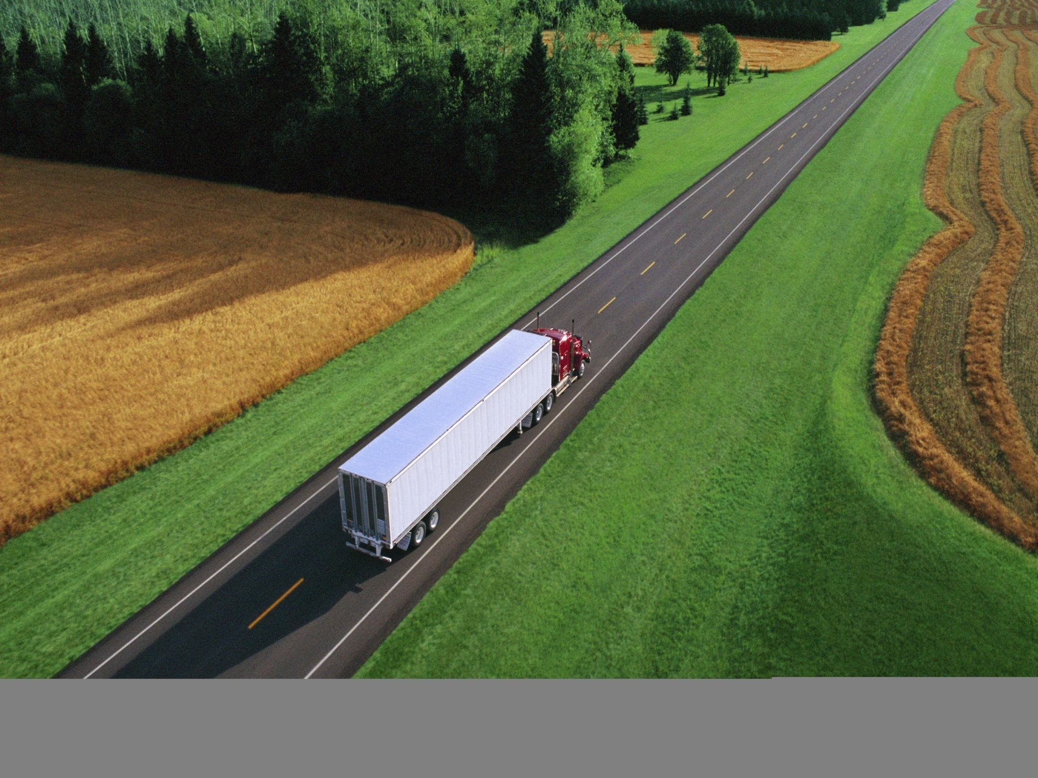


Cascade Sierra Solutions
Driving the green trucking revolution
Presented by :
Ian Burkheimer, Development Specialist
Cascade Sierra Solutions
Notes:
1

Slide 2
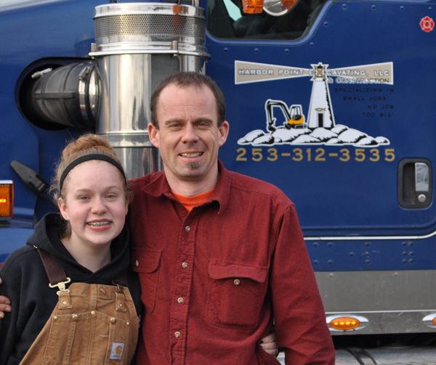
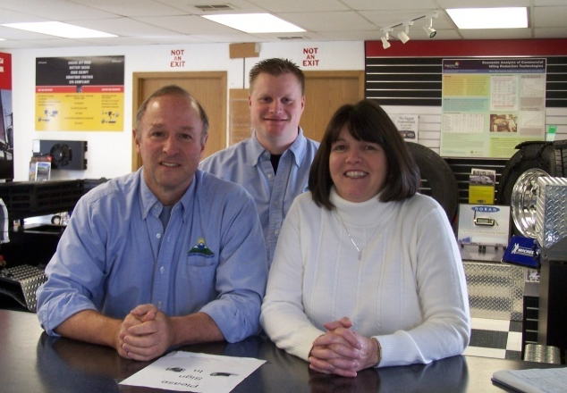
About CSS: What We Do
Education/Outreach at
Green Trucking Centers
Financial Incentives
(grants and loans)
Access to non-biased information about new technologies for saving fuel
“CSS was really an advocate for us… we now have a new, reliable truck that I can count on.”—Tony Dulas, with daughter Samantha.
Team members at each CSS Green Trucking Center connect truckers with affordable solutions to increase profitability.
Notes:
Eight of CSS’s Green Trucking Centers located along the I-5 corridor.
Unbiased information for truckers--Only place where you’ll see Cummins and Caterpillar showcased together.
We try and find technologies that can pay for themselves within a few years by reducing their fuel and maintenance costs.
Publishers of the Green Trucking Guide—quickly becoming a go-to reference for truckers, fleets, and clean-air agencies. More than 20,000 copies of the latest edition distributed to people in the industry.
CSS helps truckers understand the incentives available to them. Many truckers still find it difficult to qualify in today’s tight lending environment. We help them use grant financing and our unique credit scoring model to afford new or upgraded equipment

Slide 3
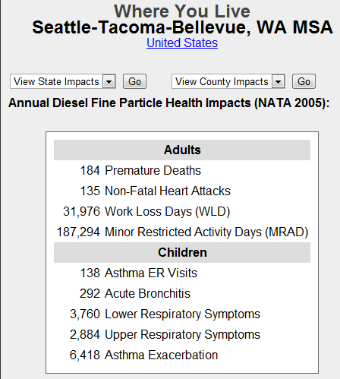
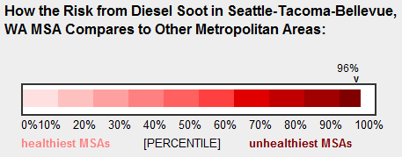


About CSS: Why we do it

Slide 4
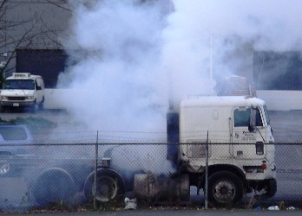
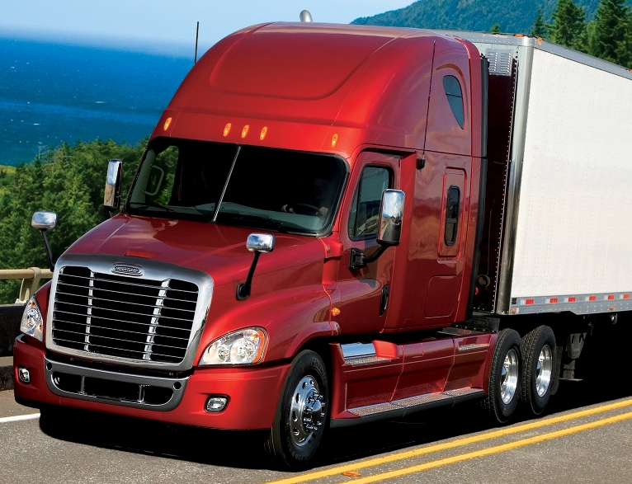
Why Trucks?
Fastest, most affordable impact on
air quality
New diesel truck nearly 100 times less polluting than the truck it replaces
One new truck = 20 cars off the road
Notes:
Why are diesel trucks the key to many of our environmental and air quality problems?
Why not hybrid cars, mass transit, and other green solutions?
For the price of five hybrid vehicles, you can get one dirty, older diesel truck off the road—with the polluting capacity equivalent to taking 40 passenger vehicles off the road.
It is the most cost-effective way to make a big impact on air quality.

Slide 5
Green Highways Initiative
Progress to Date
Upgraded or replaced more than 9,500 trucks
Garnered more than $45 million in grants to help truckers
Provided more than $54 million in financing
Educated truckers on best practices to save fuel and reduce emissions
Installed 1,250 electrified truck spaces
Saved over 42,000,000 gallons of Diesel
Notes:
Progress to date
1. CSS has upgraded or replaced more than 8,000 vehicles across the United States, saving over 35 million gallons of diesel fuel.
2. CSS has garnered more than $45 million in grants to provide financial assistance to businesses who otherwise could not afford to change.
3. CSS has provided over $54 million in financing clean, fuel efficient vehicles and upgrades.
4. CSS has educated thousands of small trucking companies on best practices to save fuel and reduce emissions, serving as the R & D department for small trucking companies.
5. CSS is in the process of installing 1,250 electrified parking spaces on five major freight corridors nationally.

Slide 6
Green Highways Initiative
Goals 2012
Replace more than 500 older diesel trucks
Conduct natural gas pilot program
Construct 1,000 electrified pedestals
Provide 4,800 grants for plug-in retrofits
Open Dallas/Fort Worth outreach center
Open Medford, Oregon outreach center
Notes:
Goals for 2012
• Replace more than 500 dirty diesel trucks with natural gas or clean diesel alternatives
• Conduct natural gas trucking pilot with emerging retrofit technology
• Construct more than 1,000 electrified pedestals at truck stops nationwide
• Provide grants for 4,800 trucks to upgrade for plug-in idle-reduction technologies
• Open Dallas/Fort Worth outreach center
• Open Medford, Oregon outreach center

Slide 7
King County and the Northwest
PSE
WorldCNG
FreightWing
PACCAR
Prometheus
WSDOT
Lynden, GTI
Allied Waste
Freightliner
Westport Innovations
Avista
Shorepower
IGW
Clean Scapes

Slide 8
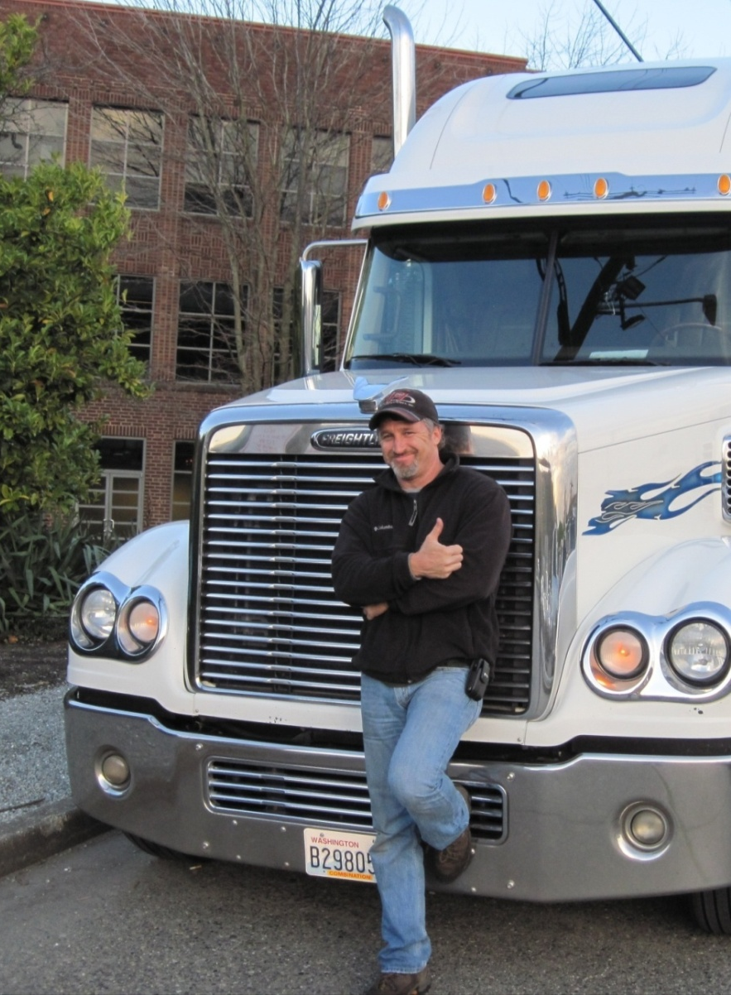
Thanks!
Ian Burkheimer
Development Specialist
iburkheimer@
cascadesierrasolutions.org
253-237-2106
cascadesierrasolutions.org

