Slide 1
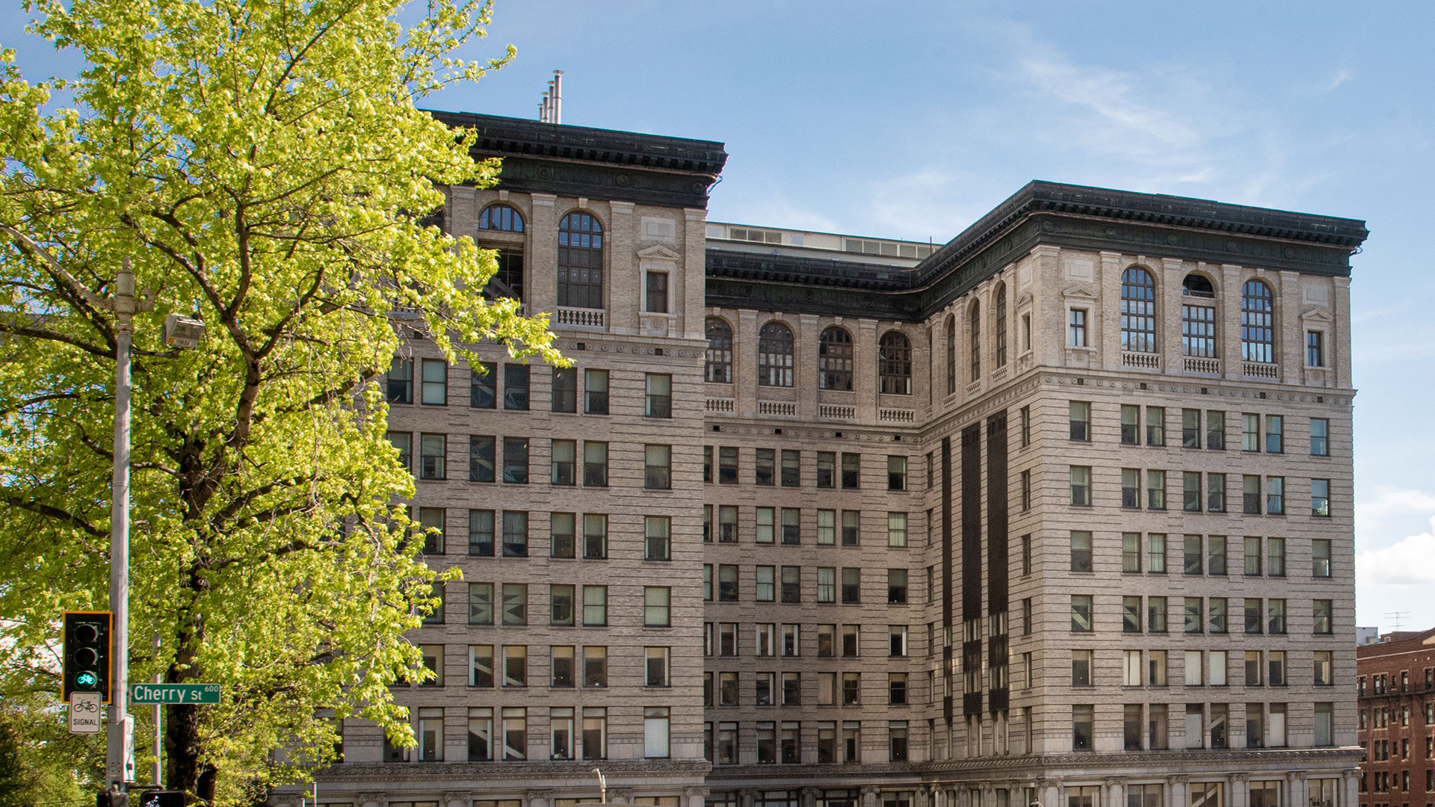

King County Regional Homelessness Authority (KCRHA) Interim Report
June 8, 2026 Presentation to Committee of the Whole
Notes:
Hyeok
Introduction
Context setting
The Executive - and all of us - are committed to seeing improvement in our region’s homelessness response.

Slide 2
Background: KCRHA Forensic Evaluation
County and City engaged Clark Nuber to conduct a forensic evaluation of KCRHA, which was completed in April 2026
The evaluation outlined financial challenges and weaknesses
      No specific evidence of large-scale fraud was identified
Key themes: invoicing and receivables inefficiencies, weak reconciliation and internal controls, reporting and accounting system limitations, and governance, policy, and budget-oversight gaps
Notes:
Aaron
Intro

Slide 3
Background: KCRHA Corrective Action Plan
Executive and Mayor required KCRHA to submit written responses:
  High risk findings by May 8
  CAP addressing additional items by May 23
The CAP established milestones for 30, 60, and 90 days, while indicating that ability to meet the milestones will depend on implementation capacity.
Notes:
Amber
Intro
Following forensic evaluation, the Executive and Mayor jointly responded, requiring KCRHA to:
Address several high-risk findings by May 8
a. These include things like a plan for ensuring segregation of duties and the need for tighter controls and/or P&Ps for employee reimbursements, gift cards and purchase cards.
Required KCRHA to address all remaining findings from the forensic evaluation through a written corrective action plan (CAP) by May 23
- KCRHA was responsive to both the May 8 and May 23 requirements. Their CAP established milestones while indicating their ability to meet the milestones depends on implementation capacity.

Slide 4
Background: KCRHA Corrective Action Plan Initial 30-60 Day Priorities
Formalizing an implementation dashboard
Initial categorization of receivables associated with the $8M finding
Developing King County Investment Pool cash-flow reconciliation schedule
Completing a fund advance inventory and roll-forward template
Formalizing a rejected-cost and invoice delay tracking mechanism
Validating administrative overspend exposure and updating administrative budget forecast
Immediate control enhancements related to reimbursements, gift cards, P-cards, and segregation of duties
Updating the monthly close checklist and financial reporting package
Initiating a NetSuite/chart of accounts/cost-center reporting assessment
Developing proposed scope for external stabilization support
Beginning City/County/KCRHA work sessions
Notes:
Aaron

Slide 5
King County Council
Motion 16970
Council requested by June 15th:
  Assessment of KCRHA administrative funding shortfall;
  KCRHA’s Corrective Action Plan (CAP)
  Executive’s initial assessment of the KCRHA’s CAP; and
  Assessment of actions necessary to comply with federal, state, and other funding requirements
By August 1st:
  A report providing a recommendation on continuing, amending, or terminating the ILA.
  The motion further sets parameters for the development of the August report and its components.
Notes:
Amber
After the forensic evaluation of KCRHA, King County Council introduced Motion 16970.
Today, we are presenting on requirements of this motion that are due by June 15th. These include:
An assessment of the administrative funding shortfall
KCRHA’s CAP
An assessment of KCRHA’s CAP
Assessment of actions necessary to comply with federal, state and other funding requirements.

Slide 6
Assessment of KCRHA Administrative Funding Shortfall
Clark Nuber forensic audit estimated KCRHA’s administrative overspend at $4.26M in June 2025.
Motion 16970 requested information on KCRHA’s administrative funding need for 2026 and 2027
    2026 Administrative budget is $13.9M. Current forecasted need by KCRHA is about $15M. This does not include the annual interest charges for carrying a negative cash balance.
      King County contribution: $3.2M.
      City of Seattle contribution: $5.2M
      State Department of Commerce: $2.2M
      HUD CoC: $3.0M
      Other: $0.2M
    2027 Administrative budget estimate ranges from $14M to $16M.
Notes:
Aaron

Slide 7
Options to Address Shortfalls
There are multiple shortfalls to consider.
  Administrative shortfall identified in evaluation: $4.26M
  Potentially unreconciled receivables identified in evaluation: $8M
  Additional shortfalls: includes 2026 administrative shortfall and ongoing interest charges. This is estimated at $2M to $3M.
  Additional unknowns
  Options to address the shortfalls include:
  County, City, and other funders agreeing to increase administrative support in 2026.
  County, City, and other funders agreeing to pay for unreconciled receivables on a one-time basis.
  KCRHA reducing administrative expenditures.
  KCRHA reducing contract expenditures.
  How to move forward is subject to ongoing discussions between funding partners and KCRHA.
Notes:
Aaron

Slide 8
Assessment of KCRHA’s CAP
The plan "does not yet provide sufficient assurance that the conditions identified in the forensic evaluation have been corrected…"
June 8 County and City Response
    Requirements Moving Forward
Notes:
Amber
KCRHA’s CAP response identifies plans to address the items identified in the forensic evaluation. We don’t yet have assurance that the items have been corrected or fully addressed.
Today, June 8, City & County provided KCRHA with a joint response to the CAP that they submitted.
The City and County's response requires KCRHA to deliver on specific requirements by:
End of July
End of August
End of September
The response also includes ongoing requirements of KCRHA.

Slide 9
Stabilize and Support KCRHA
Embed external financial consultant within KCRHA:
    Address items identified in forensic evaluation;
    Advance corrective action items to closure;
    Identify benchmarks and provide regular status reports;
    Assess actions to be taken quickly to comply with funding requirements.
Notes:
Amber
County and City are aligned on the need to stabilize and support KCHRA. Immediate next steps include:
Partnering to quickly execute a contract with an external financial consultant to embed at KCRHA. The consultant will:
Help address the items identified in the forensic evaluation, including
Advancing the corrective action items to closure
Additionally, the consultant will provide twice a month status briefings to county and city leads

Slide 10
Looking Ahead: August 1st Recommendation and Plan
The Executive and DCHS are in strong coordination with the Mayor and City Human Services Department.
Through the newly established Finance Committee of the KCRHA Governing Board, we are also working closely with Dr. Kinnison and KCRHA leadership to add another layer of financial monitoring and oversight.
Over the next few months, we will work closely with KCRHA to hold them accountable to implement actions identified in the CAP as well as the shortcomings identified in Clark Nuber's assessment.
Executive Zahilay has also made it clear that extensive engagement and communication with our provider community and diverse stakeholders will inform recommendations about the future of KCRHA; this will include engagements and listening sessions through his Breaking the Cycle Workgroup and beyond.
Notes:
Hyeok
The Executive and Department of Community and Human Services (DCHS) are in strong coordination with Mayor Wilson and the City of Seattle’s and Human Services Department (HSD). And together with the City of Seattle, we are in good communication with Dr. Kinnison and her team at KCRHA as well.
We will work closely with KCRHA to both support and hold them accountable for taking specific and immediate steps to implement the actions they’ve identified in their corrective action plan as well as address the shortcomings identified in Clark Nuber’s assessment of their CAP.
Over the next few months, we will continue the strong collaboration with the Mayor’s Office and KCRHA to come back to the County Council by Aug 1st with the information requested, including a recommended decision-making framework for the future of KCRHA.

