Slide 1

Health of King County
Focus: health inequities
February 16, 2012
King County Board of Health
David Fleming, MD
Director and Health Officer
Public Health-Seattle & King County
Notes:
Draft PowerPoint for:
KC Board of Health, 1/19/12
Seattle Times, 1/31/12, add slide on how to get more info/data
2/8/12 (HRT per DF) Deleted 3 slides, added slides #28 & 29.
Storyline:
Health and economic well-being are linked for most countries, but in spite of its economic affluence the US’s health measures are falling behind.
King County has relatively good average health measures, but residents in some parts of the county are much less healthy than others. Why is this?
King County is becoming increasingly separated, by income, race and ethnicity and immigration status.
The features of some King County communities have detrimental effects on residents’ health.
As a result, King County has some of the most profound health inequities among large US counties.
In the past, public health and the health care system has had success improving health measures on average, but to address health disparities new approaches are needed.
Place-based interventions that include a component of economic development and that involve a variety of non-traditional partners to improve communities show promise.
Same PPT for both, but maybe some additional KC health trend slides for BOH
“Where to go for more data” for Seattle Times brownbag

Slide 3
United States

Slide 4
United States

Slide 5
United States

Slide 6
United States

Slide 7
United States

Slide 8
United States

Slide 9
United States

Slide 10
US spends the most
Notes:
Source: OECD Health Data 2011; World Bank and national sources for non-OECD countries.

Slide 11
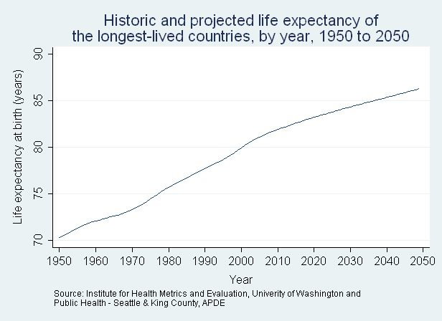
Average 81.8
2009
Australia
Canada
Finland
France
Hong Kong
Iceland
Israel
Italy
Japan
Macao
Norway
Spain
Sweden
Switzerland
US, 78.2
16 years

Slide 12
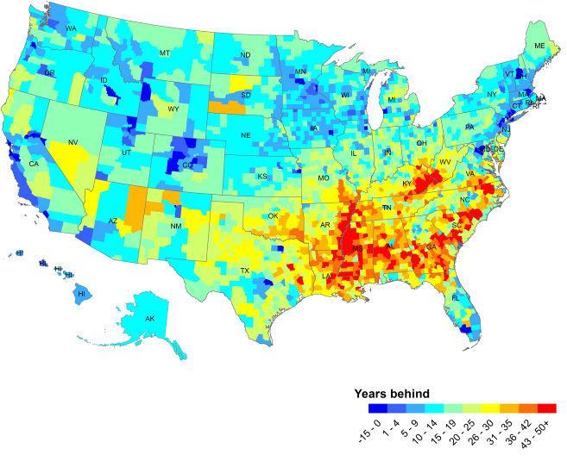
Life expectancy, by county, compared to the world’s 10 best countries
Notes:
12

Slide 13

Notes:
13
Simplify, two or three age categories with round number breaks
Add to 100 more easily

Slide 14
Health Measures Across King County
Obesity
8% - 35%
Uninsured
3% - 30%
Smoking
3% - 22%
Notes:
BRFSS data from 2006-2010, by Zip code with city boundaries
Notes: updated 1/12/2011
Shadings are relative to the KC Average,
Indicator (Adults 18+) KC Average dark red (highest) dark blue (lowest)
Obese 21% 6 to14% -13 to -9%
Uninsured 13% 8 to 17% -10 to -7%
Smoking 12% 6 to 10% -9 to -5%

Slide 15
Other key health issues with profound disparities
Access to Care
Risk Factors
Health Outcomes
  Uninsured
  Preventive Screenings
  Prenatal Care
  Dental Care
  Smoking
  Obesity
  Physical Inactivity
  Alcohol Misuse
  Infant Mortality
  Tuberculosis
  HIV
  Diabetes
  Asthma
  Injuries

Slide 16
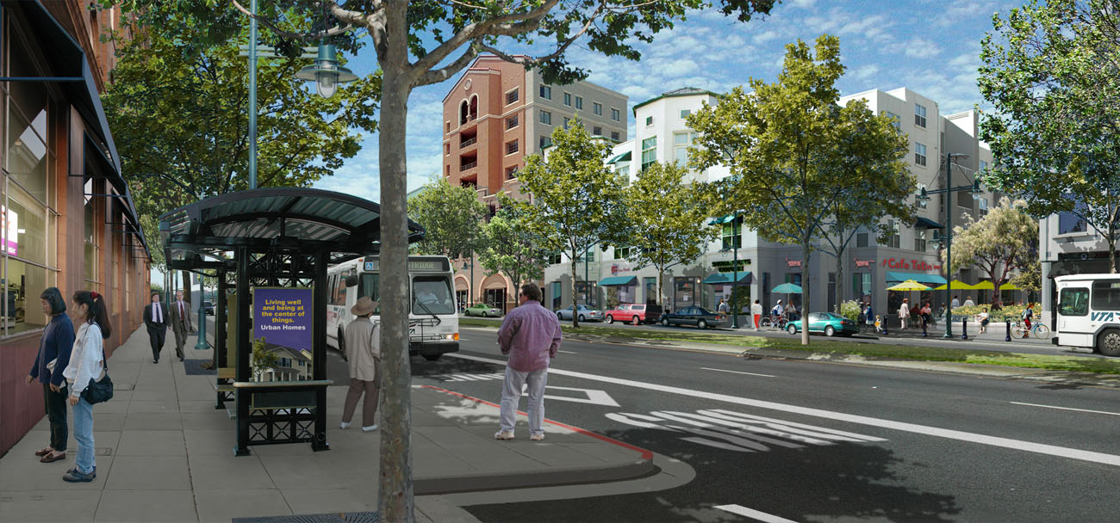
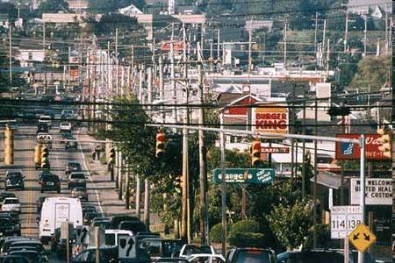
Can your neighborhood impact your health?
1/3 of women received a housing voucher to move to higher income neighborhoods
Over 10 years, obesity and diabetes rates improved compared to those who stayed behind
Health improvements were similar to diet and exercise programs or the use of medications to treat diabetes
Notes:
NEED PIX OF TWO NEIGHBORHOODS
A randomized study with 4500 women & children from poor neighborhoods in Northeast cities, Chicago and LA.
From 1994 through 1998, the Department of Housing and Urban Development (HUD) randomly assigned 4498 women with children living in public housing in high-poverty urban census tracts (in which ≥40% of residents had incomes below the federal poverty threshold) to one of three groups: 1788 were assigned to receive housing vouchers, which were redeemable only if they moved to a low-poverty census tract (where <10% of residents were poor), and counseling on moving; 1312 were assigned to receive unrestricted, traditional vouchers, with no special counseling on moving; and 1398 were assigned to a control group that was offered neither of these opportunities. From 2008 through 2010, as part of a long-term follow-up survey, we measured data indicating health outcomes, including height, weight, and level of glycated hemoglobin (HbA1c).
New England Journal of Medicine (2011) 365:16 1509 – 1519
"We didn't think of neighborhoods as having a health effect, but it turns out to have an effect in the ballpark of the size that we would see from medical interventions that address diabetes,"

Slide 17
Community traits and health effects
Community attribute | Health effect
Substandard housing | Asthma, respiratory problems, lead poisoning
Food deserts | Obesity, diabetes, heart disease, cancer
Lack of health care services | A host of preventable health problems
Lack of sidewalks, bike lanes, parks | Obesity, diabetes, heart disease, high stress
Density of alcohol and tobacco retail | Liver disease, motor vehicle death, injury; lung and heart disease
Notes:
Took out stuff and combined others.

Slide 18
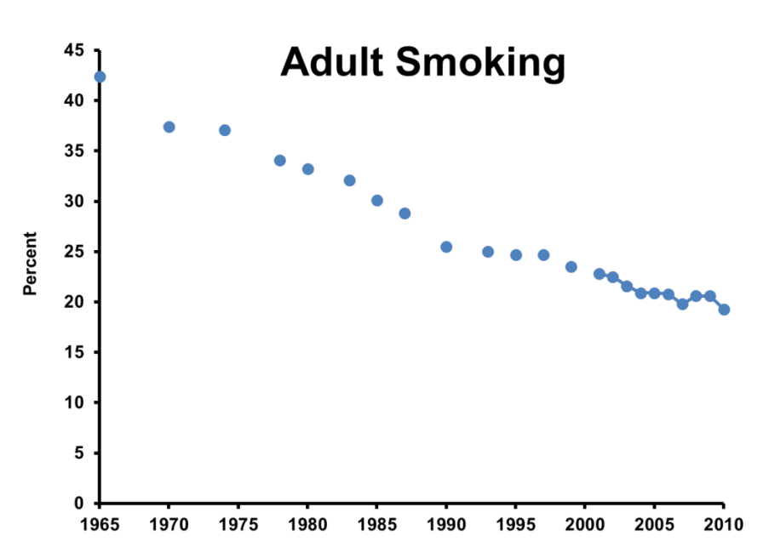
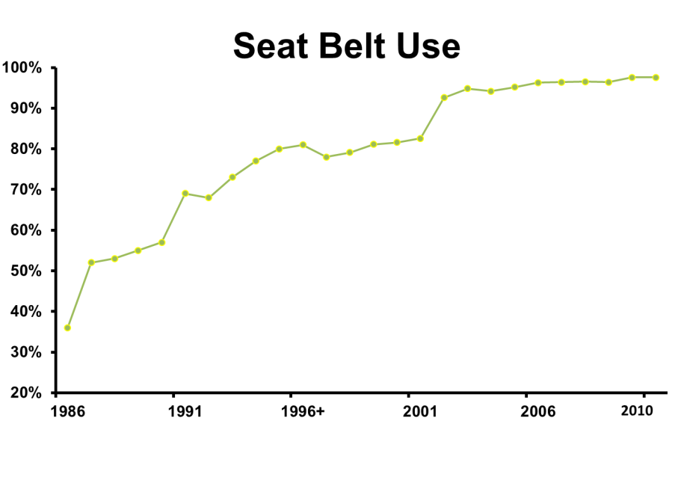
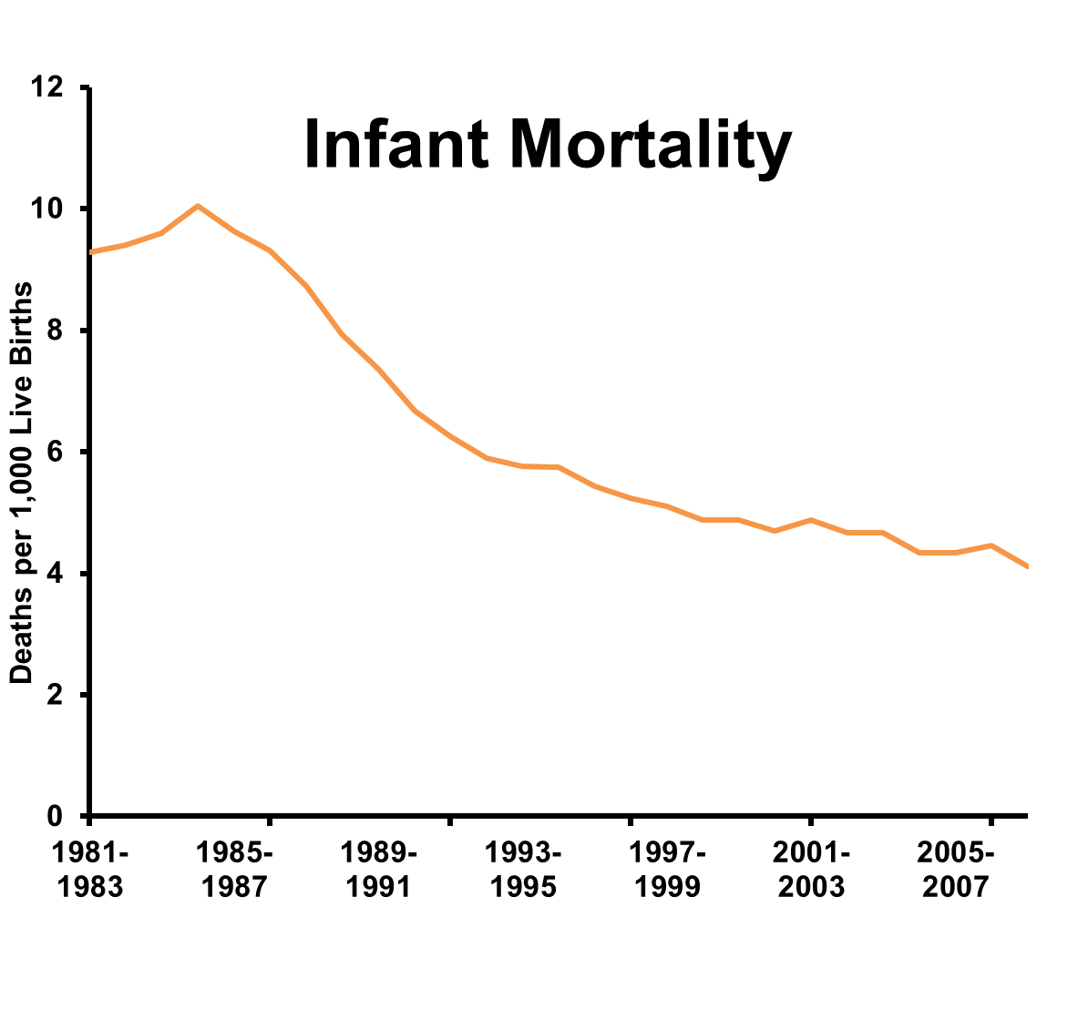
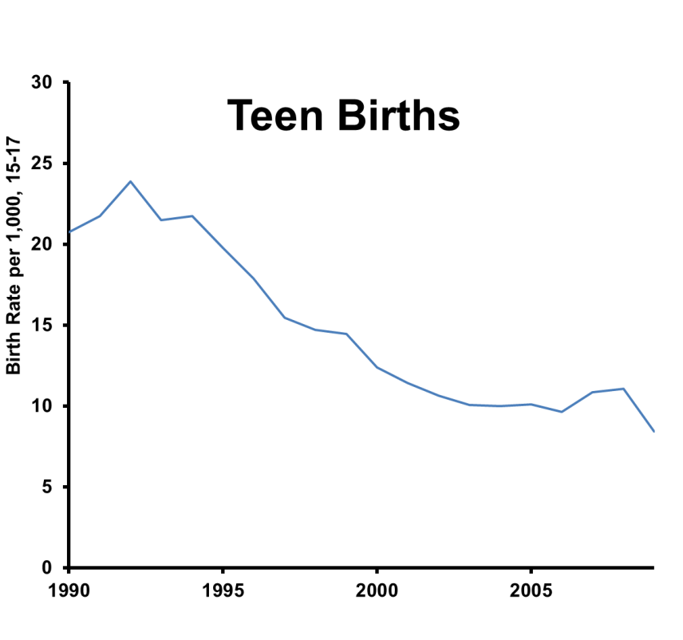
Is there evidence Public Health improves complex health problems?
Notes:
Adult Smoking: US
Seat belt use: Washington state
Infant mortality and Teen births: King County
Key footnote on seat belt: 6/13/02 primary seat belt law effective. Got to 83% with a secondary law and lots of education. It took a primary law, with enforcement and more education for us to get to that 98% current rate.
Notes and Sources:
Seat belt data from Injury Prevention Program, Washington Traffic Safety Commission
Adolescent Birth and infant mortality data from APDE
Tobacco: http://www.cdc.gov/tobacco/data_statistics/tables/trends/cig_smoking/index.htm National tobacco trend from CDC.

Slide 19
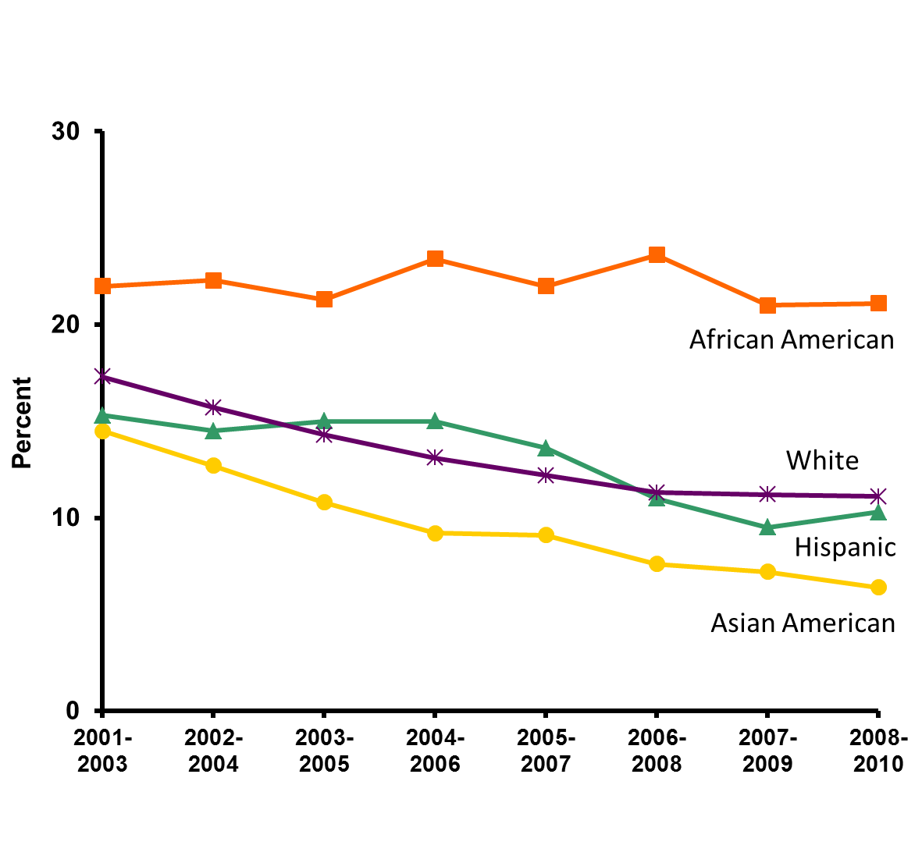
But disparities may persist
Adult smoking by race/ethnicity
Notes:
NEEDS TO BE COMPACTED – LESS HORIZONTAL
While smoking levels have continued to decline for White, Hispanic and Asian American residents of King County, smoking rates have remained stagnant for African Americans here.

Slide 20
How is King County doing compared to other large counties nationally?

Slide 21
White/African American King County vs. other largest US counties
Worst
1
5
10
Best 15
Smoking, 1.9
Diabetes, 2.1
Lower Educational Attainment, 1.5
Poverty, 3.5
Uninsured, 1.9
Lower Median Household Income, 1.9
Unemployment, 2.1
Ranking of Disparities – US Largest Counties
Obesity, 1.5
Life Expectancy, 1.1
Active Transportation, 1.4
Green circles = King County has the top 5 largest disparities for the indicator among the 15 largest US counties. Size of bubble proportional to Prevalence Ratio.

Slide 22
Disparities Across Equity Domains
African American residents
Worst
1
5
10
Best 15
Diabetes, 2.1
Lower Educational Attainment, 1.5
Smoking, 1.9
Poverty, 3.5
Uninsured, 1.9
Lower Median Household Income, 1.9
Unemployment, 2.1
Ranking of Disparities – US Largest Counties
Obesity, 1.5
Life Expectancy, 1.1
Active Transportation, 1.4
1.3 1.2 1.1 1.0 0.9 0.8 0.7 0.6
Worse than Average
Same as Average
Better than Average
King County African American Rate Compared to 15 County Average
Green circles = King County has the top 5 largest disparities for the indicator among the 15 largest US counties. Size of bubble proportional to Prevalence Ratio.

Slide 23
White residents
Worst
1
5
10
Best 15
Poverty, 3.5
Diabetes, 2.1
Lower Educational Attainment, 1.5
Smoking, 1.9
Lower Median Household Income, 1.9
Uninsured, 1.9
Unemployment, 2.1
Ranking of Disparities – US Largest Counties
Life Expectancy, 1.1
Obesity, 1.5
Active Transportation, 1.4
1.3 1.2 1.1 1.0 0.9 0.8 0.7 0.6
Worse than Average
Average
Better than Average
King County White Rate Compared to 15 County Average
Green circles = King County has the top 5 largest disparities for the indicator among the 15 largest US counties. Size of bubble proportional to Prevalence Ratio.

Slide 24
Insanity:
Doing the same thing over and over again and expecting different results.
Albert Einstein

Slide 25
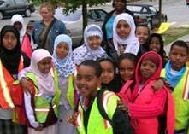
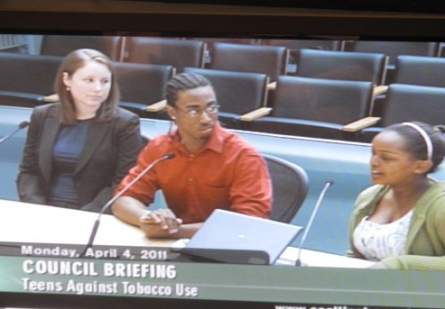
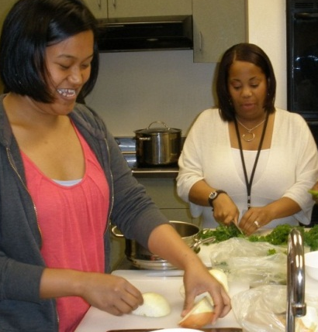
Doing something different to improve health in low income communities
Communities Putting Prevention to Work
Smoke-free housing, hospitals, mental health
Healthier food in schools, child care, senior programs
City complete streets policies
King County Strategic Plan and Equity & Social Justice
Global to Local
Community health worker training
Equity in all policies
Department commitments
Investment in high-need communities
Mobile technology
Job banks
Primary care in the community
Notes:
CPPW
Global 2 Local update
Equity and Social Justice Initiative
King County Strategic Plan, health in all policies
Value of working with non-traditional partners, common interventions

Slide 26

And we are seeing some early successes
In South Seattle & South King County:
122,000 children are eating healthier lunches in schools
70,000 SNAP recipients able to use benefits at 13 farmers markets
30 communities have healthier corner stores
359,000 people live in cities with new policies for safe, physical activity friendly streets
Notes:
Another options for “solutions,” could also build out a G2L slide
Photo options, CPPW, more photos in 11/7/11 federal reserve PPT, and on www.healthykingcounty.org

Slide 27
Health
improvement
Environmental
improvement
?
Economic development
Notes:
27

Slide 28



Community traits and health, economic and environment effects
Community attribute | Health | Economy | Environment
Food deserts | Obesity, heart disease, cancer | Fewer economically viable local businesses; fewer markets for local farmers | Less land use diversity; increased long distance transport of goods
Substandard housing | Asthma, lead poisoning | Lower home values, less worker and student productivity | Larger carbon footprint
Lack of bike paths, sidewalks | Obesity, diabetes, heart disease | Lower property values | Traffic congestion, poor air quality
Brownfields | Toxic exposures, Cancer | Unusable land; fewer business opportunities | Dead zones, pollution and toxic run off
Limited public transportation | Obesity, diabetes, stress, motor vehicle injury | Less access to jobs, shopping and education | Traffic congestion, poor air quality

Slide 29
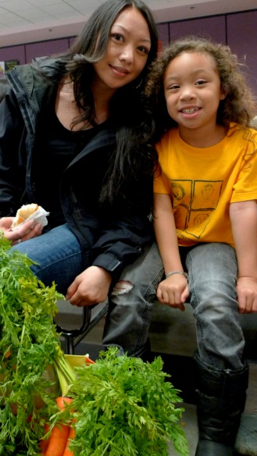
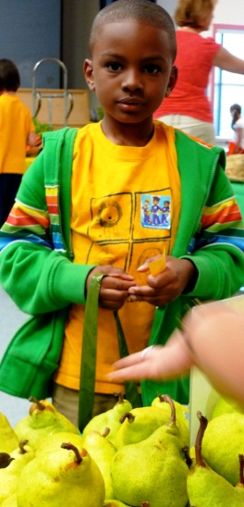
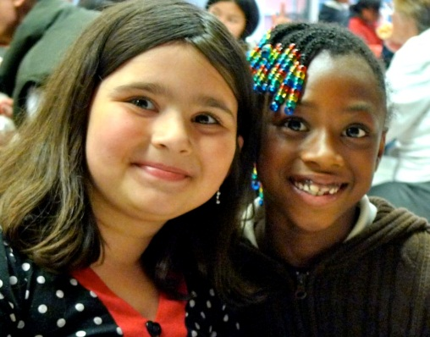
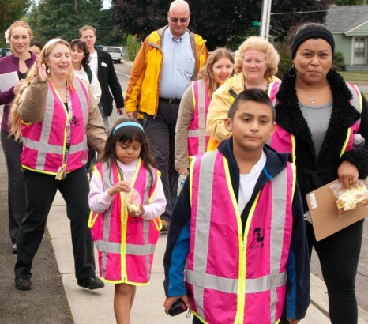
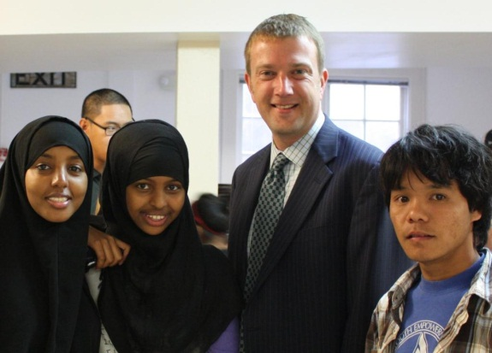
Summary
Disparities can change over time
Profound geographic disparities mean some in KC are 100 years apart
Disparities are linked to education, income and race
But solutions are fundamentally community-based
We have an opportunity in King County to make a difference because of our unique challenges
We need to do things differently (e.g. Equity & Social Justice, Communities Putting Prevention to Work, Global to Local)

