Slide 1

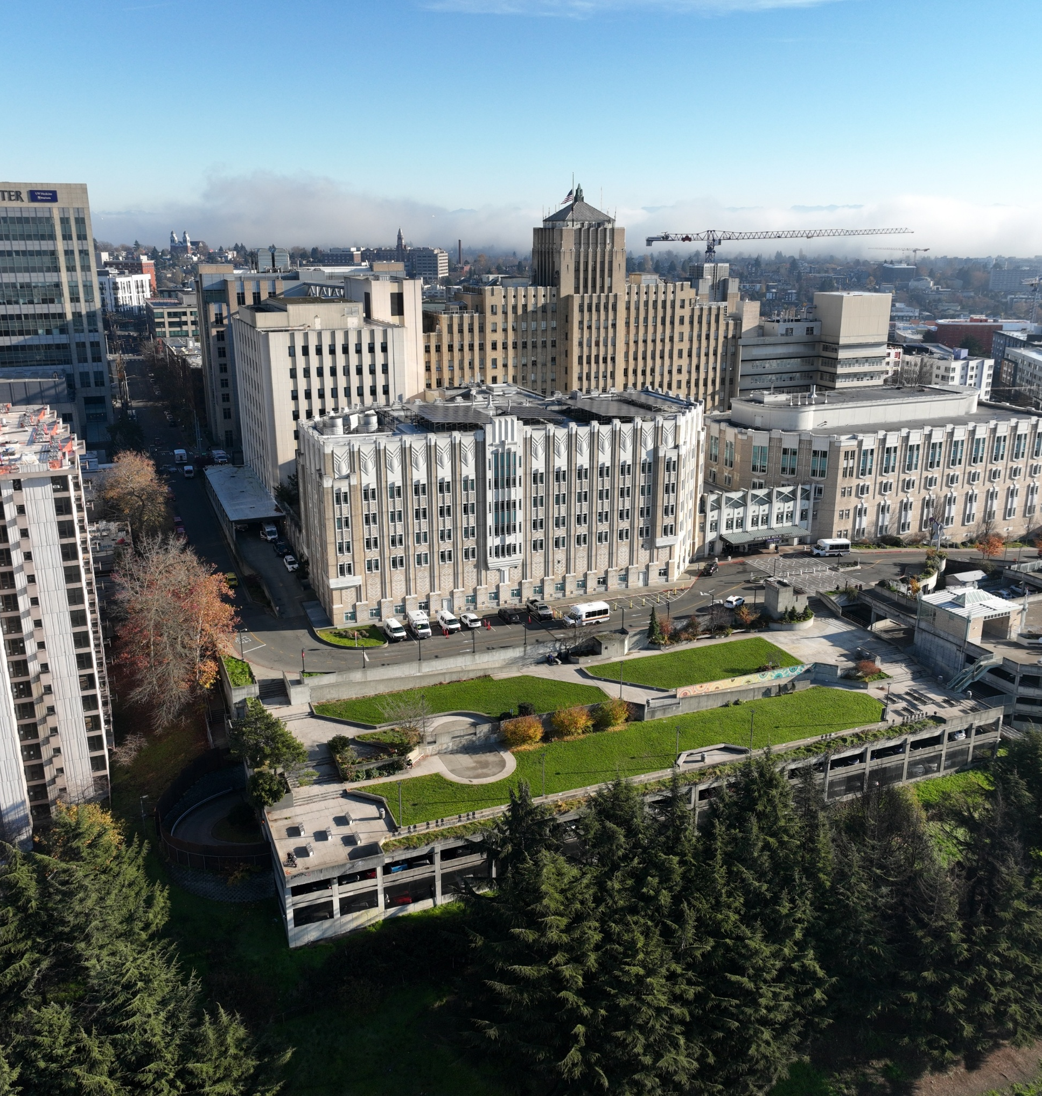
KingCounty.gov/Harborview
Harborview Bond Program WSDOT and Broadway Clinic Update – Committee of the Whole
March 24, 2026
Harborview campus,
overlooking new hospital
tower location

Slide 2
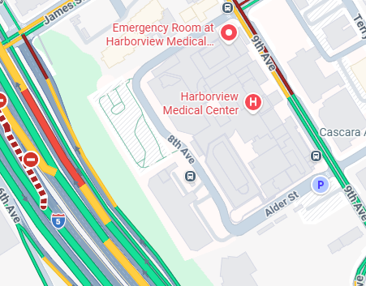
Background on WSDOT Right of Way
The property immediately west of the New Tower site and immediately east of I-5 is owned and controlled by WSDOT.
WSDOT states no need for future use, and the property exists on an extreme grade, making other uses unlikely.
However, access to the site for construction is needed and a small portion of the property is also needed for an access road.
Initially WSDOT was concerned about the loads placed onto the I-5 retaining wall.

Slide 3
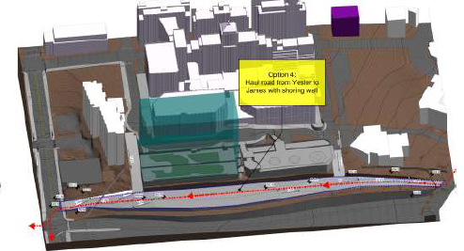
WSDOT Right of Way Access – Haul Road
To execute the construction at the planned new tower site, a temporary “haul road” will need to be built connecting Yesler St. to James St.
This assumes that materials and empty trucks (for excavation) will need to enter the site from the south and exit to the north where they can exit back onto I-5. These conversations will need to be finalized between the Design-Builder and the City of Seattle SDOT.
KC and WSDOT are in negotiations for a temporary lease for this portion of the right of way.

Slide 4
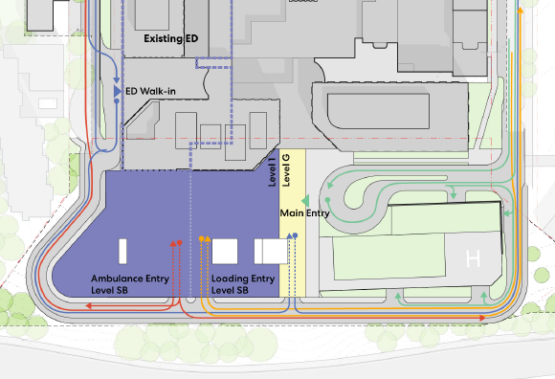
WSDOT Right of Way Access – Loop Road
To provide for ambulance, patient, and visitor access to the new tower site, a loop road will be assumed as part of the design efforts.
The project would need access to approximately 30 feet of the WSDOT property running north to south.
This acquisition will require a long-term lease between KC and WSDOT; negotiations have begun.

Slide 5
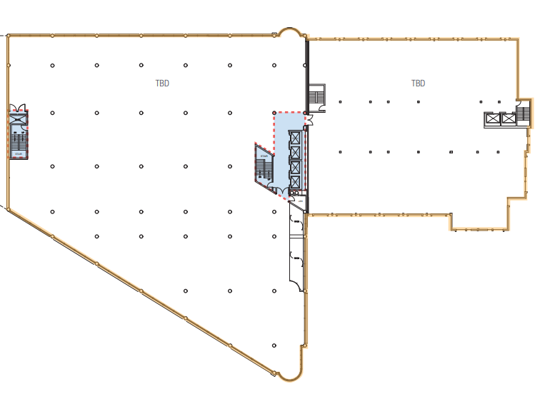
Bond Program Use of the Broadway Clinic
Harborview Medical Center is actively evaluating the potential use of the Polyclinic space in response to significant campus space constraints as construction begins with preparation for building of the tower.
Given the complexity of this opportunity, including operational considerations and currently undefined costs, a comprehensive analysis is underway.
Harborview leadership appreciates the time for thoughtful evaluation required to fully assess this option, with a goal of reaching an occupancy decision by the end of summer 2026.
North Building
14,000 square feet/floor
South Building
14,000 square feet / floor

