Slide 1

2027 Sewer Rate Proposal
Regional Water Quality Committee
March 4, 2026

Slide 2
Disclaimer
Materials and scenarios presented here are purely intended to illustrate potential impacts over time and do not represent, imply, or establish any plan, commitment, or intent by the Wastewater Treatment Division (WTD).

Slide 3
Agenda
Calendar
Assumptions and challenges for 2027
WTD’s Recommended Rate
Rate Forecast and Financial Analysis
Affordability Efforts
Summary and Next Steps
3

Slide 4
2027 Sewer Rate Process Calendar
Agency | Date | Briefing
Executive Budget Office | 1/29/2026 | 2027 WTD Preliminary Sewer Rate Proposal
RWQC | 2/4/2026 | 2027 WTD Preliminary Sewer Rate Proposal
MWPAAC R&F | 2/5/2026 | 2027 WTD Preliminary Sewer Rate Proposal
MWPAAC Gen | 2/25/2026 | 2027 WTD Preliminary Sewer Rate Proposal
E-Team | 2/26/2026 | 2027 WTD Sewer Rate Proposal
RWQC | 3/4/2026 | 2027 WTD Sewer Rate Proposal
MWPAAC R&F | 3/5/2026 | 2027 WTD Sewer Rate Proposal
Executive | 3/19/2026 | 2027 WTD Sewer Rate Proposal
MWPAAC Gen | 3/25/2026 | 2027 WTD Sewer Rate Proposal
Executive | 3/26/2026 | Tech Memo due to the Executive
RWQC | 4/1/2026 | Discussion on potential letter on sewer rate
MWPAAC R&F | 4/3/2026 | Discuss potential letter to KC Council
KC Council | 4/24/2026 | Executive transmits 2027 Rate Proposal to Council
MWPAAC Gen | 4/23/2026 | Action on potential letter to KC Council
RWQC | 5/6/2026 | Briefing Only
Budget and Fiscal Mgmt Committee | 5/28/2026 | Discussion Only
RWQC | 6/4/2026 | Briefing Only
Budget and Fiscal Mgmt Committee | 6/11/2026 | Possible Action
KC Council | 6/17/2026 | Consideration/Possible Adoption
KC Council | 6/24/2026 | Consideration/Possible Adoption (backup date)
Approval Required by: | 7/1/2026
4

Slide 5
Challenges
Operational cost increases
  Chemicals, electricity and labor
Convergence of challenges in capital program
  Big three drivers – regulatory, asset management and capacity
  Higher construction costs
  Concurrent deadlines, stacking problem
Lower risk projects already deferred to reduce rate increases
Compounding effect from multiple double-digit increases is the main impact to customer affordability
5

Slide 6
Bottom Line Up Front
Draft WTD rate proposal and forecast prioritizes regulatory compliance, limits rate increase forecast through 2034
Alternative scenarios that shift project timing have modest value
  Deferred asset renewal/replacement and capacity projects - adds risk of failure, risk of compliance or both
Beyond just a ‘when’ question
  Combined Sewer Overflow (CSO) consent decree, National Pollutant Discharge Elimination System (NPDES) permit, anticipated nutrient regulations
  Requires successful negotiations, process may take some time
WTD continuing to undertake variety of cost management efforts
6

Slide 7
2027 Rate Scenario Development
Operating expenditure assumptions for 2027 are consistent with the 2026 adopted rate and associated forecast; outyear assumptions for inflation and growth also remain the same.
Budget proviso requires two additional scenarios to complement the Executive’s 2027 rate proposal.
  One scenario must be at least 2% less than the official Executive proposal. Executive Work Plan also requires another scenario and associated tradeoffs. Scenarios presented are illustrative. Executive has not yet proposed an official rate.
Inflation and schedule risk adjustment assumptions in the Capital Improvement Program (CIP) remain constant. Since last year, WTD is using schedule risk adjustment to more accurately reflect capital expenditures.
Scenarios assume WTD will maintain strong financial policies to minimize cost of debt.
7

Slide 8
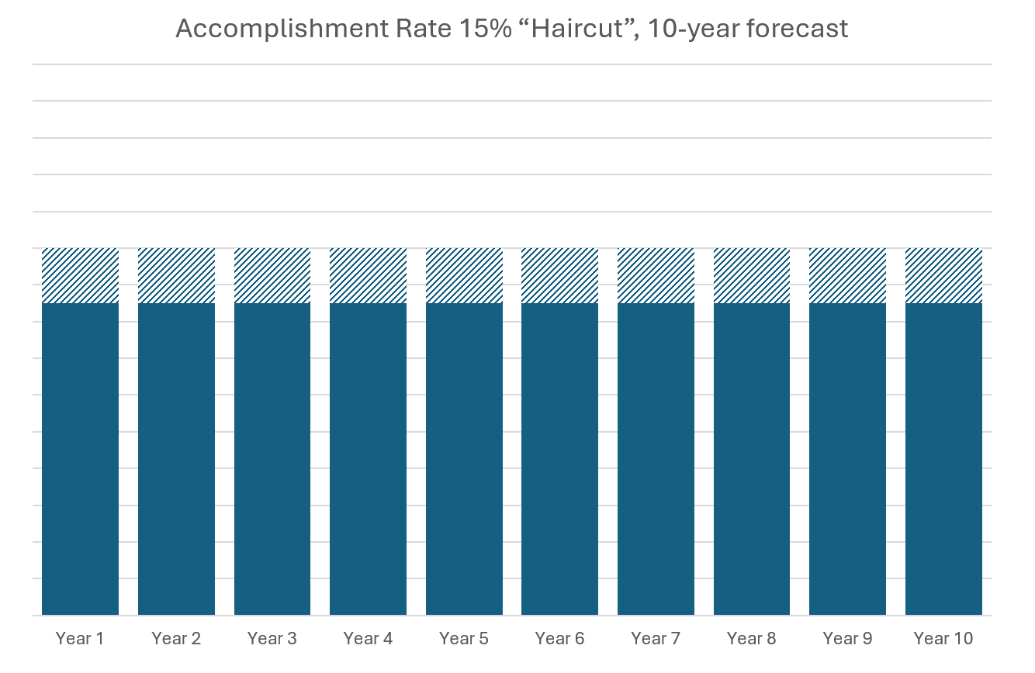
Assumptions for 2027 – Schedule Risk Adjustment vs Accomplishment Rate
Prior to the 2026 rate process (in 2025), WTD utilized an 85% accomplishment rate on the capital forecast input to the sewer rate model to attempt to reflect the tendency to overestimate capital expenditures in a given year.
Project forecasts are adjusted downward in all years
(represented by )
Result is that adjusted amount is removed from forecast period
8

Slide 9
Assumptions for 2027 – Schedule Risk Adjustment vs Accomplishment Rate
Since 2026, WTD has shifted to using a 20% schedule risk adjustment factor on non-regulatory projects to more accurately reflect the fact that capital projects tend to spend all of their budget, they just tend to spend it in later years than initial forecasts.
Project forecasts are adjusted downward in early years
(represented by )
9

Slide 10
Capital Scenarios Summary
*The draft WTD proposal is very similar to the forecast projected at the time of the 2026 rate adoption but starts to differ significantly towards the end of the 6-year period.
10

Slide 11
Major Changes in Current State from 2026 Adopted Sewer Rate Forecast
Project/Program | 2026-2036 Impact
Minor Asset Management Programs | + $490M | Annual forecasts increased as part of 2026/2027 Budget Submittal decisioning
Sammamish Plateau Diversion | + $460M | Prelim Gate 2 estimate in Oct 2025
Elliott West WWTS | + $320M | Gate 3 approved June 2025
East Ship Canal CSO Program | + $270M | ROM estimate for combined alternative
South Magnolia Supplemental Compliance Project | + $235M | Identified in options analysis
South Plant Electrical Improvements | + $170M | Charter approved July 2025
Lake Hills Trunk/NW Sammamish Interceptor Upgrade | + $110M | Revised 90% estimate reflected in May 2025 forecast save
Brightwater Aeration Basin No. 4 | + $85M | Revised conceptual estimate from Treatment Planning Program
Confidential - For Internal Discussion Only
11

Slide 12
Seattle area construction costs have outpaced inflation
Source for Seattle-area and national CCI: Engineering News-Record
Source for CPI (All Items): Federal Reserve Bank of St. Louis
Confidential - For Internal Discussion Only
12

Slide 13
Capital Efficiency and Transparency Measures
Facility programs: Dedicated facility-based delivery teams; reduces learning curve and provides increased coordination with O&M
Procurement Improvements: Programmatic contracts to reduce procurement volume; expanded contractor outreach to increase competition; dashboards to identify and resolve bottlenecks
Real-Time Project Information: Continuously improving project information system (PRISM) combining nightly accounting data with team reporting for real‑time status, schedule, and cost visibility
Cost Estimating: Formulation program for early conceptual estimates; standardized Basis of Estimate documentation; continue to build in-house estimating capability
Responsiveness and Transparency: Long range capital forecast; clearer rate communication; increased engagement with MWPAAC
Confidential - For Internal Discussion Only
13

Slide 14
WTD Proposed Capital Portfolio Assumptions
Regulatory (50% of 1st Decade Forecast)
  Prioritize meeting known regulatory requirements: CSO Consent Decree, Lower Duwamish, West Point Treatment Plant NPDES permit
  Funds nutrient reduction evaluation and near-term optimization strategies, but not large-scale nitrogen reduction
  Does not fund any other potential regulation (PFAS, other CECs, etc.)
Asset Management Conveyance and Plants (27% of 1st Decade Forecast)
  Addresses the highest risk asset renewal and replacement needs – major asset, poor condition, larger scale cost (>$5M)
  Includes funding (about $80M per year) to address small scale asset replacements that do not require major system overhauls
14

Slide 15
WTD Proposed Capital Portfolio Assumptions
Capacity (15% of First Decade Forecast)
  Prioritizes capacity projects (conveyance system and treatment plants) that are driven by population growth
  Deprioritizes conveyance system projects due to inflow and infiltration in first decade, shifts those to second decade forecast
All Other Portfolio Categories (e.g., Resource Recovery, Op Enhancements, etc.) (8% of First Decade Forecast)
  Prioritizes system planning (RWSP Update, Conveyance System Improvements, Treatment Planning, Climate Adaptation Planning, etc.)
  Prioritizes cost-efficient investments to meet climate action goals in the near-term
  Defers investment in seismic resiliency to the second half of the 1st decade and beyond
  Does not invest in projects to address climate resiliency of existing system
15

Slide 16

Regulatory required investment is a key rate driver
Current State Capital Forecast
By Portfolio Category
Regulatory projects – and the state and federal requirements that drive them – are the largest driver of the current sewer rate increases. Changing this requires modification of regulatory and consent decree requirements.
2037 CSO Consent Decree Deadline
Asset management projects represent minimal opportunity to modify the rate and the greatest risk if deferred. Risks include overflows, sinkholes, equipment damage, permit violations, and life safety hazards.
16

Slide 17
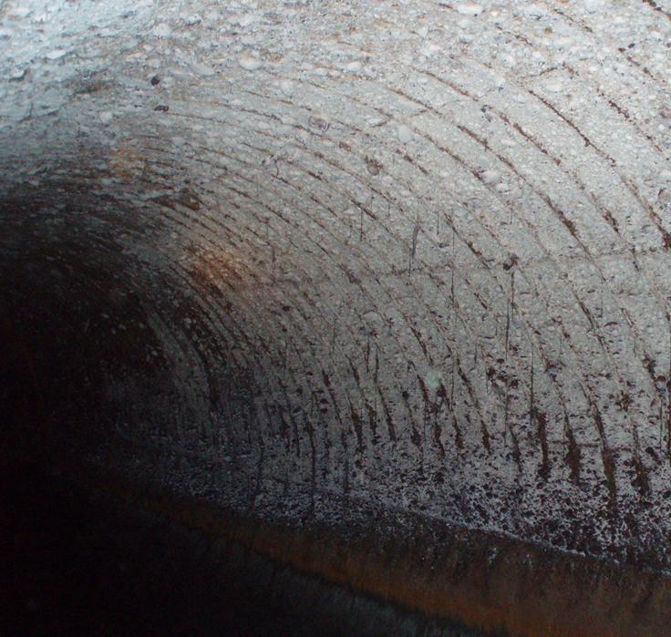
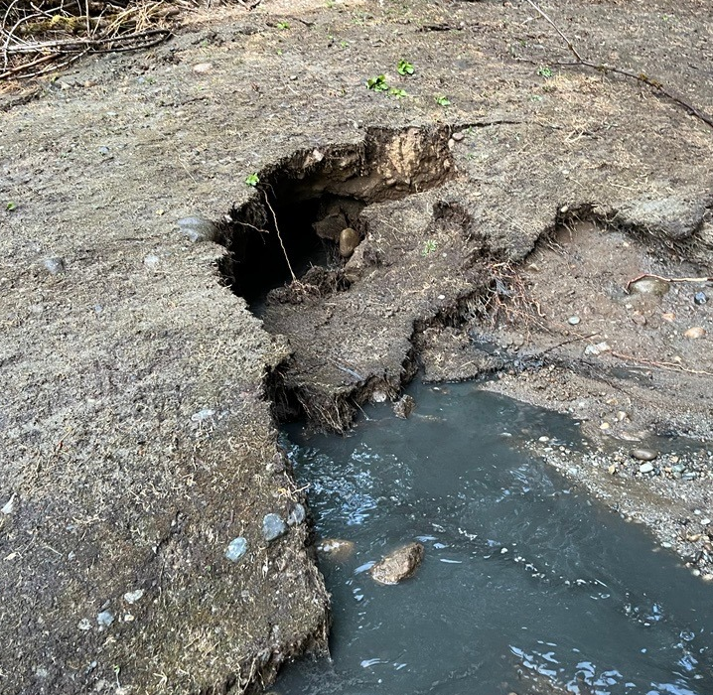
Deferred investment in aging assets increases risk of catastrophic failures
Example: Unaddressed corrosion will cause pipeline failure resulting in sinkholes and raw sewage overflows
Future Implications
Some equipment and piping across the system are operating beyond useful life.
Further deferral increases the risk of sudden failures, with significant consequences.
Impacts to safety, human health, water quality, and higher response cost.
South Interceptor (Renton, located under I-405)
Heathfield Force Main (Bellevue)
17

Slide 18
WTD’s Recommended Rate
18

Slide 19
Draft WTD Proposal prioritizes regulatory compliance, needed asset renewal and replacement, and addresses capacity needs
Benefits:
Current State Capital Forecast*
By Portfolio Category
This capital forecast positions WTD to meet regulatory deadlines, proactively replace some of the most critical assets prior to failure, and avoid building moratoria driven by insufficient capacity.
Implications & Risks:
Asset Reliability and Safety, System Capacity, and Financial Risk
Still defers some AM projects identified as being in poor to very poor condition. Risks include overflows, sinkholes, equipment damage, permit violations, and life safety hazards.
Defers I/I driven capacity projects with low levels of service, risks include sewer overflows
Deferrals affecting asset remaining useful life and condition also poses risk to credit ratings
Regulatory Compliance Risk
Includes significant investments (50% of 10-year CIP) to meet regulatory milestones
Confidential - For Internal Discussion Only
19

Slide 20
Rate Impacts – WTD’s Recommended Rate
2026 Rate Forecast:
2027 WTD’s Recommended Rate Forecast:
20

Slide 21
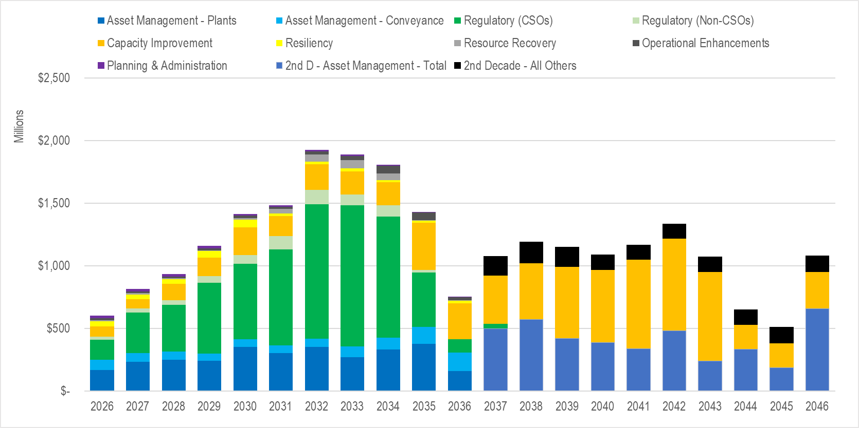
20-Year WTD’s Recommended Rate Capital Forecast by Portfolio Category
1st Decade (‘26-’36): $14.2B
2nd Decade (‘37-’46): $10.3B
Known Unknowns, e.g.:
Nutrient regulations and costs
Contaminants of emerging concern
Other CSO cost updates
Significant uncertainty
21

Slide 22
Breakdown of forecasted $815M of capital spend in 2027
Capital Projects with Largest Forecasted 2027 Spend by Portfolio
Regulatory (44%)
Mouth of the Duwamish CSO ($200M) – Pre-Design/Land Acquisition
West Duwamish Wet Weather Storage ($40M) – Construction Awarded
Joint Ship Canal Water Quality Program ($25M) – Nearing Completion
Elliott West Wet Weather Treatment Station ($20M) – Final Design
Asset Management – Plants & Conveyance (38%)
West Point Electrical Improvements ($90M) – Preliminary/Final Design
Interbay Force Main & Odor Control ($20M) – Mid-Construction
Capacity Improvement (9%)
Coal Creek Siphon & Trunk Parallel ($30M) – Mid-Construction
Sammamish Plateau Diversion ($20M) – Preliminary Design
Notes:
Note for presenter: The status/phase indicated next to each project is current as of 2/2026 and not the forecasted status/phase of the project in 2027

Slide 23
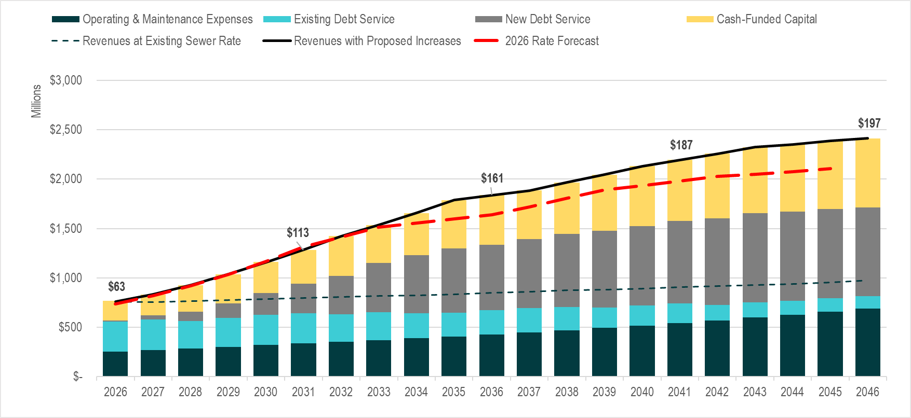
Revenue Requirement
2027 Rate: $70.65
32%--O&M
37%--Existing Debt Service
5%--New Debt Service
25%--Cash-Funded Capital
23

Slide 24
Alternative Scenarios
24

Slide 25
Council Request scenario accepts higher additional risk of asset failure and some financial risk, would shift costs out
Benefits:
Forecast Balancing to 10.75% Rate Increase
Offers lower near-term rate increase relative to the Draft WTD Proposal
Assumptions to balance to ceiling:
Keep CSO and other near term regulatory investments on current timeline
Defer Nutrient Reduction Optimization
Further defer high risk Asset R&R projects
Further defer capacity projects
Further defer proactive seismic investments
Further defer other County goals like Climate Change
Implications & Risks:
Asset Reliability and Safety Risk
+ System Capacity Risk
Requires deferral of approximately $1.4B of planned investment out of the first decade
Deferrals in this scenario would impact asset replacement and capacity projects resulting in increased likelihood of detrimental impacts such as overflows, sinkholes, equipment damage, permit violations, and life-safety risks
Regulatory Compliance Risk
Meets existing regulatory milestones (uncertainty remains around future nutrient requirements in operating permits)
Financial Risk
Future Borrowing: introduces additional risk of rating downgrades and higher cost of borrowing
Confidential - For Internal Discussion Only
25

Slide 26
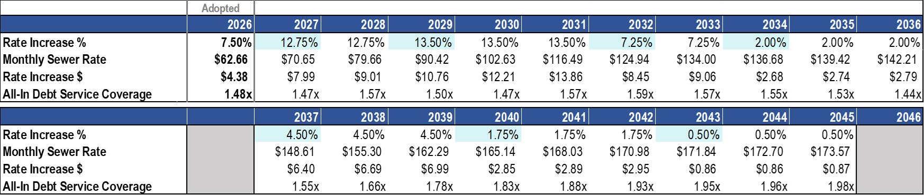
Rate Impacts – Council Request
2026 Rate Forecast:
2027 Council Request Rate Forecast:
26

Slide 27
Theoretical Regulatory Deadline Extension Disclaimer
Regulatory deadline extension scenario is illustrative only
Successful negotiations with state and federal regulators would be needed to implement a scenario like the Regulatory deadline extension
Potential penalties for violating consent decree include:
  increased future borrowing costs
  civil contempt sanctions
  injunctive relief
  criminal contempt proceedings
WTD has not yet determined order/timing of projects that would best fit environmental quality and financial sustainability

Slide 28
Theoretical Regulatory Deadline Extension adds compliance and financial risk, assumes successful renegotiation of regulatory requirements
Benefits:
Regulatory Deadline Extension Scenario: 20-year Forecast by Portfolio Category
With Illustrative CSO Completion Milestones
Offers lower near-term rate increase relative to the Draft WTD Proposal
Implications & Risks:
Asset Reliability and Safety Risk & System Capacity Risk
Risk and implications remain the same for this criteria as the WTD Proposed scenario
Capacity upgrade projects remain on same timeline as Current State scenario, posing moderate risk
Regulatory Compliance and Financial Risk
Regulatory compliance projects are no longer assumed to meet established deadlines
Additional risks include:
  future borrowing costs
  civil contempt sanctions
  injunctive relief
  criminal contempt proceedings.
Confidential - For Internal Discussion Only
28
Notes:
Caveats that need to be added to slide deck
Assumptions-12.75% is not executive recommended rate, make it clear
Mess w/titles—CH to do
For official sewer rate proposal
CH to add Op Ex slide – why doesn’t it work?
Create slide to demonstrate why financial policy changes don’t impact the rate path

Slide 29

Rate Impacts – Theoretical Regulatory Deadline Extension
2026 Rate Forecast:
2027 Theoretical Regulatory Deadline Extension Rate Forecast:
29

Slide 30
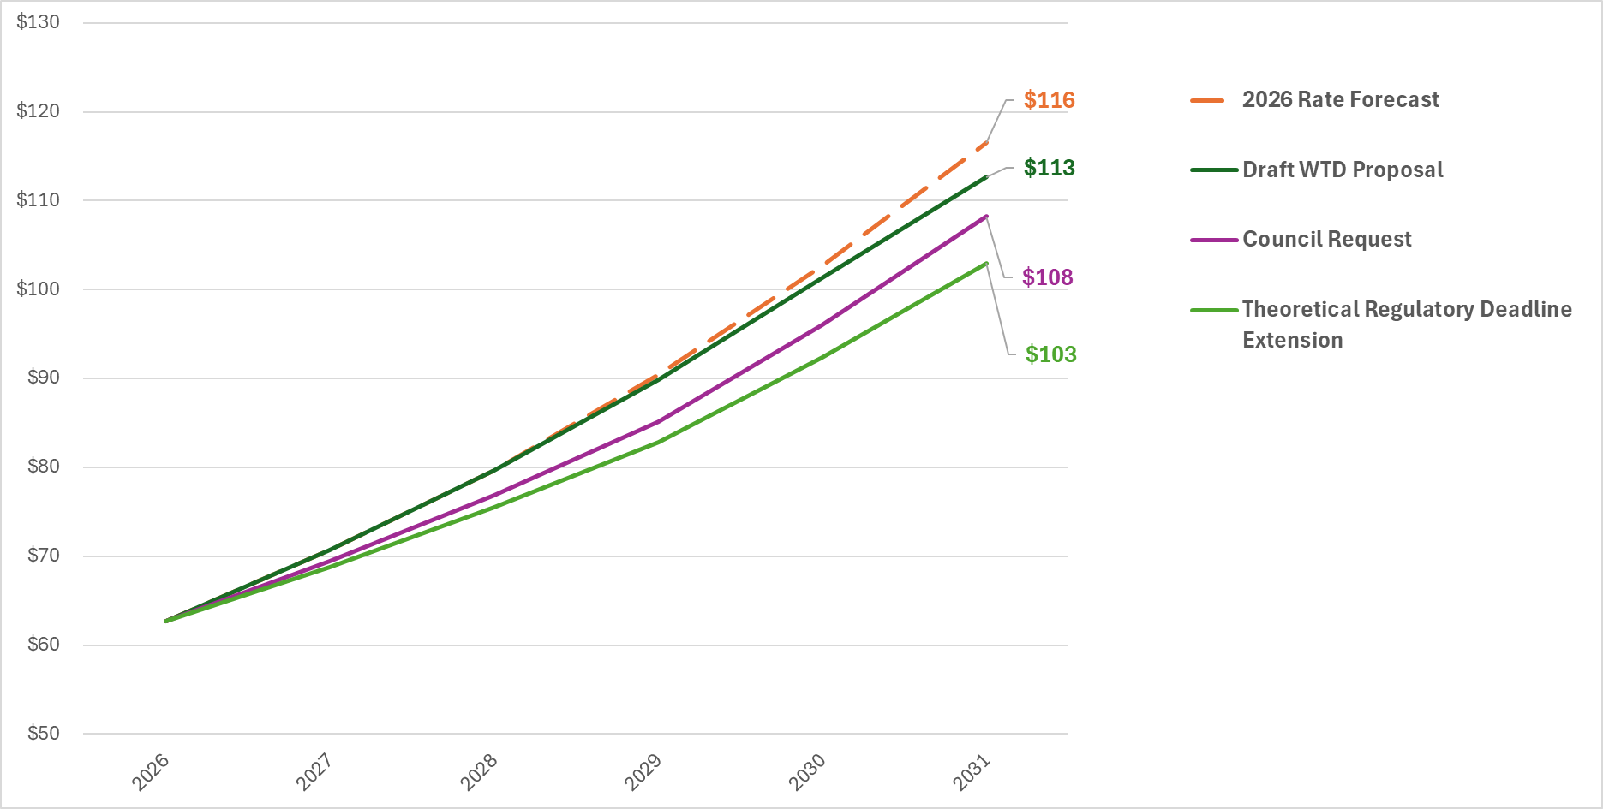
Scenario Rate Paths (Next 5 Years)
30

Slide 31
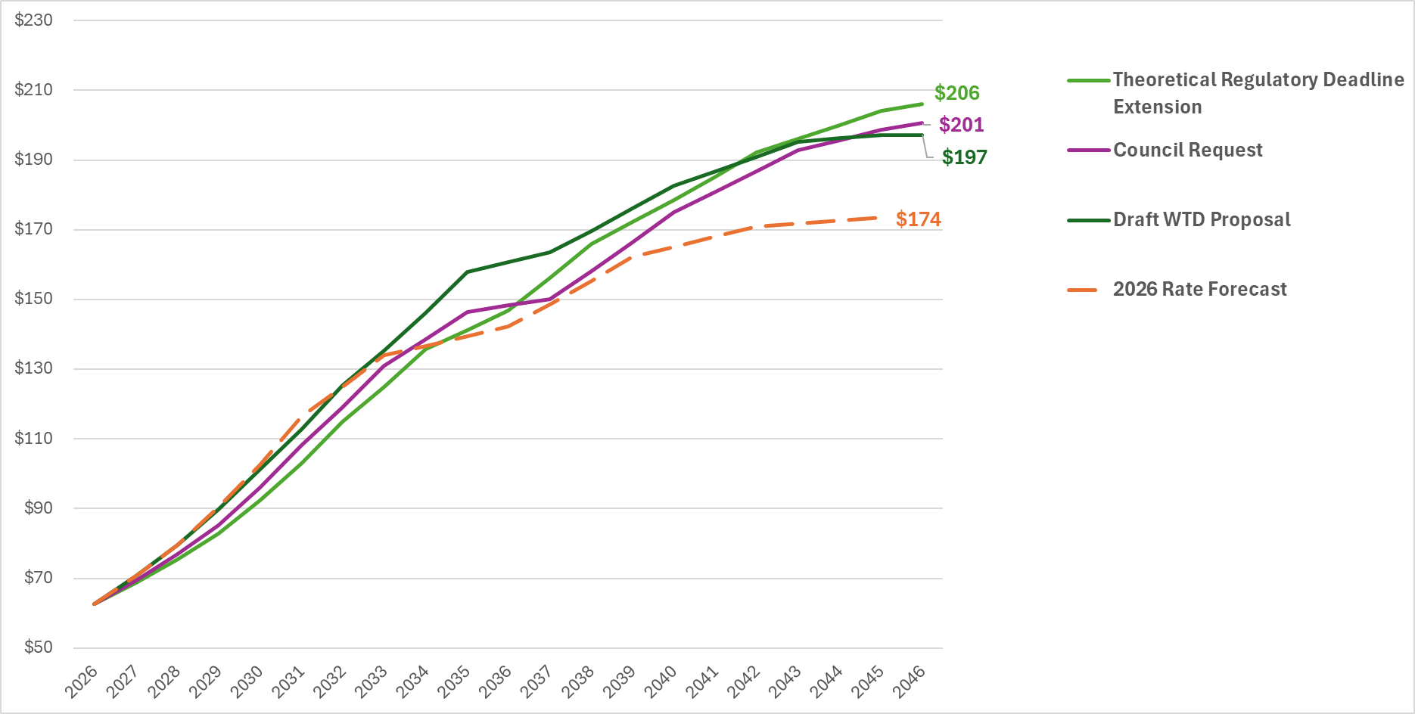
Scenario Rate Paths (20-Years)
31

Slide 32
Cost Management
Improved transparency, cost containment initiative, overhead reductions
Implement proviso and motion requirements (Increased reporting, third party oversight, etc.)
Continue to pursue lower interest financing (SRF, WIFIA, etc.)
Affordability
Define and measure affordability
RWSP update process
Nutrient Reduction Financial Capability Analysis
Work with National Association of Clean Water Agencies
Low-Income Household Water Assistance Program, WIFIA protection
Capacity charge payment plan program and low-income assistance
32

Slide 33
Summary and Next Steps
Draft WTD rate proposal and forecast prioritizes regulatory compliance, limits rate increase forecast through 2034
Alternative scenarios that shift project timing have modest value
  Risk of equipment or facility failure, and/or risk of compliance, increases if further defer asset renewal/replacement and capacity projects
Review CSO consent decree, NPDES permit, anticipated nutrient regulations, and pursue negotiations with regulators
Next Steps
  March 5 – MWPAAC R&F
  March 25 – MWPAAC GEN
  April 1 - RWQC
33

Slide 34
Q & A

Slide 35

Conclusion with logo

