Slide 2
Investment Bank Serving Sustainable, IT, & Middle Market Companies
Cornerstones of Cascadia Capital
Deep Domain Expertise Industry group heads have unique insight from actually working in their industries: Managing companies Acquiring/selling businesses Raising capital Selling to accounts Venture startups | Investment Banking Expertise Seasoned team from top-tier investment banks Over $1 billion of capital raised Over $1 billion of M&A deals completed | Strong Relationships Dedicated coverage effort of private equity firms, hedge funds and VCs Active dialogues with leading companies and consolidators within the relevant industries Unique relationships with top executives across all industries
Services Offered
Mergers & Acquisitions
Corporate Finance
Strategic Advisory
Project Finance
Sell-Side Representation
Buy-Side Representation
Minority & Majority Recapitalizations
Management Buyouts
Private Equity Placements
Debt Financings
Public Company Capital Raises
Strategic Financings
Restructurings
Shareholder Value Analysis
Corporate Valuations & Fairness Opinions
Transaction Execution
Debt & Equity Raising
Project Structuring
Refinancing
Industry Focuses
Alternative Energy
Cleantech
Internet New Media
IT
Business Services
Consumer
Distribution
Industrial
1

Slide 3
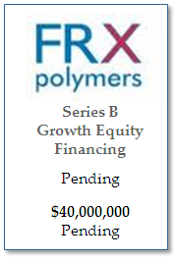




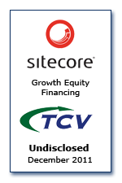
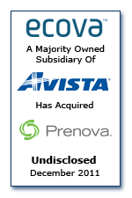
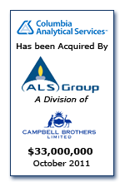

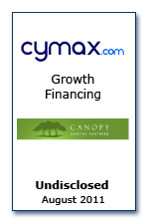
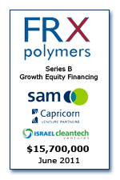

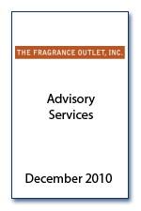
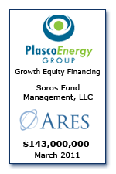
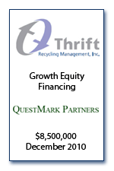
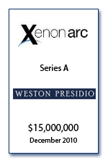
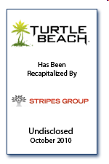

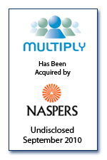
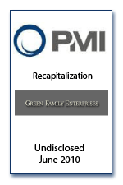



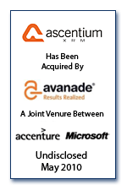

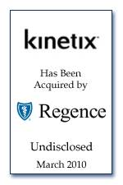




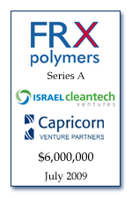
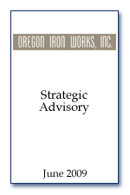

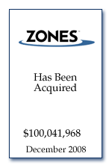
Strong Track Record Maximizing Value, Speed and Certainty
Equity Financing
2
Notes:
2

Slide 4

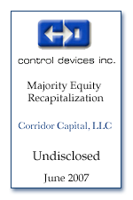
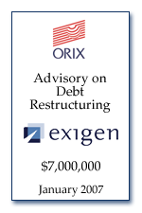
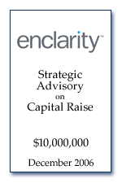
Full Service Firm
Representative Services
Select Recent Transactions
Mergers &
Acquisitions
Sell-side representation
Buy-side representation
Minority & majority recapitalizations
Management buyouts
Over $1bn of recent transactions
Corporate
Finance
Private equity placements
Debt financings
Public company capital raises
Strategic financings
Over $1bn of recent transactions
Strategic
Advisory
Services
Restructurings
Shareholder value analysis
Corporate valuations & fairness opinions
Public company takeover defense services
3
Notes:
3

Slide 5
Emphasizing the Importance of Every Mandate
Strong Alignment
Conflict free model enabling firm to serve as a trusted and objective advisor
Commitment to clients to establish mutual alignment
In Depth Preparation
Upfront diligence prior to engaging in the transaction process
Research-quality analytics and comprehension
Unique analyses and client positioning
Disciplined Execution
Proprietary insight through ongoing dialogue with industry consolidators and sources of capital
Senior attention throughout the transaction process
Focused teamwork across entire banking team
Consistent Results
Integrity and accountability in all client engagements
Strong track record of delivering value to our clients
Proven success in closing mandates
4
Notes:
4

Slide 6
Why Cascadia?
Diversified Boutique
Senior experienced team dedicated to the client
Conflict-free model ensures objective advice
Diversified platform provides stability
Deep Domain
Expertise
In-depth knowledge of renewable energy and cleantech ecosystem
Ability to tailor message to individual investors and strategics
Access to all classes of financial investors
Multi-level relationships with key strategics
Proprietary insight through ongoing dialogue with industry consolidators and sources of capital
Broad Relationships With Financial Investors & Strategics
Leading Private Placement Franchise
Broad distribution network maximizes reach
Proven execution expertise enhances certainty
World class M&A Expertise
Strong Sell-side and Buy-side track record
Proven ability to maximize value for clients
5
Notes:
5

Slide 7


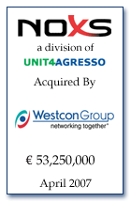



Helping Companies in All Stages of their Lifecycle
Company Size
Early Stage
Growth Stage
Public
6
Notes:
6

Slide 8
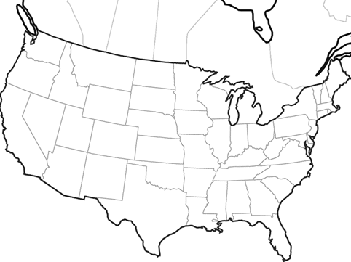
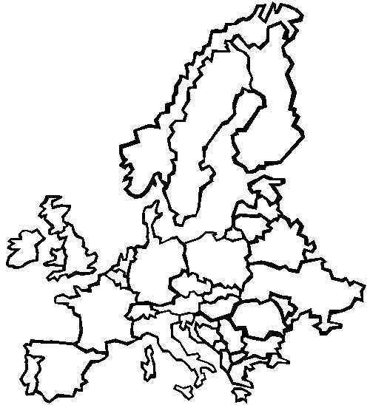
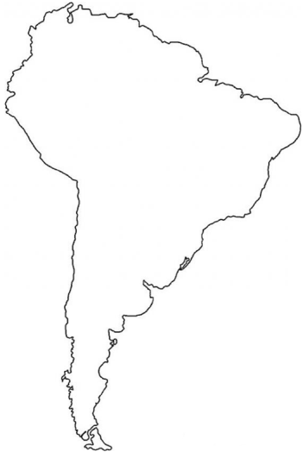
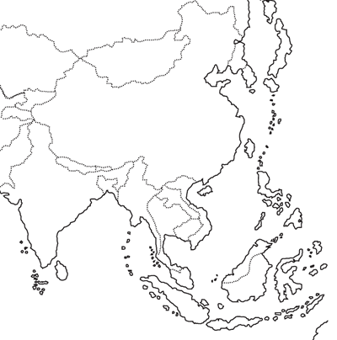
Global Reach and Perspective
Cascadia Capital has the reach to access corporate buyers and to penetrate global capital markets
Closed deals and active mandates
7
Notes:
7
7

Slide 9
Cascadia Alternative Energy/Cleantech Group Overview
8
8
The Cascadia Cleantech Group has spent the past five years forging relationships with stakeholders within the sustainability movement:
  Private and institutional investors
  Companies at all levels of maturation (pre-revenue to public)
  Public Sector
The Group has been primarily focused on advising early to mid-stage companies in financing and M&A transactions
Cascadia has represented clients in closed transactions within an array of sectors:
  Energy Efficiency
  Smart Grid
  Solar
  Materials
  Carbon Emissions
  Wind
  BioFuels
  Storage
  Renewable Energy

Slide 10
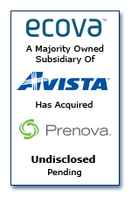
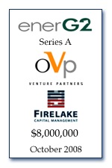
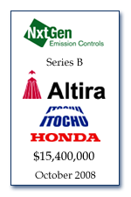
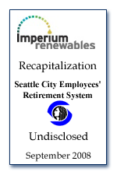

Recent Alternative Energy/Cleantech Closed Deals
Equity Financing
$20,000,000
Early and recognized thought leader in this rapidly evolving space
One of the most experienced teams focused entirely on the Alternative Energy and Cleantech Sectors
Deep network of relationships with industrials, utilities, capital markets and policy makers/influencers
Full Suite of advisory services
9

Slide 11
Cascadia Sustainable Industries Focus Areas
Renewable Energy
Industrial Technologies
Energy Efficiency
Smart Grid
Water
Transportation
Wind
Solar
Geothermal
Woody Biomass
Waste to Energy
Wave/Tidal/Hydro
Fuel Cells
Natural Gas
Anaerobic Digestion
Green Materials
Green Chemicals
Power Electronics
Emission Control
Environmental Testing
Solid State Lighting
Lighting Controls
In-Building Management Systems
Power Optimization
Energy Infrastructure
Grid Management
Intelligent Network Components
Software/IT Applications
Demand Response
Energy Storage
Remediation
Treatment
Purification
Agriculture
EV/PHEV/ Alternative Fuel
Battery Chemistries
Power Management
Advanced Biofuels
Logistics / Infrastructure
Natural Gas (CNG / LNG)
One of the most experienced teams focused exclusively on the alternative energy and cleantech markets
10
Notes:
10

Slide 12
Cascadia Capital’s Sustainable Industries Team
Michael Butler, Chairman & CEO
Michael Butler is Chairman and the CEO of Cascadia Capital. Prior to co-founding Cascadia Capital, Michael served as a Managing Director at Lehman Brothers responsible for global equity sales and equity syndication. He also served on the firm's Equity Commitment Committee, Equity Syndicate Committee and Private Equity Commitment Committee. Prior to his work with Lehman Brothers, Michael served as a Principal with Morgan Stanley & Company where he was responsible for divisional global product and risk management and was a member of the division's Operating Committee. He has been involved in numerous equity financing transactions for both public and private companies. Michael holds a B.A. in Political Science from the University of Washington and an M.B.A. in International Finance from the Wharton School of the University of Pennsylvania.
Jamie Boyd, Managing Director
Jamie Boyd is Managing Director at Cascadia Capital where he is responsible for group initiatives in the sustainable practice area (alternative energy and clean technology related industries) as they relate to all aspects of capital formation, M&A, project finance, and corporate finance related transactions. Jamie has advised in the sustainable industries arena since the group's inception at the firm over five years ago. Prior to joining Cascadia Capital, he was a corporate lawyer with the international law firm Dechert LLP. Boyd holds an L.L.M. from New York University School of Law, a J.D. from Gonzaga University School of Law and a Bachelor of Commerce and Business Administration from the University of British Columbia.
Mike Maruhashi, Vice President
Mike Maruhashi develops and manages the firm’s venture capital relationships, working closely with the Industry Practice Groups and Product Groups to ensure that they are kept abreast of capital markets activity. Mike’s focus has been on the Sustainable Industry sectors. Mike brings more than twenty years in the investment industry including experience in the investment departments of Peoples National Bank, Rainier National Bank, and Security Pacific Bank where he worked with both institutional and high net worth individuals. Mike also brings deep experience in both the equity and debt capital markets, having served for nine years as Vice President at US Bancorp Piper Jaffray. Mike holds a B.A. in Communications from the University of Washington.
Alexis Broadbent, Senior Associate
Alexis Broadbent is a project finance specialist. Prior to joining Cascadia Capital, Alexis worked at Macquarie Bank in London and has acted as financial advisor on 20 project finance transactions. He has experience in the major sectors of project finance, including energy generation, transport, social infrastructure, Public Private Partnerships, and projects in emerging markets. Alexis holds an LL.B. in English Law and French Law from Manchester University, UK and the University of Bourgogne, France.
Drew Laxton, Senior Associate
Drew Laxton is an associate who focuses on the sustainable industries. Prior to joining Cascadia Capital, Drew worked at Barclays Capital in their Global Natural Resource division and has acted as advisor on numerous financing and M&A transactions in the oil and natural gas industry. Prior to his work at Barclays, he worked as a commercial and industrial credit analyst for Regions Bank where he focused on a wide breadth of industries ranging from food services to transportation. Drew holds a B.S. in Finance from Louisiana State University and an M.B.A. from Rice University.
Kyle Montgomery, Analyst
Kyle Montgomery is an analyst who focuses on sustainable industries. Kyle develops financial models and performs company valuations. Kyle also researches industry trends and companies in the sustainable industries. Kyle Montgomery graduated from Jamestown College, North Dakota in May 2010 with a B.A. in Accounting & MIS.
11
11

