Slide 1

Harborview Challenges and Priorities
Harborview Medical Center
2026

Slide 2
Harborview’s Mission
Harborview Medical Center is owned by King County, governed by the Harborview Board of Trustees, and managed under contract by the University of Washington.
Harborview Medical Center is a comprehensive healthcare facility dedicated to the control of illness and the promotion and restoration of health. Its primary mission is to provide healthcare for the most vulnerable residents of King County; to provide and teach exemplary patient care; to provide care for a broad spectrum of patients from throughout the region; and to develop and maintain leading – edge centers of emphasis. As the only Level I Adult and Pediatric Trauma Center in Washington, Harborview Medical Center provides specialized comprehensive emergency services to patients throughout the region and serves as the disaster preparedness and disaster control hospital for Seattle and King County.
The following groups of patients and programs will be given priority for care:
Persons who are non-English speaking poor
Persons who are uninsured or underinsured
Persons who experience domestic violence
Persons who experience sexual assault
Persons incarcerated in King County’s Jails
Persons with mental illness, particularly those treated involuntarily
Persons with substance abuse
Persons with sexually transmitted diseases
Persons who require specialized emergency care
Persons who require trauma care
Persons who require burn care
Harborview’s patient care mission is accomplished by assuming and maintaining a strong leadership position in the Pacific Northwest and the local community. This leadership role is nurtured through the delivery of health services of the highest quality to all of its patients and through effective use of its resources as determined by the Harborview Board of Trustees.
Harborview, in cooperation with UW Medicine, plans and coordinates with Public Health Seattle and King County, other County agencies, community providers, and area hospitals, to provide programs and services.
Harborview fulfills its educational mission through commitment to the support of undergraduate, graduate, post-graduate and continuing education programs of the health professions of the University of Washington and other educational institutions, as well as programs relating to patient education.
Harborview recognizes that the delivery of the highest quality of healthcare is enhanced by a strong commitment to teaching, community service and research.

Slide 3
A Changing Landscape: Implications for Harborview’s Mission, Access, and Sustainability
Reimbursement Cuts
Projected $700M+ in reimbursement reductions through FY31 due to federal and state healthcare cuts
Coverage and Service Changes
Harborview uninsured increased nearly 3% between FY25 and FY26 YTD (Every 1% additional uninsured means about $8M less revenue annually)
Decrease in transfers that help subsidize services with lower reimbursement
Capacity Constraints
A space-constrained campus limits our ability to meet patient demand and grow—exacerbated during construction of tower

Slide 4
Harborview 2025 County Hospital Levy Operating Support at Work
In 2025, the County Hospital Levy provided $46 million in crucial operating support for Harborview to be spent during Harborview’s 2026 fiscal year. These dollars are currently at work supporting 265 FTE in the following subset of areas providing care for our most vulnerable:
Primary care clinics at Harborview: International Medicine, Pediatric, Senior Care, Family Medicine, and Adult Medicine Clinics
Off campus clinics: Hobson Place, Pioneer Square Clinic, 3rd Avenue Center for Primary Care, Madison Clinic, Downtown Programs
Behavioral health and psychiatry, including: inpatient psychiatry, inpatient psychiatric ICU, and psychiatric emergency services

Slide 5
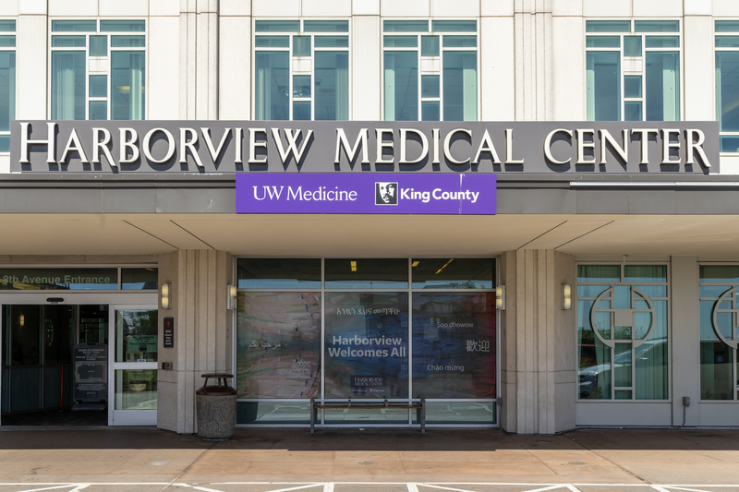
Harborview 2025 County Hospital Levy Operating Support Spotlight: International Medicine Clinic
Comprehensive primary & mental health care for refugees/immigrants (16+)
Full access to UW Medicine specialty & hospital services
Community House Calls program for in-home and follow-up care
On-site pharmacy: prescriptions, travel medicine, immunizations
Patient care coordination: insurance, appointments, system navigation
Cultural mediators, multilingual staff + interpreter services across many languages
11,999 visits completed in FY25

Slide 6
Harborview 2025 County Hospital Levy Operating Support Spotlight: Downtown Programs
Healthcare
in Housing
RNs, providers, and mental health staff embedded in local supportive housing units with partners DESC and Plymouth Housing
3,715 visits in FY25
Healthcare for the Homeless
RNs, providers, and mental health staff embedded in homeless shelters throughout the city.
2,523 visits in FY25
Palliative Care for the Homeless
Mobile, trauma-informed palliative care for people with serious illness, delivering team-based support across shelters, encampments, and supportive housing and receiving referrals from King County
314 visits in FY25

Slide 7
Harborview 2025 County Hospital Levy Operating Support Spotlight: Behavioral Healthcare
The 2025 County Hospital Levy supports clinicians and staff providing care at a subset of behavioral health services at Harborview, including:
Inpatient psychiatry: Provides inpatient psychiatric stabilization for patients with complex behavioral health needs, including those needing assistance with mental illness on a voluntary or involuntary basis for crisis stabilization. 1,138 patients in FY25.
Inpatient psychiatry intensive care unit: High-acuity inpatient psychiatric care for patients requiring the highest level of supervision, behavioral intervention and support. 494 patients in FY25.
Psychiatric emergency services (PES): providing rapid evaluation, stabilization, and crisis intervention for patients experiencing acute mental health and substance use emergencies 24/7.
Downtown Programs field-based mental health team: Field-based teams that provides psychotherapy, medication monitoring, case management, crisis response and follow up, discharge planning support, and patient and system advocacy. 314 visits in FY 25.

Slide 8






2026 – 2027 County Budget Harborview Provisions
We are grateful for King County’s 2026–2027 budget, which provides critical funding to support Harborview and helps mitigate the impacts of a rapidly changing healthcare landscape with critical operating and capital support. The budget:
Increases County Hospital Tax from 10 to 15 cents
Funds new building for Pioneer Square Clinic
Provides additional funds to support the Prop 1 Bond Program
Funds operations and provides additional support to mitigate Medicaid cuts
Supports critical infrastructure projects
Funds design and permitting of a parking solution that includes a medical office building, which would address parking and space shortages due to construction of new tower

Slide 9
2026-2027 Additional Harborview Capital Priorities
Harborview’s Board approved near-term capital strategy focuses on expanding clinical capacity on a constrained campus and advancing essential precursor projects for the new tower. That is why Harborview seeks authorization for two additional capital projects in the 2026–2027 budget through supplemental legislation:
New infusion center and consolidated neurosciences floor to maintain services that will be impacted by the Bond project and to grow to meet demand
New parking facility to enable the start of tower construction and address future parking shortages

Slide 10
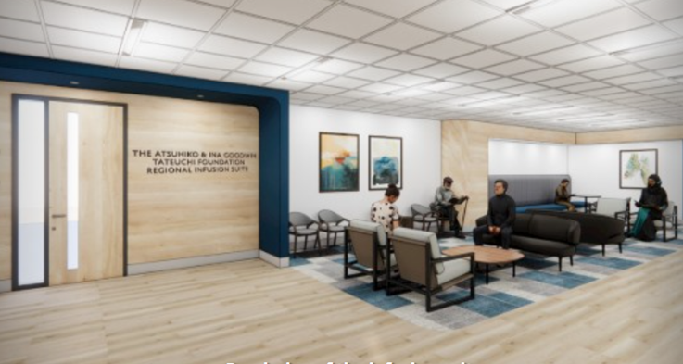
Maintain & Expand Access to Infusion and Neurological Services for All Patients
A renovated floor on the 13th floor of the Ninth & Jefferson Building will replace capacity that will be lost in tower construction, improve access, streamline care, and triple infusion capacity for Harborview patients with neurological diseases and other conditions.
Approximately 2/3 of the patients served by our Neurosciences Clinic and our Infusion Center have Medicare or Medicaid insurance
Reduce waitlist of 700+ patients and meet increasing patient demand, including for Alzheimer’s infusion drugs.
Raised $8.5 million in philanthropic donations to date to offset cost of project
Atsuhiko Tateuchi Foundation Regional Infusion Suite Design Rendering

Slide 11
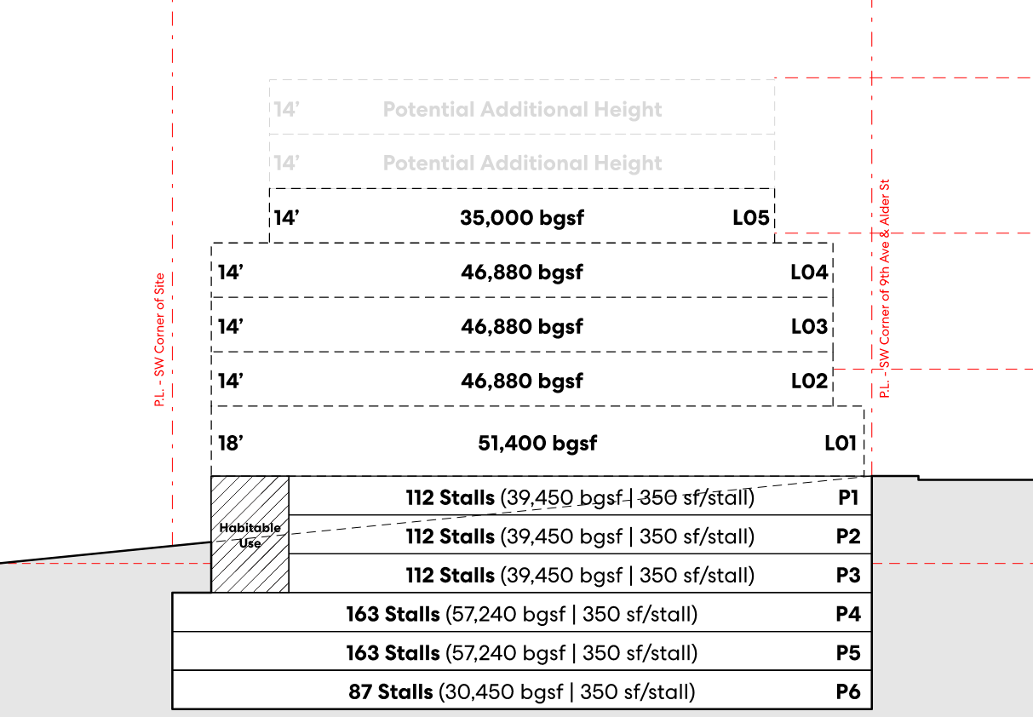
Parking to Support Harborview Campus Access through Bond Program Campus Changes
Harborview is collaborating with the Executive’s Office Bond Team to develop a proposal for construction funding to complete the 9th and Alder parking structure, a critical enabling project for the new tower that preserves patient and family access.

