Slide 1
Public Health – Seattle & King County
Financial Update
Aaron Rubardt, Chief Budget Officer
Michael Gedeon, Chief Administrative Officer, PHSKC
May 5, 2026
Health, Housing & Human Services Committee
King County Council
Notes:
*Amharic, Arabic, Chinese (Sim, Tra), Korean, Russian, Somali, Spanish, Tagalog, Ukrainian, Vietnamese

Slide 2
Countywide Perspective on Public Health Fiscal Outlook
General Fund and Hospital Services Agreement (HSA) in 2025 Budget
  Removed $25M of General Fund support for clinics, leaving the existing $5M from HSA
  Amended HSA added $23M for a total of $28M per year for mission population services in 2025-2027
Better Governance Executive Order
  Base budget review
  Staffing Management Plans and Cost Control Plans for distressed funds

Slide 3
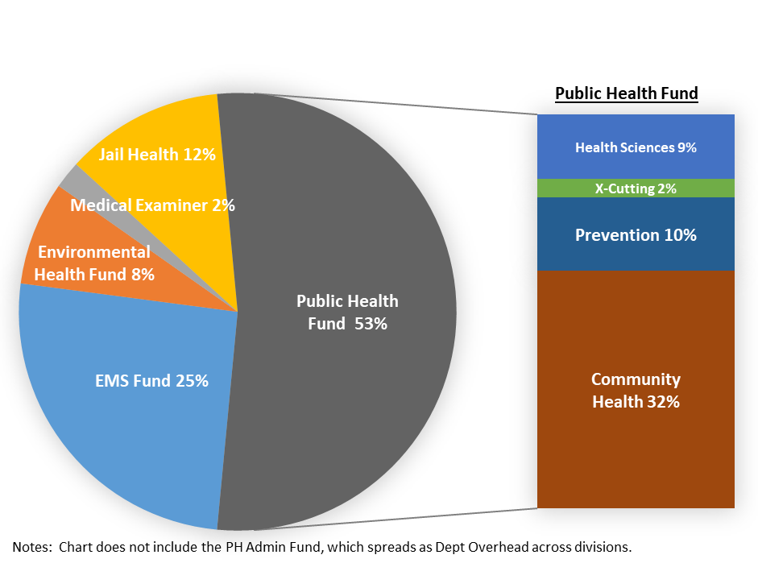
Total $1.2B Adopted 2026-27 Budget
PH Fund Expenditures
$631 M
PH Fund Revenue $585 M
General Fund

Slide 4
Public Health Fund Long-Term Drivers
Long-Standing Structural Gap for Foundational Services and PH Center Services
Removed Hospital Services Agreement Funding Starting in 2028
Expected Impacts from Federal & State Funding
Notes:
Federal uncertainty continues
Medicaid impacts from more stringent work reporting requirements and decreased enrollment
Continue to face the risks of federal grant funding as the new administration change grant priorities and attempts to impose unacceptable conditions to the grant funding (e.g,. HRSA)
State impacts
Likely FPHS reduction. 21 M across the state. Will know in July the amount for us
HB 2442 revenue options including providing counties that ability to impose a public health clinic tax.

Slide 5
Core Population-based Services (Foundational) | Public Health Center Services | Other Programs & Services (Examples)
Access to Health Care Services Assessment, Communications, Policy, & Community Partnerships Chronic Disease, Injury and Violence Prevention Emergency Preparedness Maternal/Child/Family Health Prevention and Control of Communicable Disease Vital Records | Community Health Services Division Dental Care Healthcare for the Homeless Network Maternal Child Health (Direct Services) Pathways for Opioid Use Disorder Primary Care (inc. Mobile Medical) School-based health centers Sexual Reproductive Health Prevention Division Tuberculosis Sexual Health/HIV/STI | Child Care Health Consultation (BSK) Children with Special Health Care Needs Community Health Centers Help Me Grow (BSK) Family Ways Gun Violence Prevention Infant Mortality Prevention Network (BSK) Overdose Prevention Screening for Breast and Cervical Cancer
Public Health Fund Programs & Services
Notes:
This chart illustrates the breadth of programs and services in the PH Fund
The first column are core programs and services many of which do not get much public attention until there is a crisis.
The middle column highlights the services associated with the PH Centers in both the CHS and Prevention Divisions.
The last column shows examples of other priorities.
Note that the operating gap primarily impacts the first two columns

Slide 6
PH Fund Operating Gap per 26/27 Budget (millions)
Updates:
Revising projection based on analyzing actuals vs budget.
Expect the operating gap to be lower but the trajectory to be the same.
Notes:
This chart shows the operating gap based on the adopted 2026-27 budget.
We will soon have an updated projection of the operating. The good news: As we work with the Budget Office to analyze actuals for the past several years, the indications are that the operating gap will be less. However, while the bars may be shorter, the trajectory due to the structure gap won’t change.
It also shows that the gap exists both for the PH Centers and core population-based services. (Rough estimate of the split)

Slide 7
Executive Order efforts including base budget review to identify potential savings; continue efforts to improve programs and reduce costs
Prepare for impact from changes to Medicaid (e.g., work requirements, lower enrollment)
Respond to federal actions that threaten grant funding and to state funding reductions
Review with Executive Office revenue tools from the last legislative session and develop proposals
Update operating gap forecast based on Executive Order efforts
Prepare proviso report due at the end of this year on financial outlook and options
Public Health Fund Sustainability Efforts
Notes:
Priority for Dr V:.
Priority from Day One to understand our budget and where our funding is going.
Aligns with Exec Order
Have had in-depth meetings to review our budget and spending trends to not only orient her but also work through her questions and ideas for possible savings.
Note the proviso report and timeline

