Slide 1
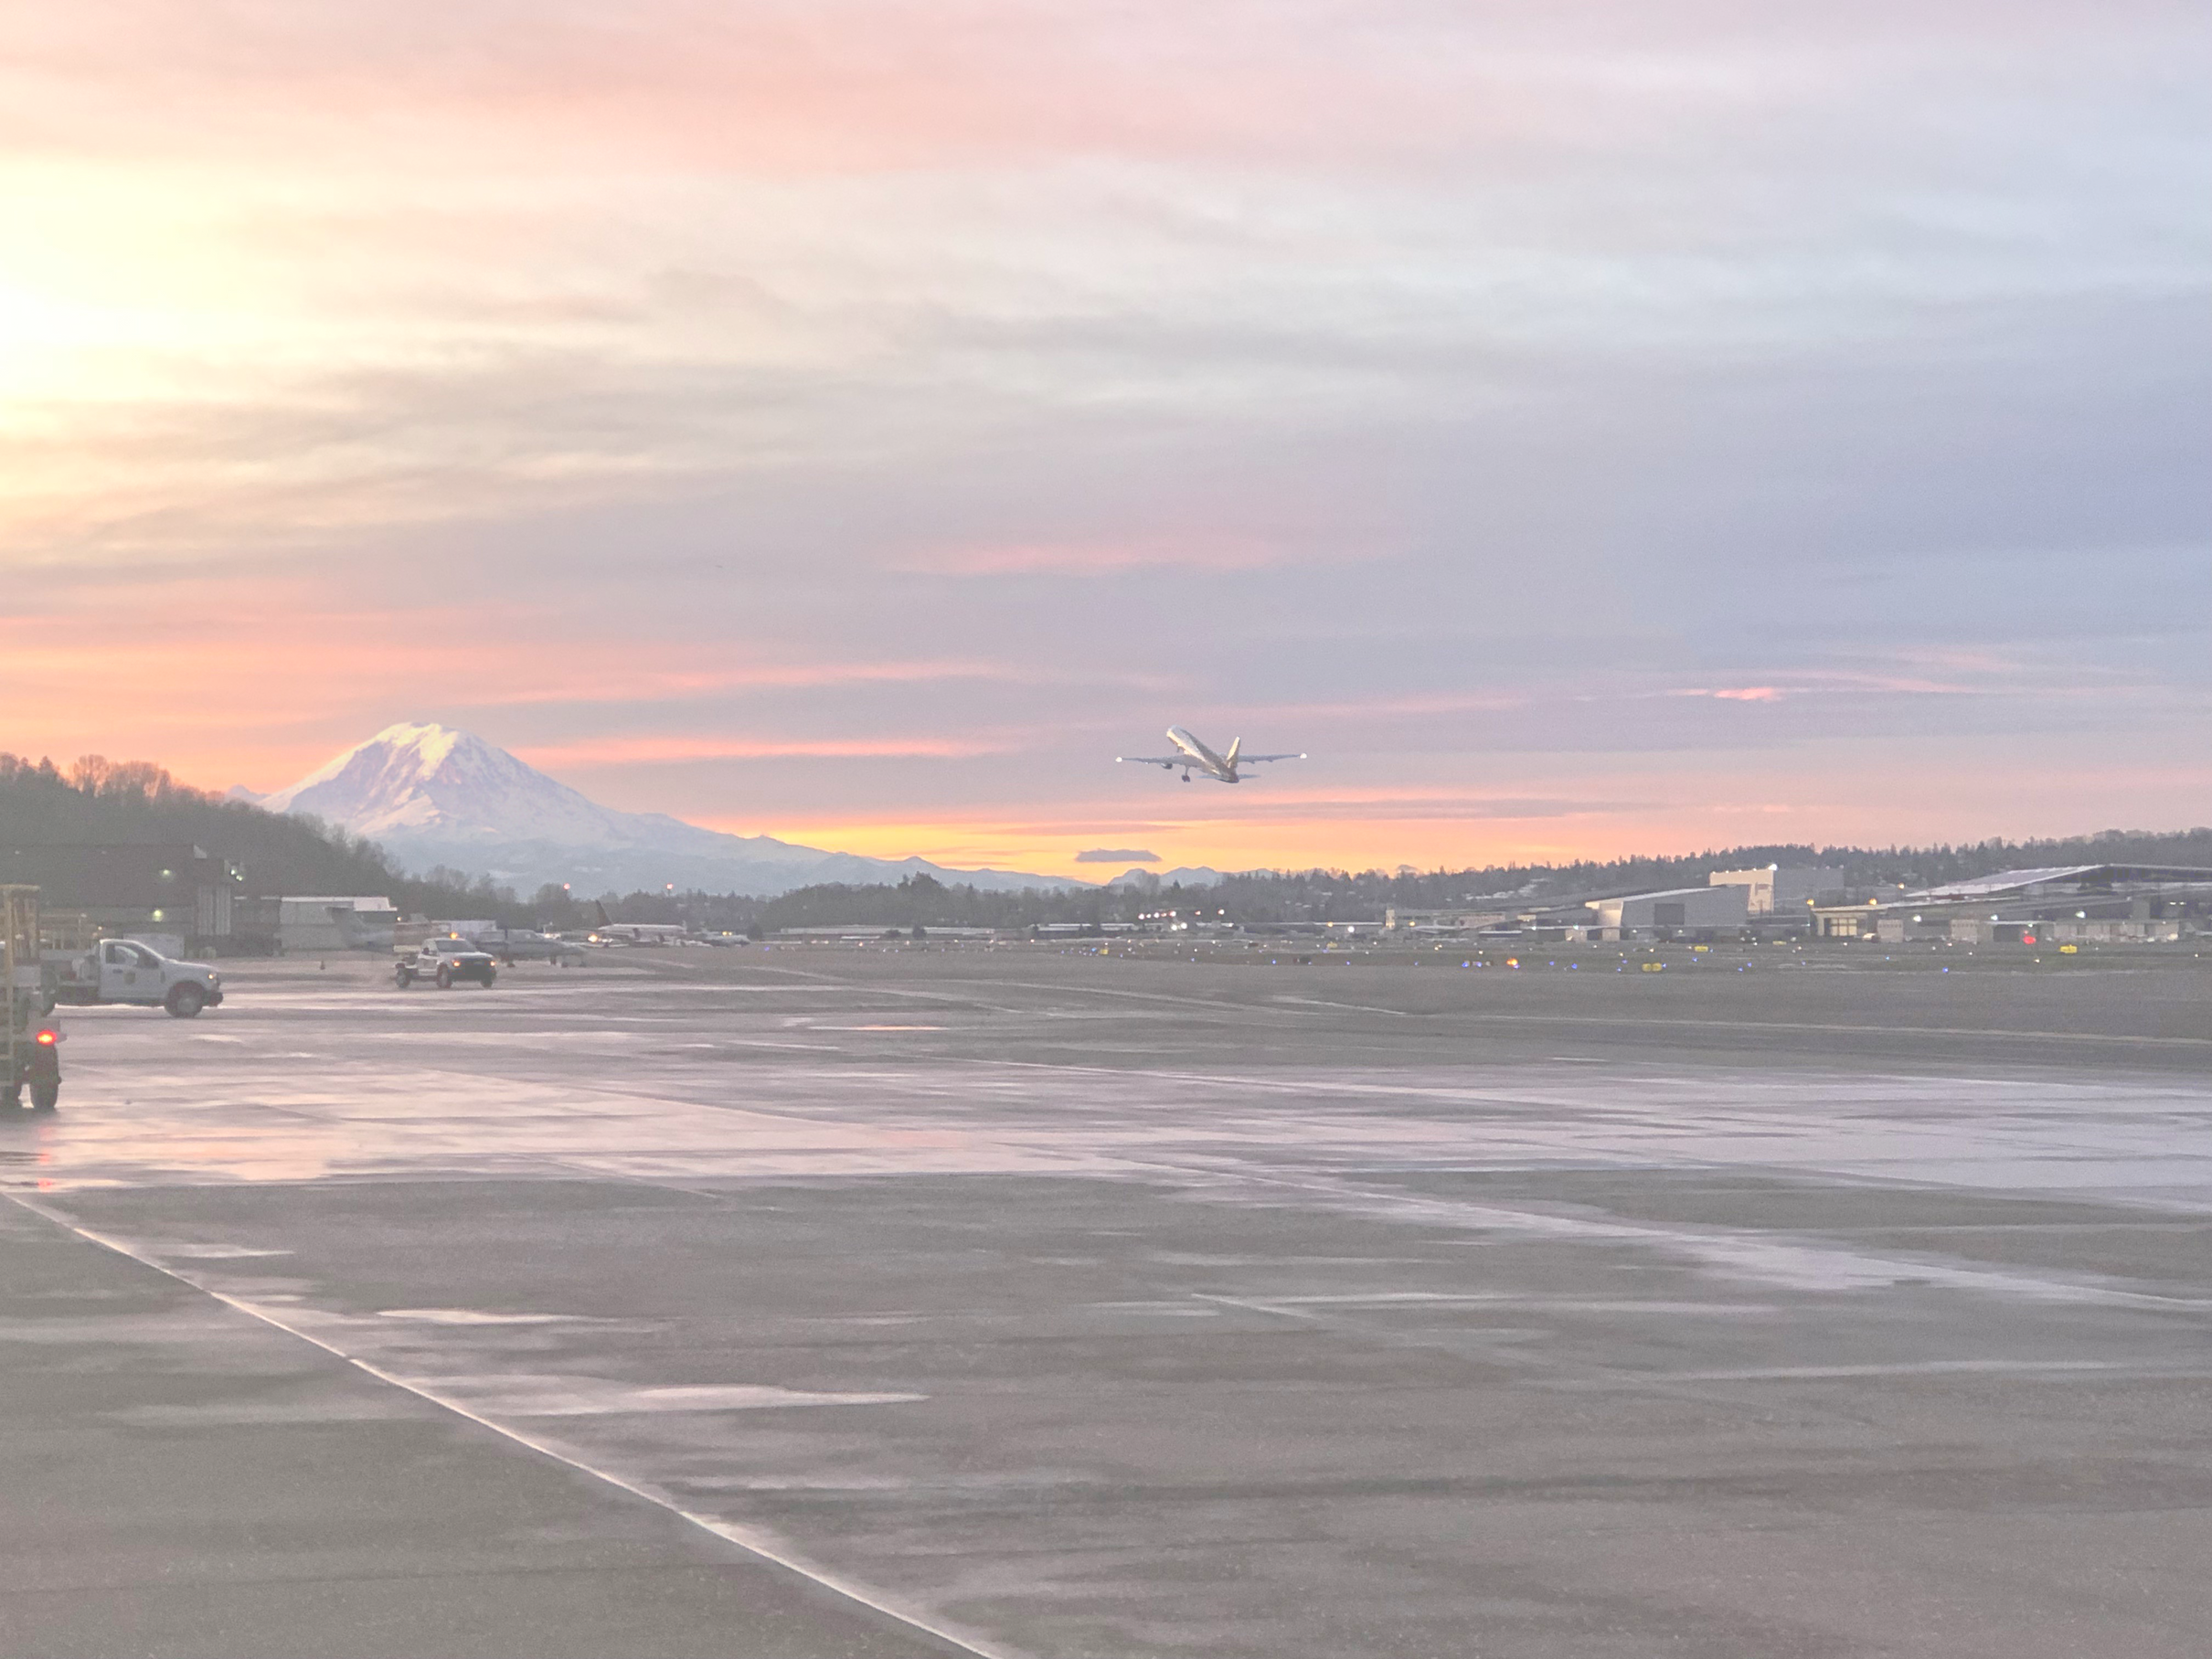

John Parrott, Airport Director Lisa Pearson, Facilities Management Division Director

Slide 2
2024 Occupied Square Footage
Property Category | 2024 Occupied SF | 2024 Vacant SF
Aeronautical Portfolio Total | 1,601,865 | 160,300
Fixed Based Operator (FBO) Portfolio Total | 1,741,015 | 0
General Aviation (GA) Aeronautical Portfolio Total | 107 GA Tie-Downs 74 GA Hangers | 0
Non-aeronautical Portfolio Total | 34,990 | 348,234
Other Portfolio Total | 5,189,077 | 0
KCIA Portfolio Total | 8,566,947 | 508,534
Occupancy Rate | 94.4% | 5.6%
Notes:
First slide: hide total units; hide the occupied units;

Slide 3
Current Occupied Square Footage
Property Category | Current Occupied SF | Current Vacant SF
Aeronautical Portfolio Total | 1,384,943 | 377,222
FBO Portfolio Total | 1,741,015 | 0
GA Aeronautical Portfolio Total | 107 GA Tie-Downs 74 GA Hangers | 0
Non-aeronautical Portfolio Total | 67,803 | 315,421
Other Portfolio Total | 5,189,077 | 0
KCIA Portfolio Total | 8,382,838 | 692,643
Occupancy Rate | 92.4% | 7.6%
Notes:
Change colors (too bright)

Slide 6
Marketing for KCIA
Media Types Utilized:
  Seattle Times
  Puget Sound Business Journal
  Gov Delivery
  KCIA website
Results:
  On average, 3-6 expressions of interest
  Recent example: 1 Fixed Base Operator (FBO), 2 Third Party Developers and a Flight School

Slide 7
General Aviation Promotion
Awaiting the Proviso Study
Completed rehabilitation of the Short GA Runway in 2025
36 million dollars of KCIA capital expenses
4.4 million dollars from the FAA

Slide 8
Sky Harbour
Solicitation resulted in two applicants
Building Assessment
Due to capital cost and layout constraints could not reach an agreement
King County plans to issue a Request for Information (RFI) for long-term tenancy

Slide 9
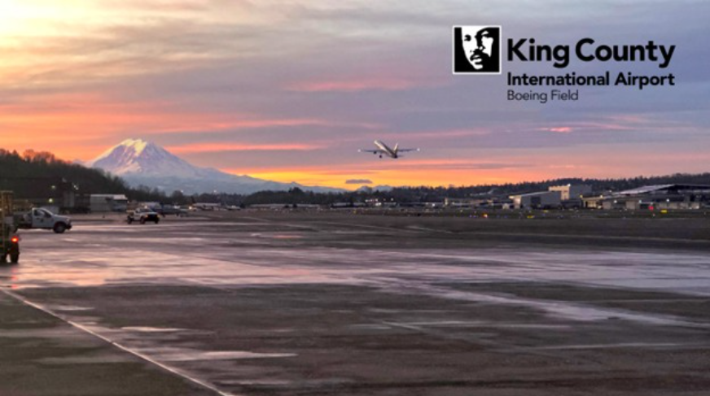
Questions?

